Slide 1
Surface Wind Speed Simulations in the NARCCAP Models
Rachel Hatteberg and Eugene S. Takle
Iowa State University
NARCCAP Fourth Users Meeting
Boulder,CO
10-11 April 2012
Presented by Bill Gutowski

Slide 2
Outline
Spectra of winds from NARCCAP models for NCEP-driven runs
Representation of extreme high winds in NARCCAP models
Impact of climate change on wind spectra in NARCCAP models
Representation of extreme low winds in NARCCAP models
Peculiar behavior of MM5 at low wind speeds

Slide 3
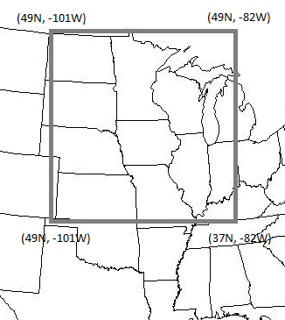
Background on Study
May – September (original objective was to look at derechoes)
3 – hourly instantaneous wind speeds
10 m u, v wind components
Calculated U = (u^2 + v^2)^1/2
Domain = 37°N to 49°N, -82°W to -101°W
Domain allowed for minimal orographic affects
Masked out Great Lakes

Slide 4
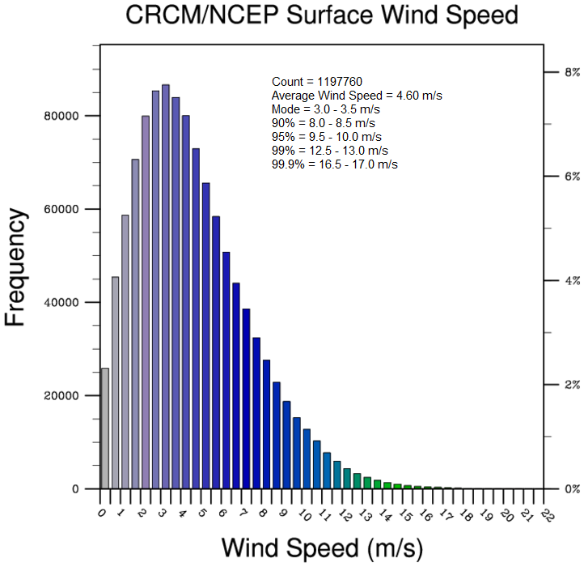
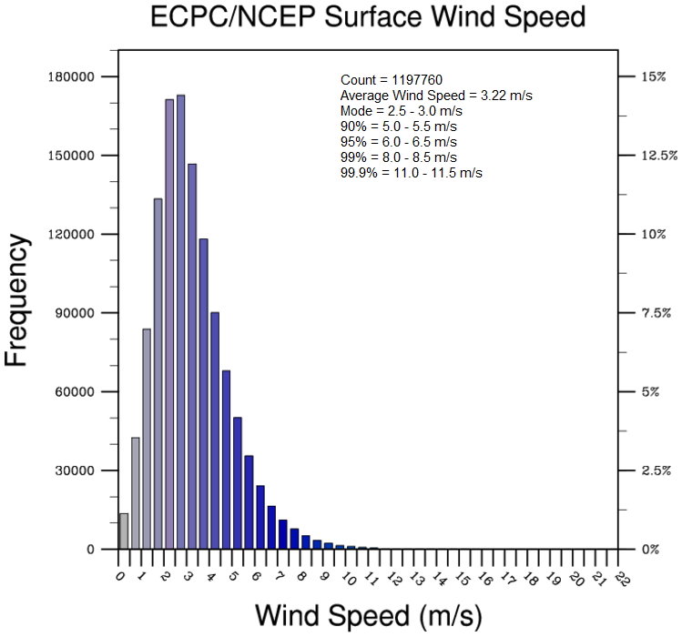
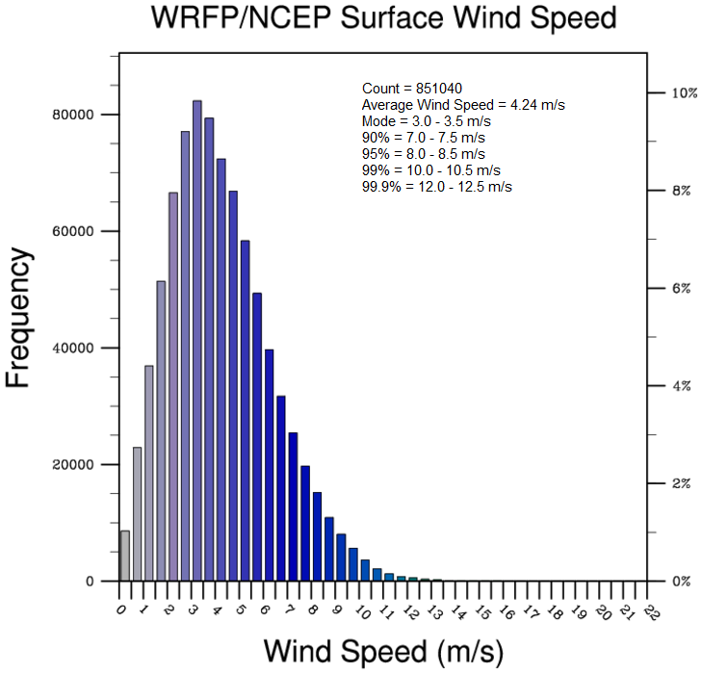
What Does a Regional Climate Model with 52-km Grid Spacing Consider to be an “Extreme” High Wind?

Slide 5

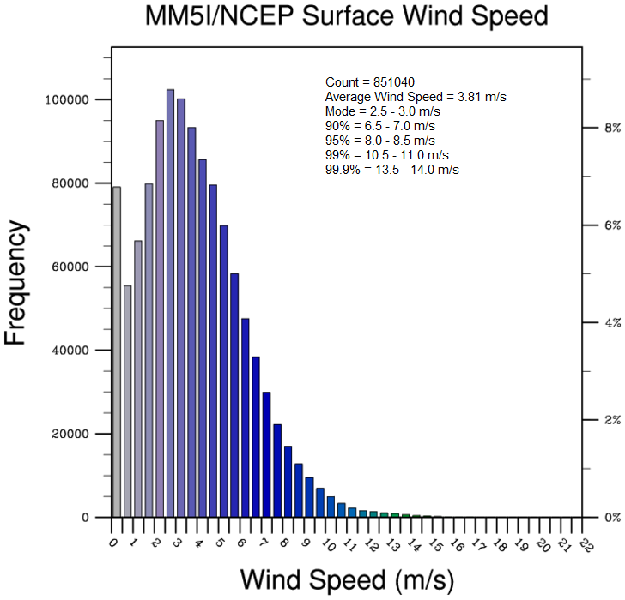
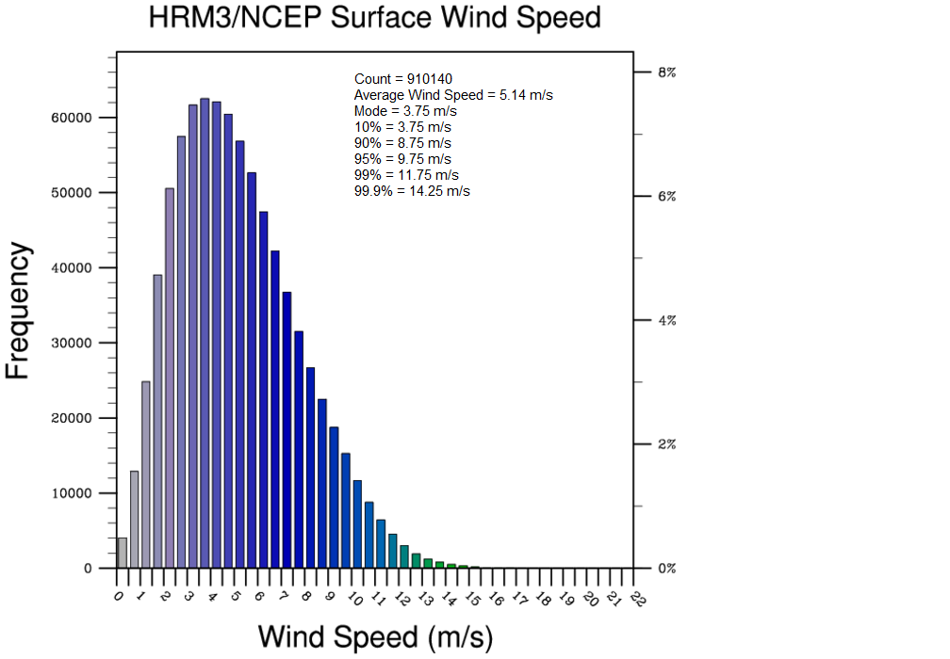
What Does a Regional Climate Model with 52-km Grid Spacing Consider to be an “Extreme” High Wind?
800,000 - 1,100,000 modeled wind speeds in each distribution

Slide 6
What Does a Regional Climate Model with 52-km Grid Spacing Consider to be an “Extreme” High Wind?
Note. (More on this later)
800,000 - 1,100,000 modeled wind speeds in each distribution

Slide 7
What Does a Regional Climate Model with 52-km Grid Spacing Consider to be an “Extreme” High Wind?
How extreme? 95%? 99?

Slide 8
What Does a Regional Climate Model with 52-km Grid Spacing Consider to be an “Extreme” High Wind?
Message: RCMs differ in their representation of surface winds. This has implications for applications to studies of evapotranspiration, air pollution, extreme wind characteristics

Slide 9
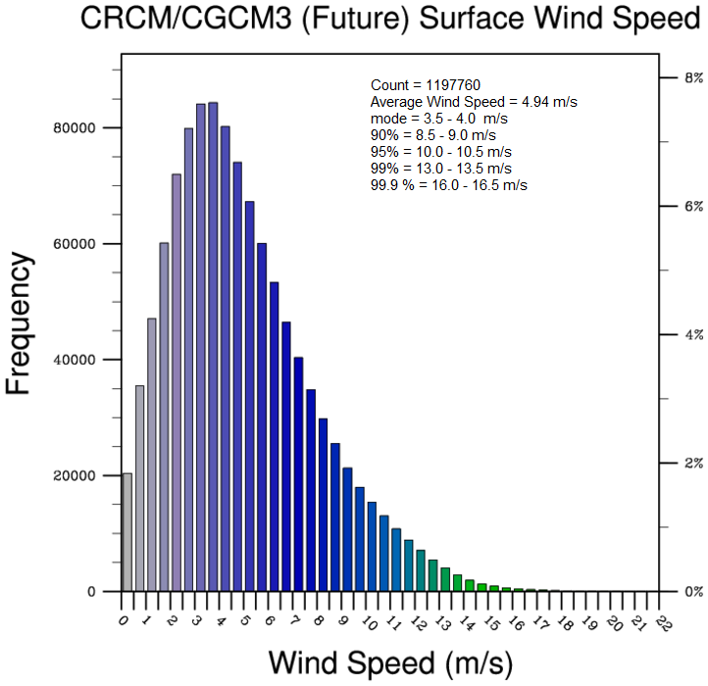
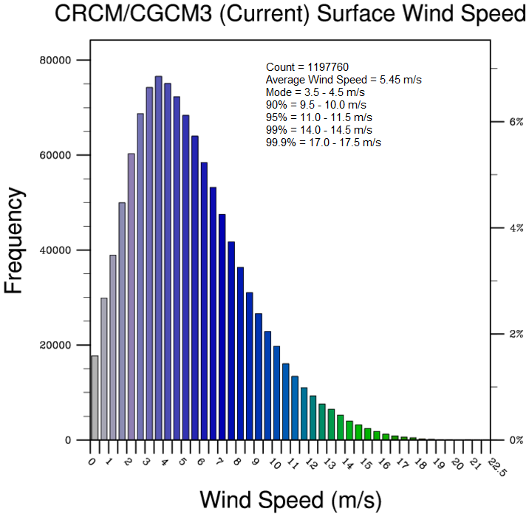
Effect of Climate Change on Surface Winds
Result:
CRCM/CGCM3:
Overall decrease in
surface winds

Slide 10
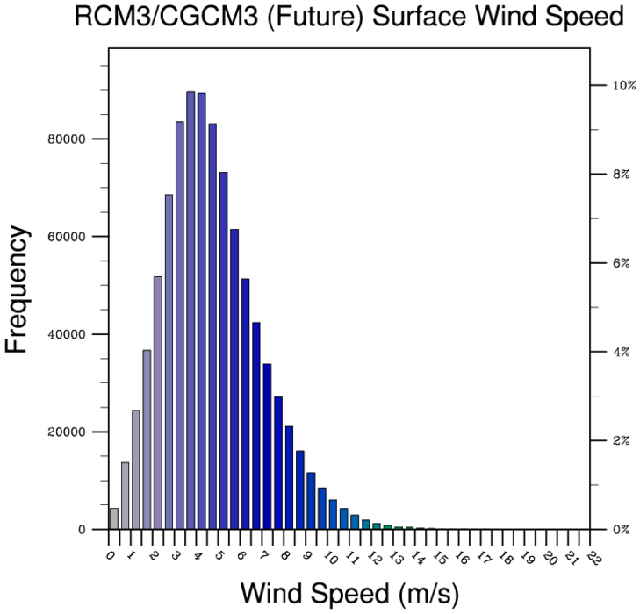
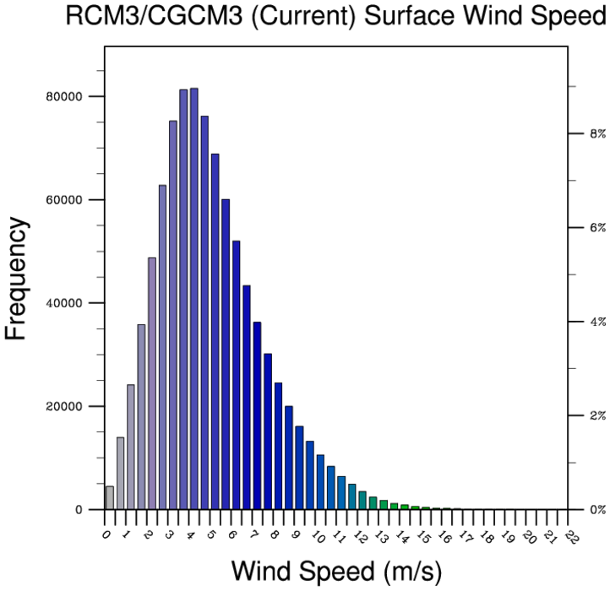
Effect of Climate Change on Surface Winds
Result:
RCM3/CGCM3:
Overall decrease in
surface winds

Slide 11
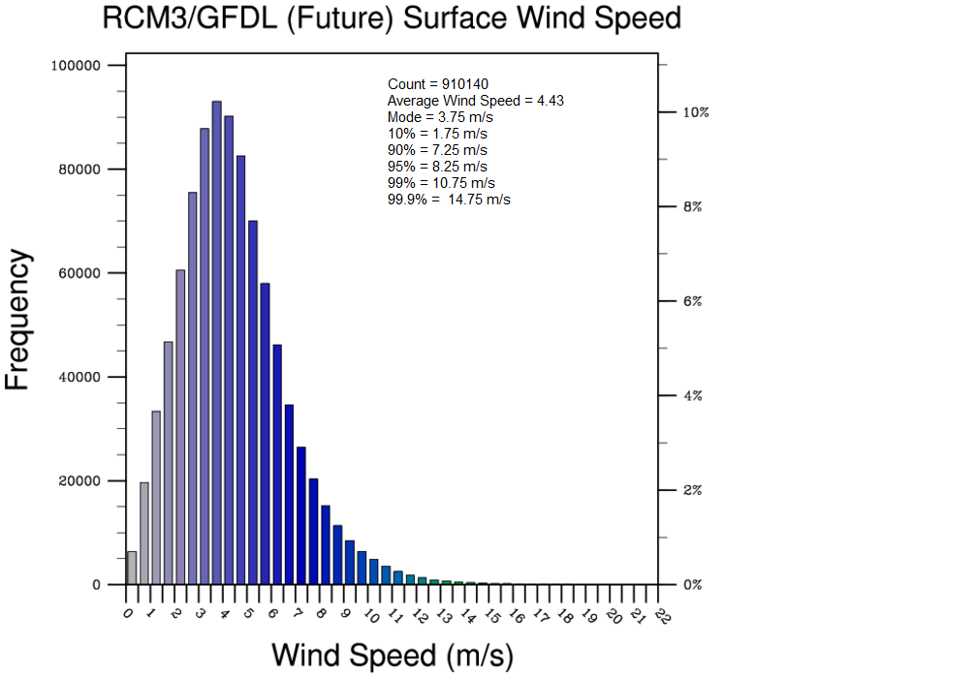

Effect of Climate Change on Surface Winds
Result:
RCM3/GFDL:
Yo, what’s this?!
Change at night but
not day? More/fewer
traveling synoptic systems?
Must be introduced by GCM
(see previous slide)

Slide 12
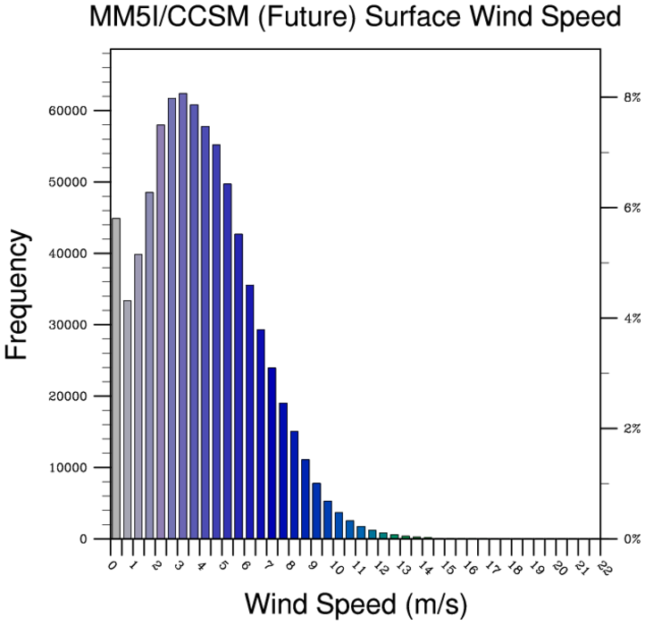
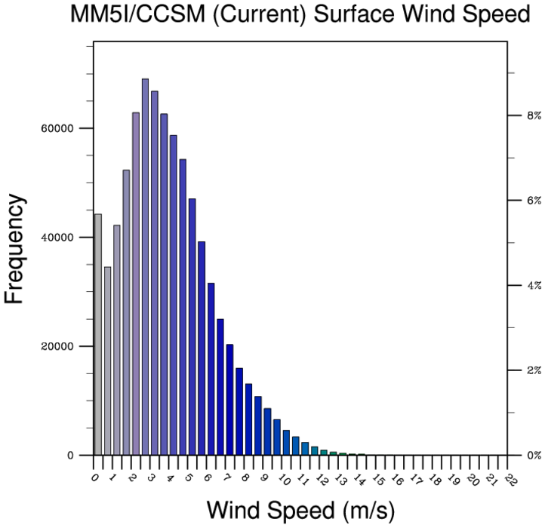
Effect of Climate Change on Surface Winds
Result:
MM5I/CCSM:
Hmm…
Not only GFDL creates
this peculiar behavior

Slide 13
Summary:
Influence of GCM on the RCM?

Slide 14
Summary of Influence of Climate Change on RCM/GCM Percentiles
RCM/GCM | Scenario | Mode | 10% | 50% | 90% | 95% | 99% | 99.90%
 |  | m/s | m/s | m/s | m/s | m/s | m/s | m/s
CRCM/CGCM3 | Current | 3.75 | 1.75 | 5.45 | 9.75 | 11.25 | 14.25 | 17.25
 | Future | 3.75 | 1.75 | 4.94 | 8.75 | 10.25 | 13.25 | 16.25
RCM3/CGCM3 | Current | 3.75 | 2.25 | 5.06 | 8.75 | 9.75 | 12.25 | 16.25
 | Future | 3.75 | 2.25 | 4.73 | 7.75 | 8.75 | 10.75 | 13.75
RCM3/GFDL | Current | 3.75 | 1.75 | 4.46 | 7.25 | 8.25 | 11.25 | 14.25
 | Future | 3.75 | 1.75 | 4.43 | 7.25 | 8.25 | 10.75 | 14.75
MM5I/CCSM | Current | 2.75 | 1.25 | 3.95 | 7.25 | 8.25 | 10.75 | 13.25
 | Future | 3.25 | 1.25 | 3.93 | 7.25 | 8.25 | 10.25 | 12.75
Result: Large decrease in extreme high end; less change to mode or low end
Notes:
Red highlighted cells show the highest values compared to the other models
Yellow cells show lowest values

Slide 15
What about the peculiar behavior of low wind speeds in MM5?
MM5
WRF

Slide 16
What about the peculiar behavior of low wind speeds in MM5?
Calm happens! – especially in flat terrain mid-continent areas.
If model winds are extrapolated from lowest model level to zero at the surface, the wind at 10 m should almost never be zero.
BUT, MM5 spectra looks more realistic than others compared to observed winds in Midwest – for some wrong reason?

Slide 17
What about the peculiar behavior of low wind speeds in MM5?
Choice of model could have high impact for studying air pollution stagnation events, heat waves, and agricultural applications (e.g., irrigation, evapotranspiration, pollen spread).
This MM5 behavior is present in future scenario simulations and in simulated values over the entire year (not just May-August)

Slide 18
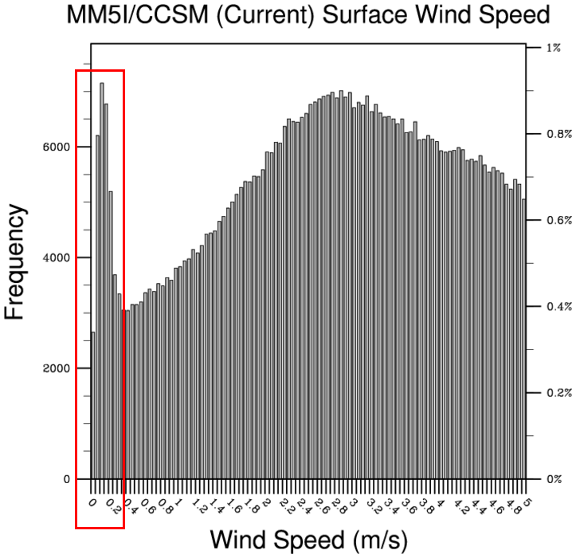
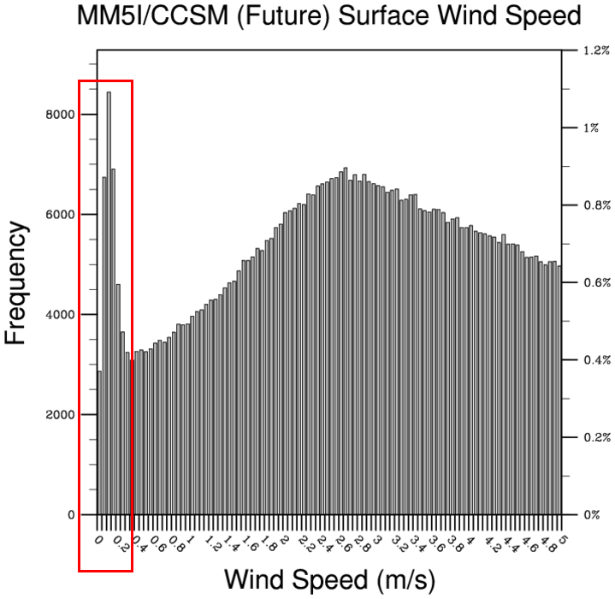
MM5I/CCSM Current and Future Scenarios
Low-End Wind Speeds

Slide 19
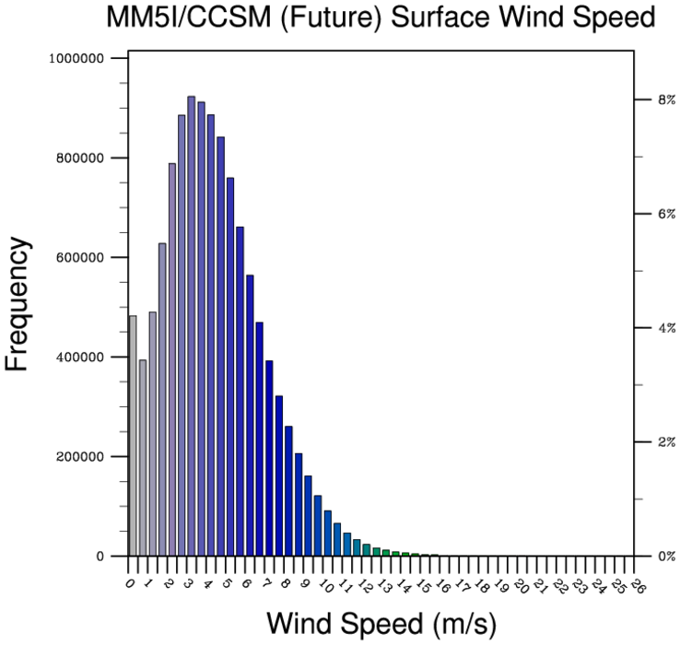
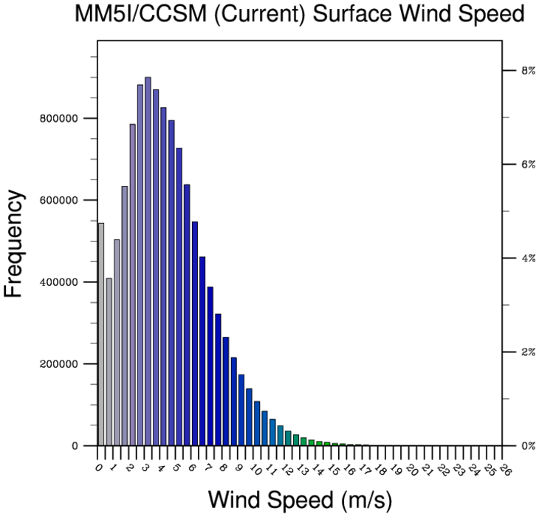
MM5I/CCSM
(Full Year)

Slide 20
Summary
For the Upper Midwest domain and time period studied, NARCCAP models show some differences in wind speed spectra, particularly at extreme high values
Wind speeds decline with climate change, although peculiar behavior is shown for some RCM/GCM combinations
MM5 has a unique representation of extreme low wind speeds for reasons yet unknown
Sooo, for those of you who may have thought RCMs were orderly and systematic….

Slide 21

Think Again!!

Slide 22
THANKS, BILL !!

