Slide 1

Interannual Variability of Surface Temperature and Precipitation using Regional Modeling Over Western North America
John Mejia (John.Mejia@dri.edu)
and
K.C. King, Darko Koracin
Desert Research Institute, Reno, NV

Slide 2
CMIP3 and CMIP5: Regional Context
How do CMIP3 and CMIP5 participant GCMs compare to reproduce present (“historical”) climate?
Are they capable of adequately simulating main climatic features over Western North America?
How does Regional Climate Models compared when driven using a “perfect GCM” or reanalysis data?

Slide 3
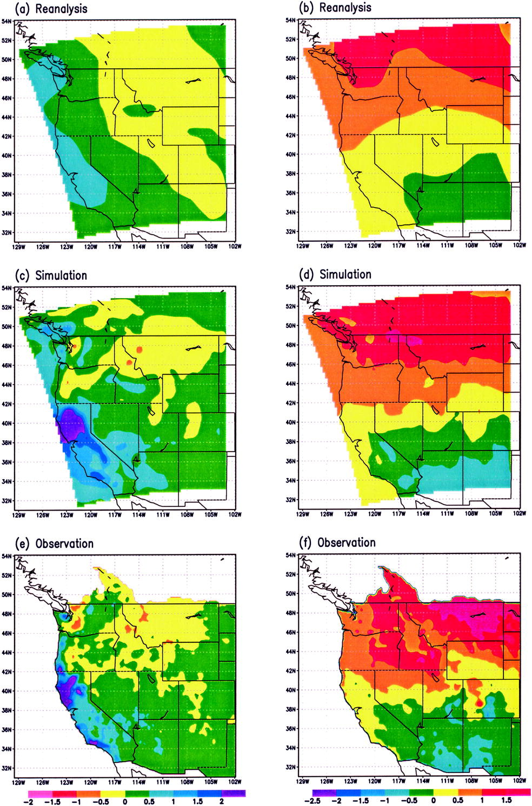
The role of orographic features in ENSO variability
”….when realistic large-scale circulations are used to drive RCMs, ENSO anomalies can be correctly simulated at the regional scales..”
Leung et al. 2003 (J. of Climate)
Anomalies of precipitation and surface temperature during El Niño years in the period1981-2000. Simulations based on MM5.

Slide 4
EPAC vs. CPAC
Recent studies have documented structural differences in dynamics, onset, variability, and teleconnection patterns associated with these different ENSO “modes” (Kao and Yu 2009; Kug and Jin 2009; Mo 2010).
Regardless such differences:
  Is there a significant difference in precipitation patterns over the U.S. when considering either ENSO index?
  What is the performance of different RCMs to capture different ENSO modes.

Slide 5
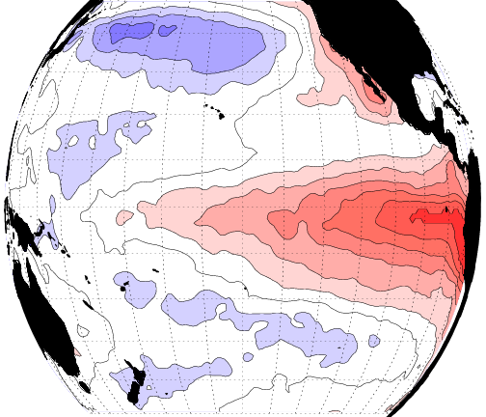
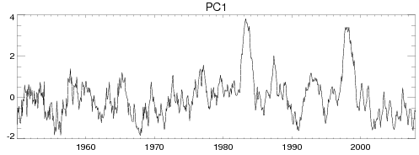
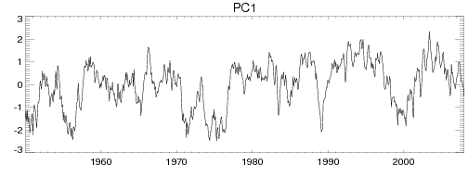
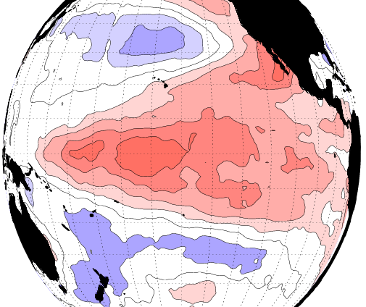
Defining EPAC and CPAC
Very Warm ENSO events…82/83, 97/98
EPAC
EPAC (28%)
CPAC
(33%)
CPAC
SSTs (Met Office - HadISST 1.1) leading empirical orthogonal patterns (Left) and corresponding principal components (Bottom) for:
Eastern Pacific (EPAC; “Traditional” El Nino; Cold Tongue)
Central Pacific (CPAC; “non-traditional”, “date line”, or “Modoki” El Nino; Warm Pool).
ENSO indices (Following Kao and Yu (2009)- J. of Climate).

Slide 6
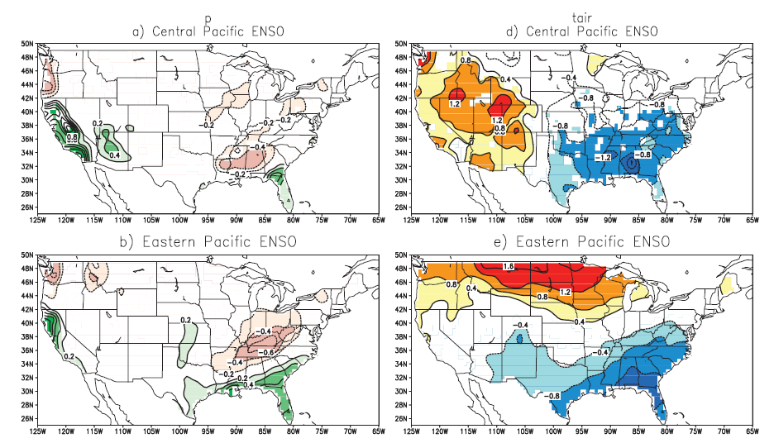
Sensitivity around ENSO modes
Mo (2010)

Slide 7
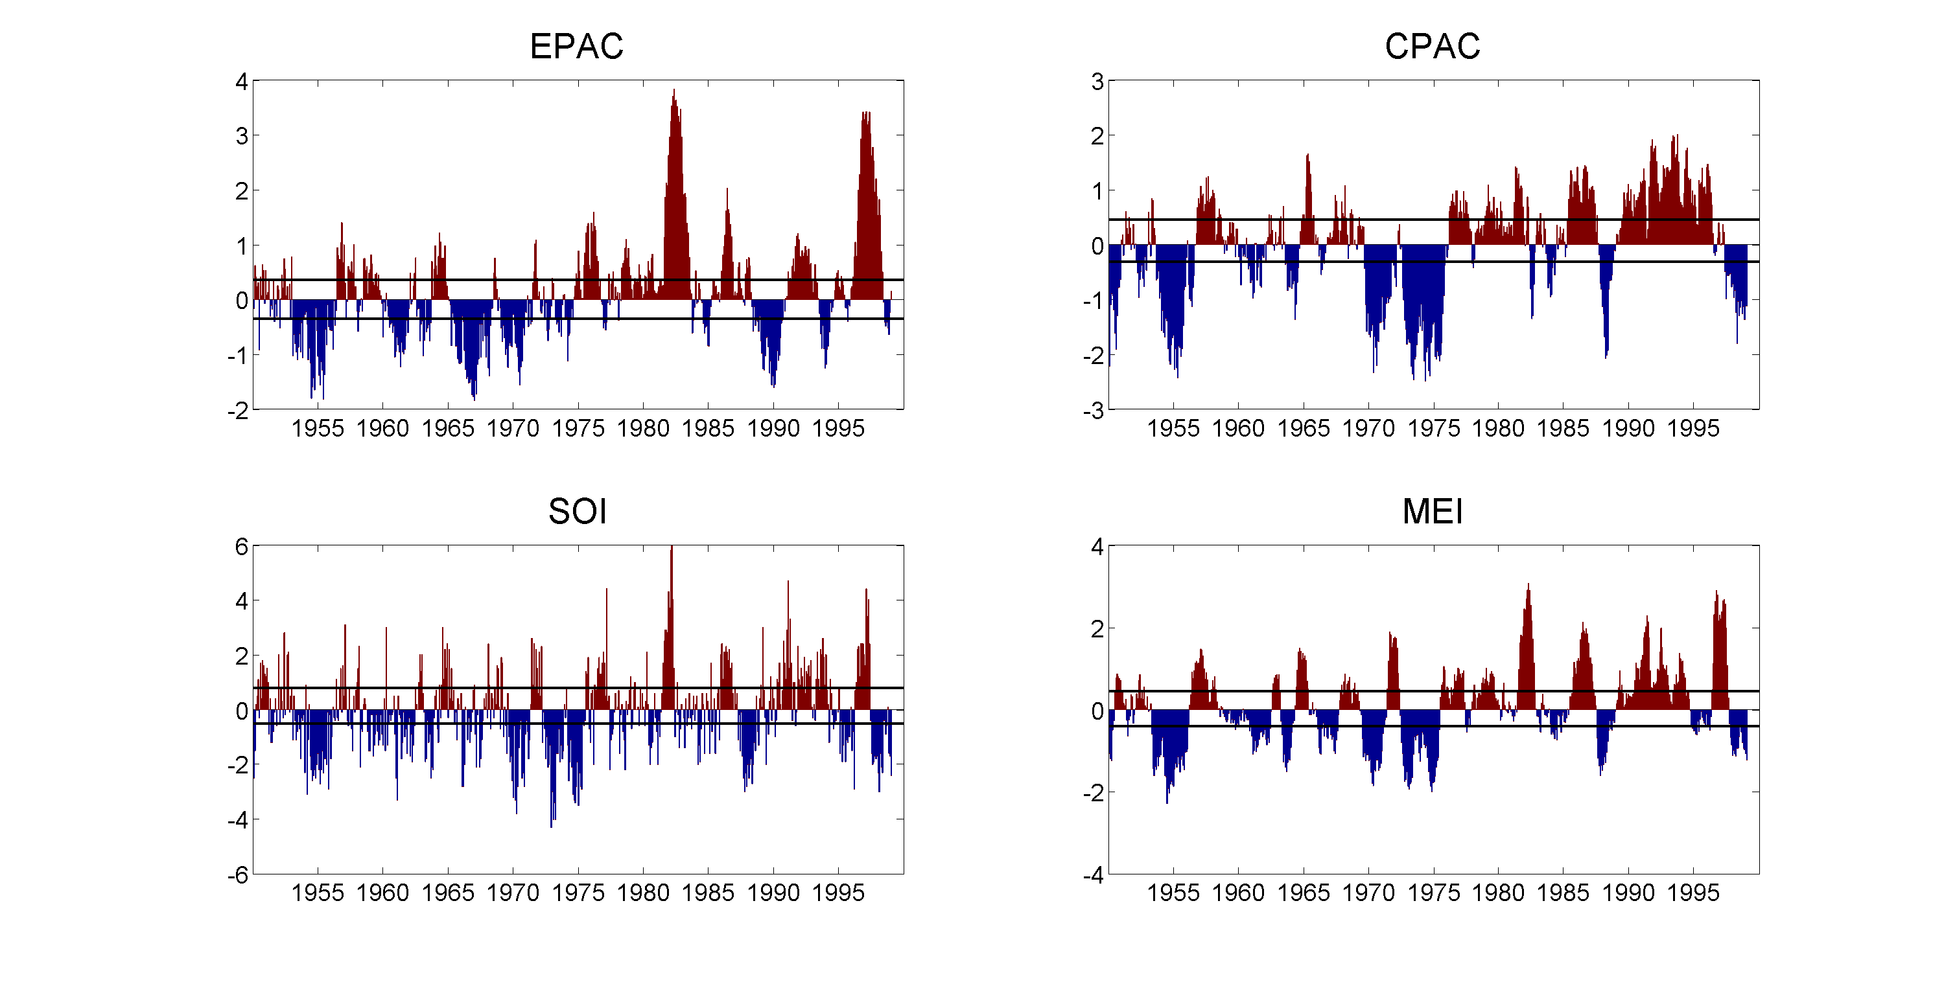
82/83
66%
33%
-1 x
82/83
82/83
Notes:
I suggested to draw 33th percentile lines in each plot…

Slide 8
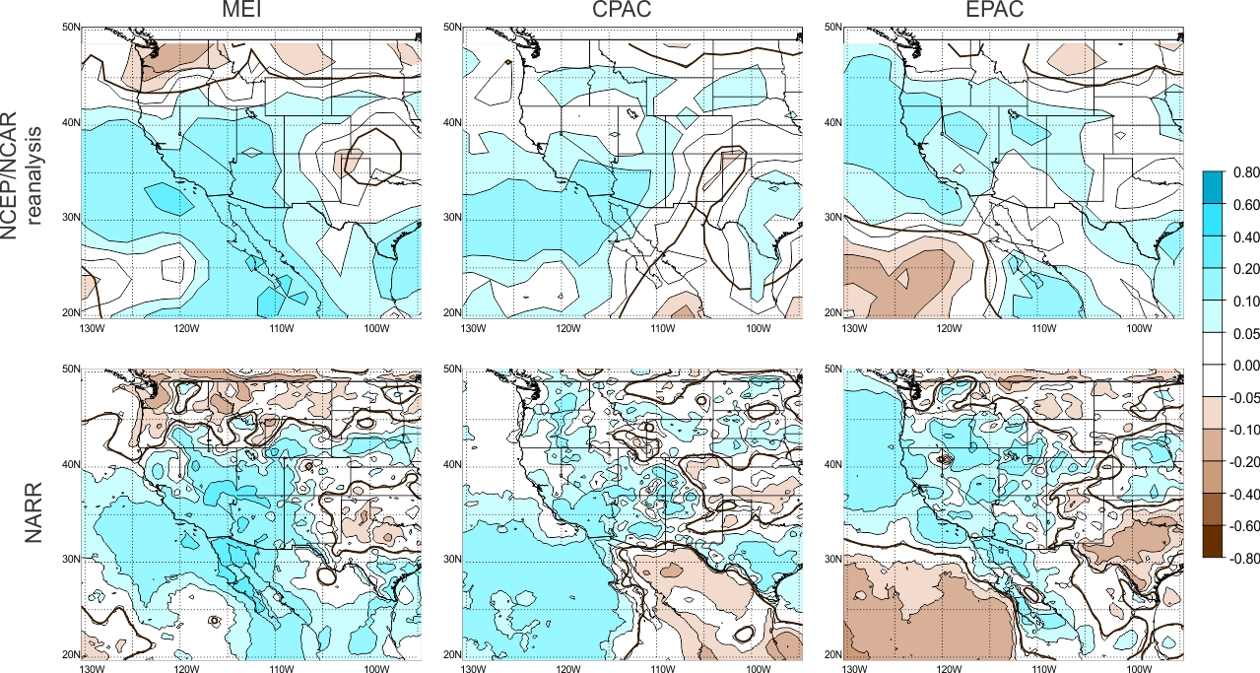
Sensitivity around ENSO modes, cont’d

Slide 9
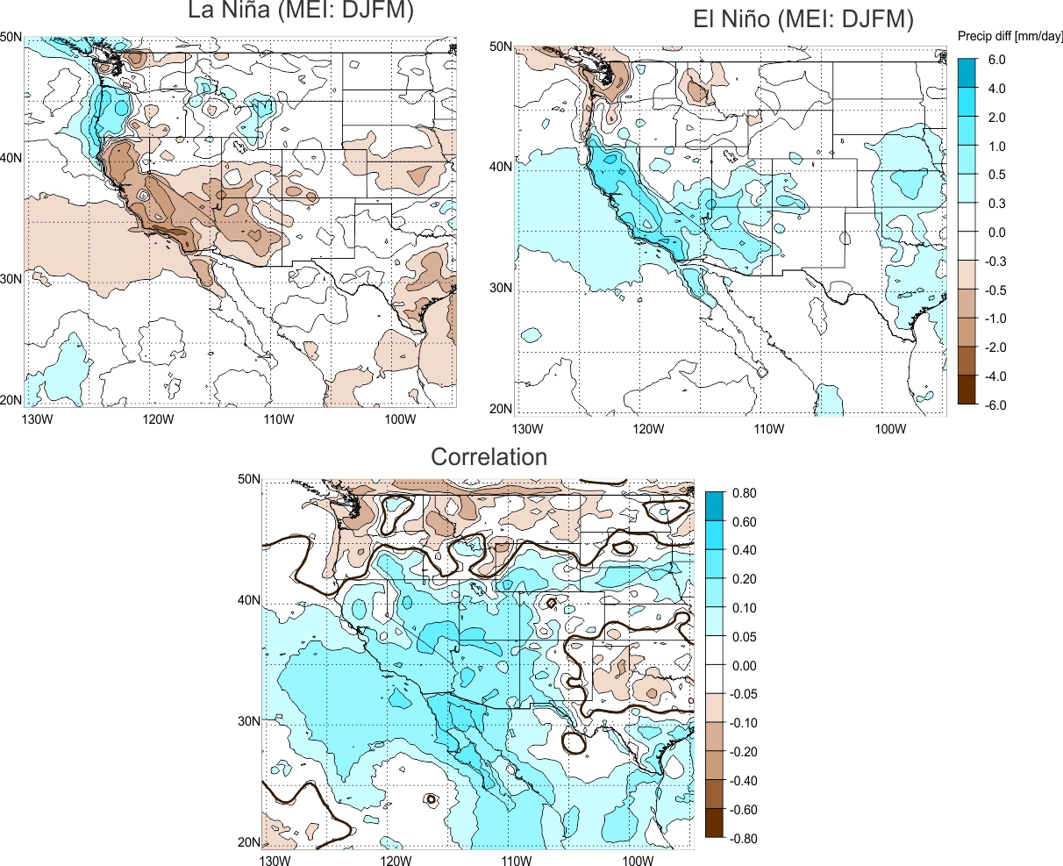
NARR: MEI-ENSO composites and correlations

Slide 10
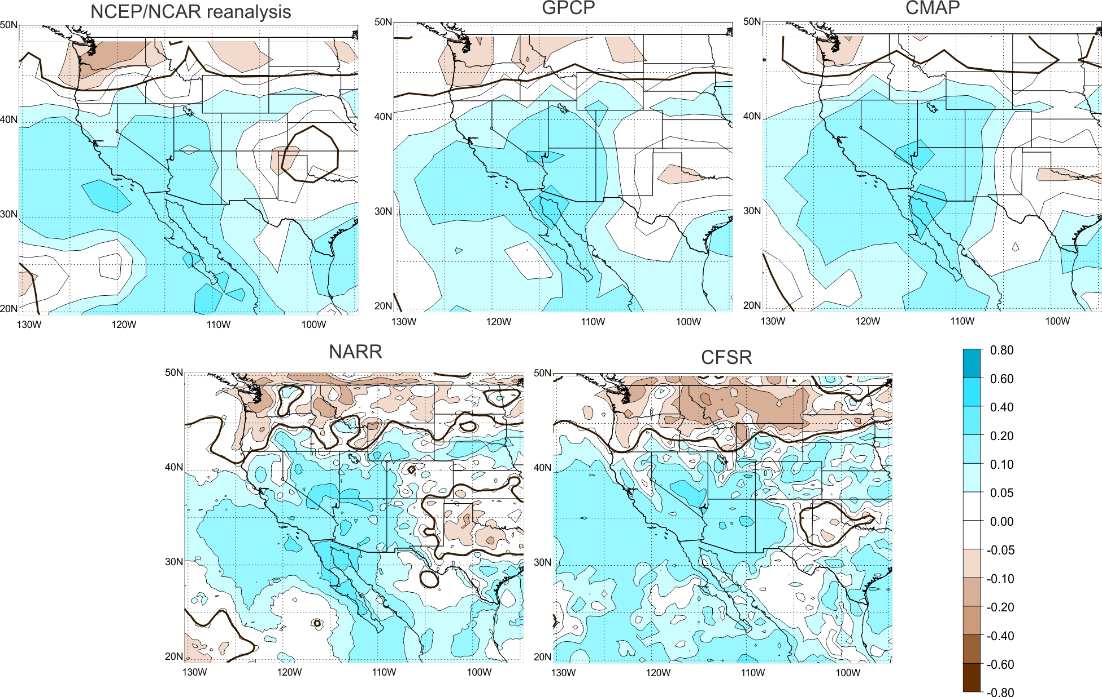
The observations: MEI correlations (Lag = -4 months)

Slide 11
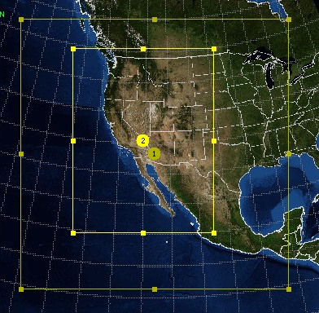
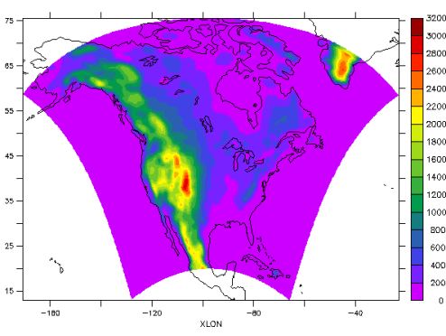
DRI-RCM: finer grids and different domains.
DRI-RCM (WRFV3.2-based)
36-km
12-km
Available in our NEVADA CLIMATE CHANGE PORTAL
(sensor.nevada.edu)
NARCCAP - 50km
GCM
GCM
GCM
In this presentation we only evaluate and analyze RCM outputs forced with NCEP/NCAR reanalysis for 1980-2000.

Slide 12
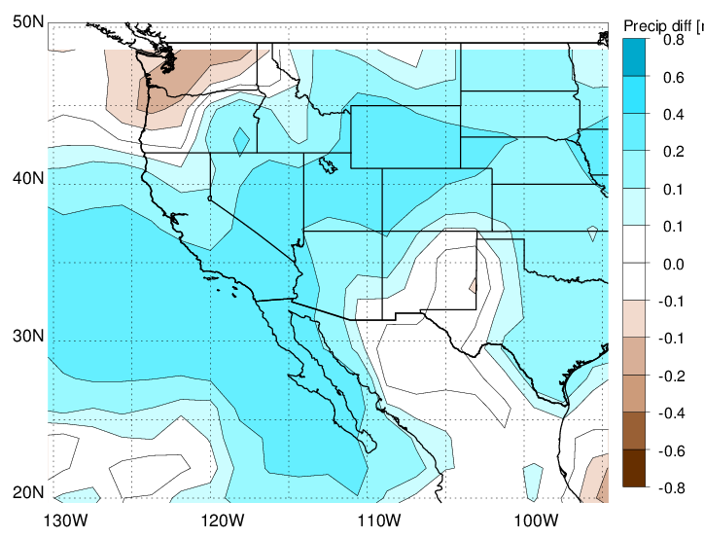
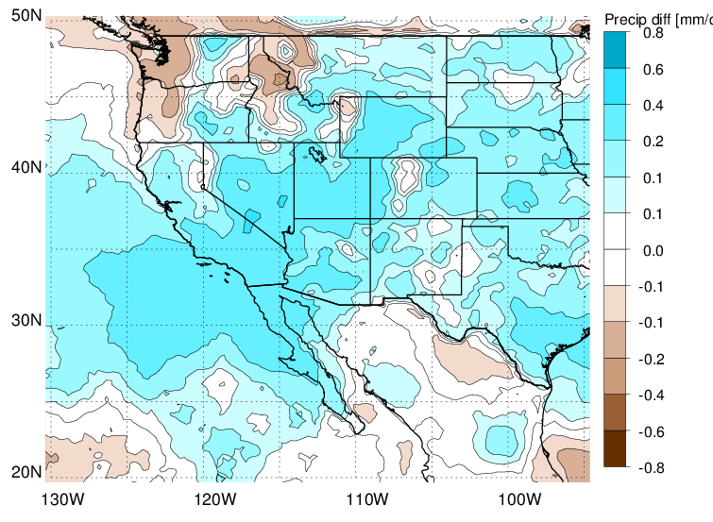
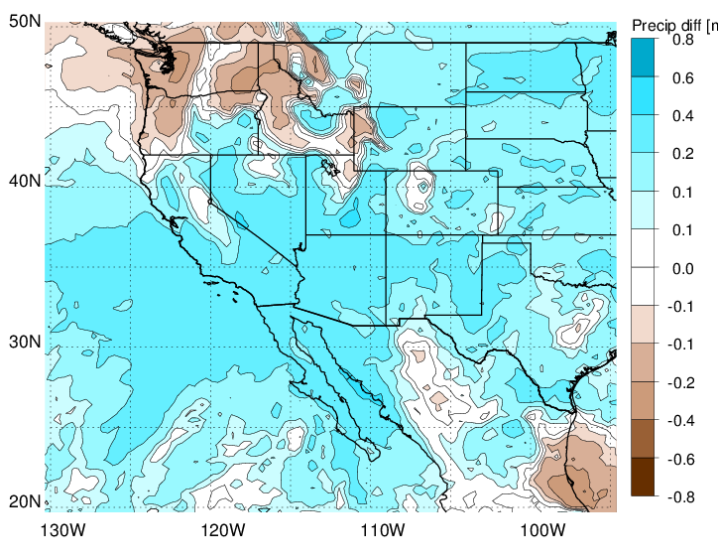
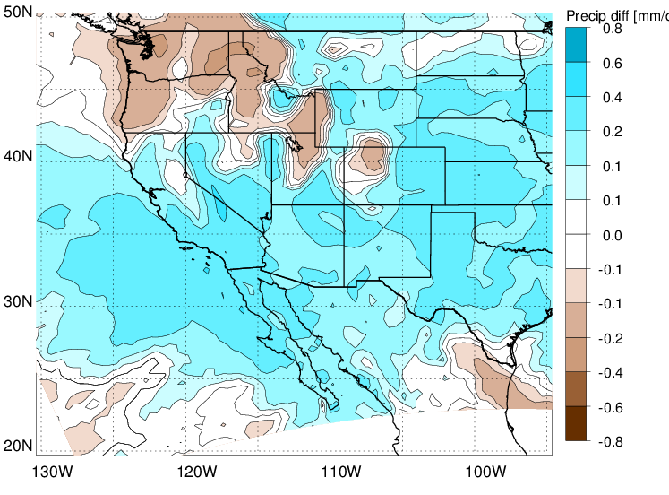
NCEP/NCAR ~250km
NARR-32km
DRI-WRF-36km
NARCCAP-WRFG-50km

Slide 13
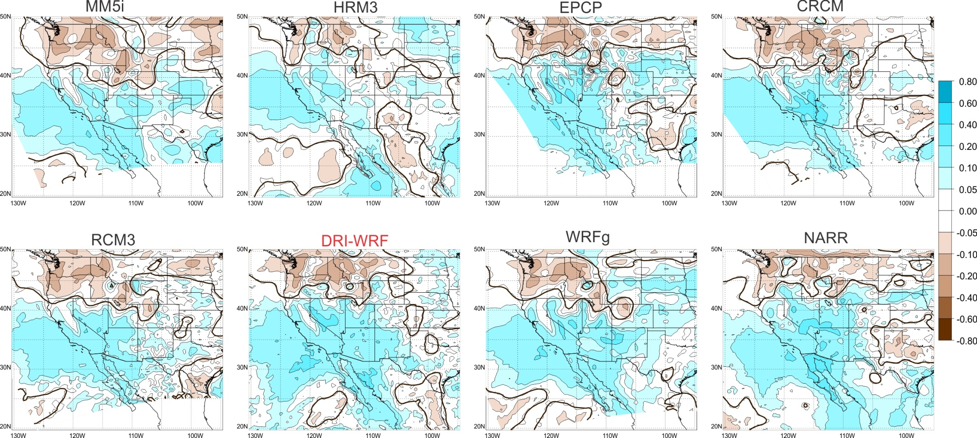
ENSO Modes: MEI (Lag -4 months)

Slide 14
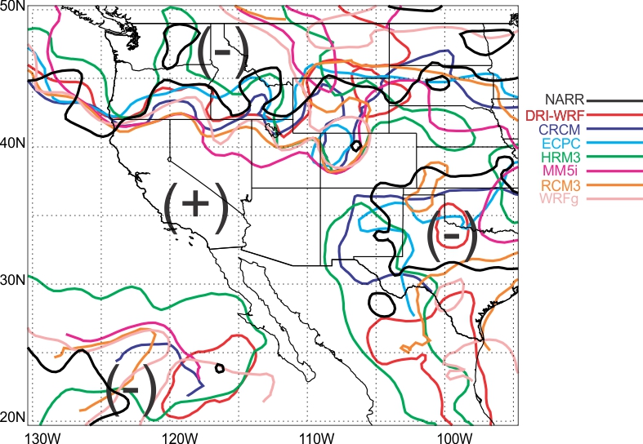
ENSO Modes: MEI (Lag -4 months)

Slide 15
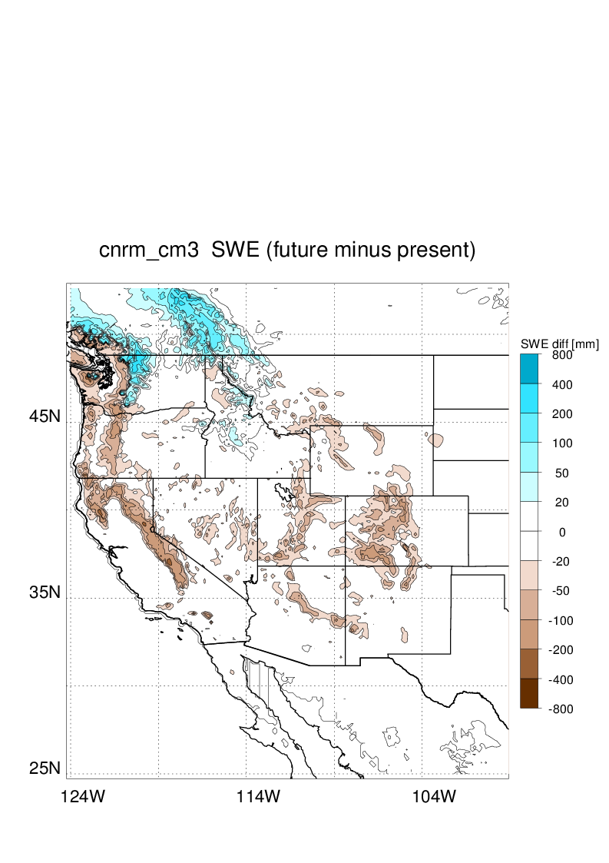
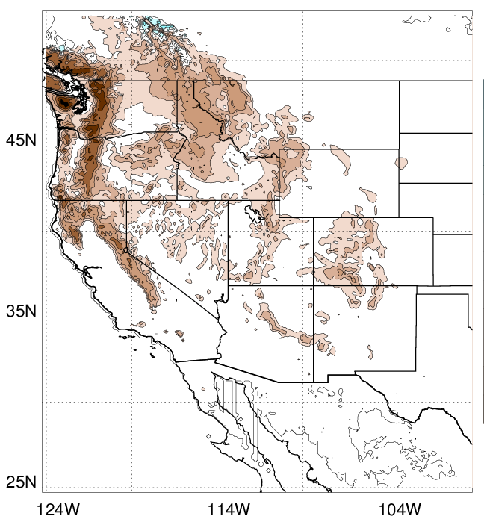
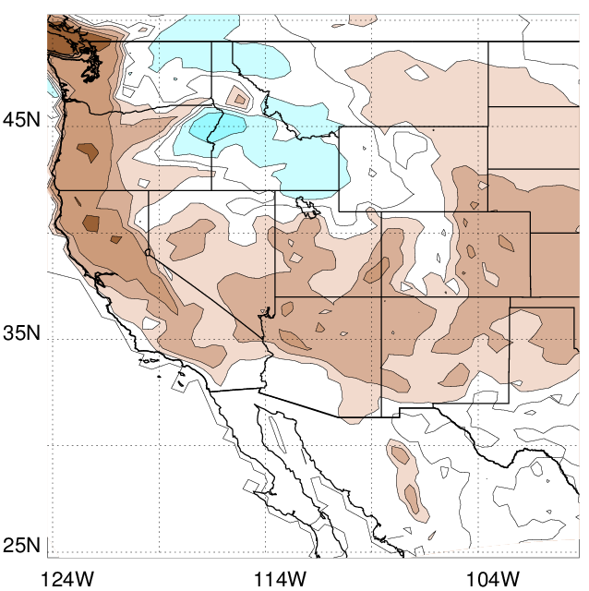
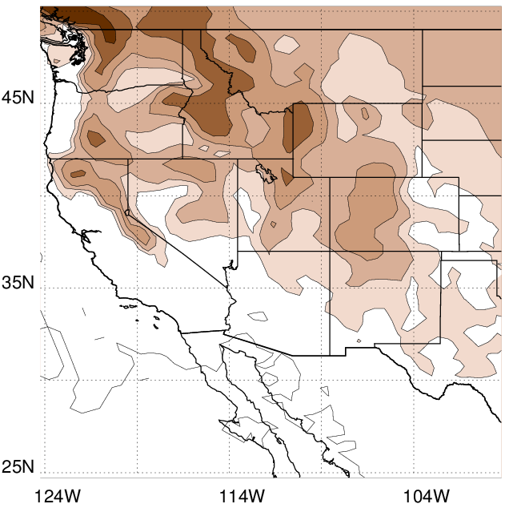
Regional Climate Modeling at DRI
Modeling development and customize for the Western U.S.
Downscaling Global Climate Model output based on IPCC -CMIP3 (Done!) and CMIP5 (near future) climate change projections.
Customized-suitable input for impact studies, including: hydrological catchment scale, ecosystems, agriculture, water & energy, air quality, urban environments.
Snow Water Equivalent [mm]
(2040-2070) minus (1980-2000)
Statistical: BCCA
CNRM_CM3 12km
Statistical: BCCA
GFDL_CM2 12km
Snow Water Equivalent - f(Tmean, Precip) [Dai, 2008 , GRL] - projections for different CMIP3 GCM output and downscaled using statistical (top) and dynamical (bottom) downscaling approaches.
Dynamical: NARCCAP
CCSM3 + CRMC 50km
Dynamical: DRI
CCSM3 + WRF-36km
Notes:
The DRI Climate Modeling Group is currently working on the climate modeling component efforts as part of the Nevada NSF-EPSCoR Climate Change project. We are focused on the implementation and development of “statistical” and “dynamical” based downscaling techniques using Global Clime Modeling products into space scales relevant for regional and local impact studies.
The synthesis and interpretation of these results will increase scientific understanding to provide information of value to decision-makers. The downscaling techniques consist in creating consistent and quantitative fine scale datasets suitable for climate variability and climate change impact. His special emphasis has been to create the framework and to explore and explain future climate change signals in Nevada and SW U.S intermountain region.
- Efforts to quantify and reduce uncertainty within and across models in order to increase the accuracy of regional and local climate projections.
- Provide fine-resolution climate predictions on regional and subregional scales, including assessment of confidence and variables of most relevance for the other disciplines in this project.
- Making model outputs available for different time horizons and on various temporal scales required for different adaptation measures.
- Provide and disseminate climate information that is more relevant to adaptation and policymakers.
- Promote guidance and information in plain English associated with climate models, downscaling methods and resulting data.
Continue integration of research with education component via students and teaching and training.

Slide 16
Conclusions
MEI/CPAC/EPAC ENSO modes have very different resulting teleconnections over western US.
Our results verify previous finding (Leung’s) on the role of large-scale circulation and topography amplifying ENSO patterns.
RCMs for the most part are capturing different ENSO patterns well.

Slide 17
Future Work
Assess ENSO-like teleconnection patterns from GCM using ocean-based Indices (Mo 2010)
Assess regional sensitivity = ENSO/Regional trends
CMIP5+RCM adapting all the learning experiences using CMIP3.

Slide 18
Acknowledgements
NSF Cooperative Agreement number EPS-0814372.
DOI-B. of Reclamation: WaterSMART Program.
DRI-Department of Atmospheric Sciences
PCMDI archives and distributes the WCRP CMIP3 and CMIP5 multi-model datasets.
NARCCAP data
DRI-Climate Modeling Group members (faculty and students) for their insight and contributions.

