Slide 1



NARCCAP Fourth
Users’ Meeting
Welcome!
Linda O. Mearns
National Center for Atmospheric Research
Boulder, CO
April 10 - 11, 2012

Slide 2
Meeting Goals
Learn about NARCCAP – conceptually and nuts and bolts
Interact with modelers and other scientists on NARCCAP Team– get questions answered – give users’ perspectives
See what other users have been working on -- network with other users with similar research interests - develop projects
Discuss with NARCCAP Team further development ideas for data provision and information on web site for users
Have fun!

Slide 3
Uncertainties about
Future Climate
The future trajectory of emissions of greenhouse gases (based on uncertainties about how the world will develop economically, socially, politically, technologically)
  Explored through the development of scenarios of future world development
How the climate system responds to increasing greenhouse gases.
  Explored through use of climate models
  Spatial scale at which climate models are run is part of this source of uncertainty
Internal natural variability of the climate system

Slide 4
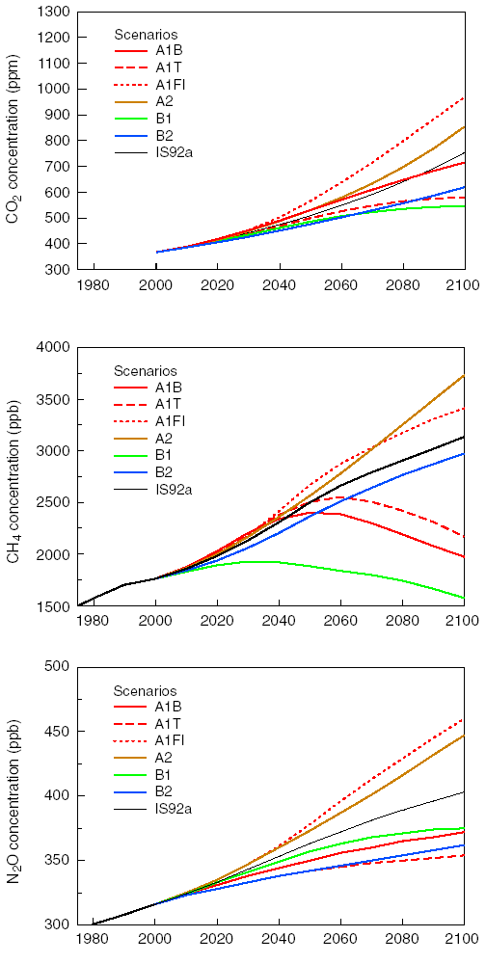
Concentrations of greenhouse gases in the atmosphere

Slide 5
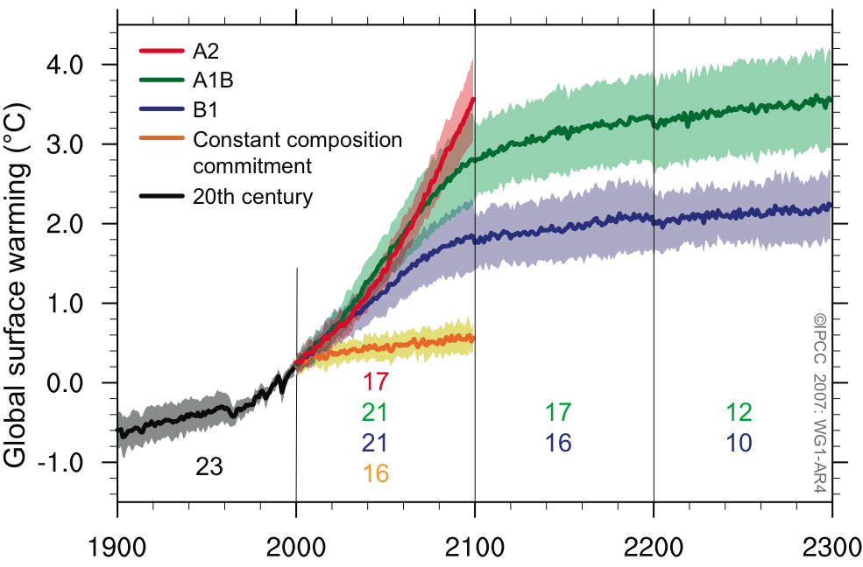
The Future
Warming will increase if GHG increase. If GHG were kept fixed at current levels, a committed 0.6°C of further warming would be expected by 2100. More warming would accompany more emission.
CO2 Eq
3.4ºC = 6.1ºF
850
2.8ºC = 5.0ºF
600
1.8ºC = 3.2ºF
400
0.6ºC = 1.0ºF
Notes:
B1 and A1B have similar population projections – ca 7 billion at 2100. A2 population more than double at 15 billion. GDP/capita is 47k$, 75k$, 16k$ for B1, A1B, A2.

Slide 6
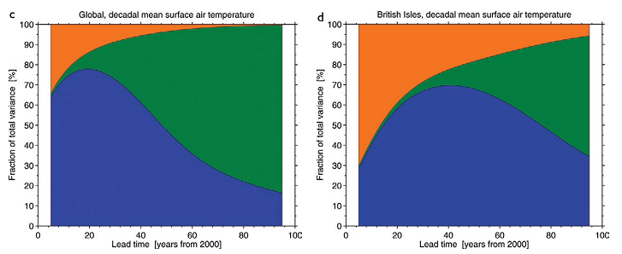
Uncertainty on Regional Scales
Fraction of total variance in decadal mean air temperature predictions explained by the three components of uncertainty
Orange = internal variability
Green = emissions scenario uncertainty
Blue = model uncertainty
Internal variability
Hawkins and Sutton, 2009
Notes:
Component of internal variability can be reduced through more complete initialization of ocean models.

Slide 7
What about higher resolution information about climate change?
Global models run at about 200 km spatial resolution - what resolution do we need for adaptation planning in various sectors (water resources, agriculture etc.)
How to balance the desire for higher resolution with the other major uncertainties (future emissions, general response of climate system, internal variability).

Slide 8
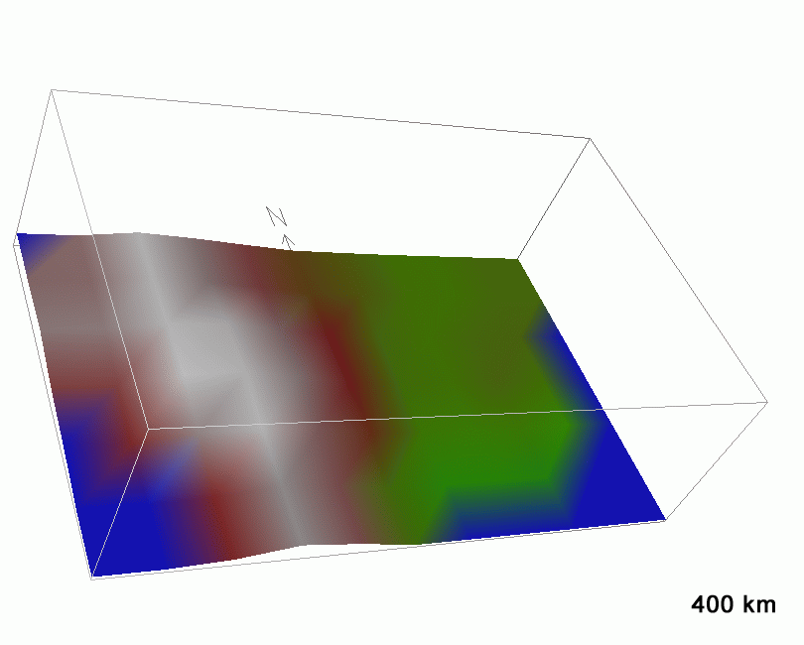
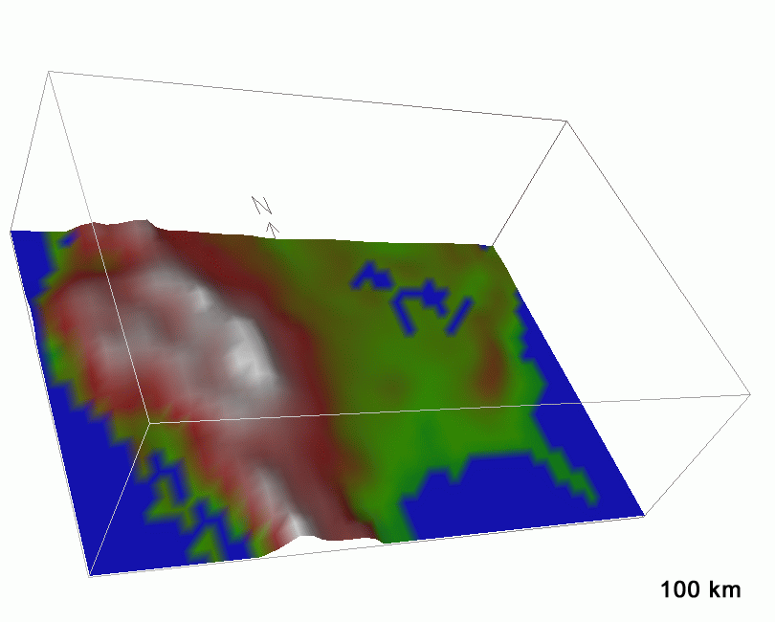
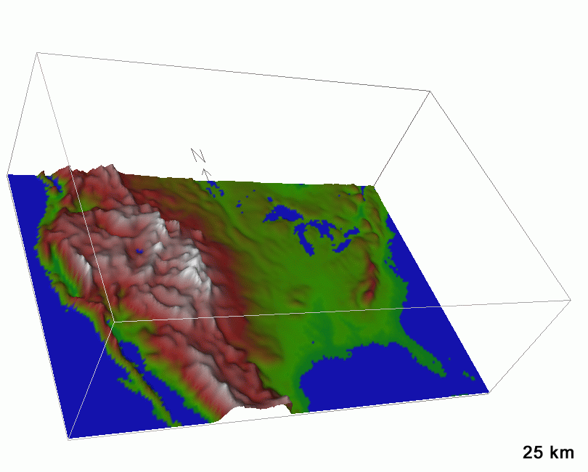
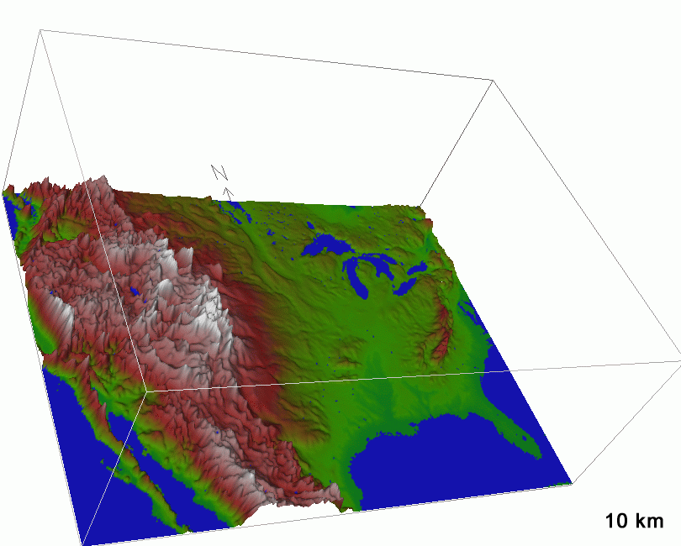
Global Climate Models
Regional Climate Models
Notes:
Slide from Rick Anthes – NARCCAP runs are at 50 km – not quite as fine as the lower left panel.

Slide 9
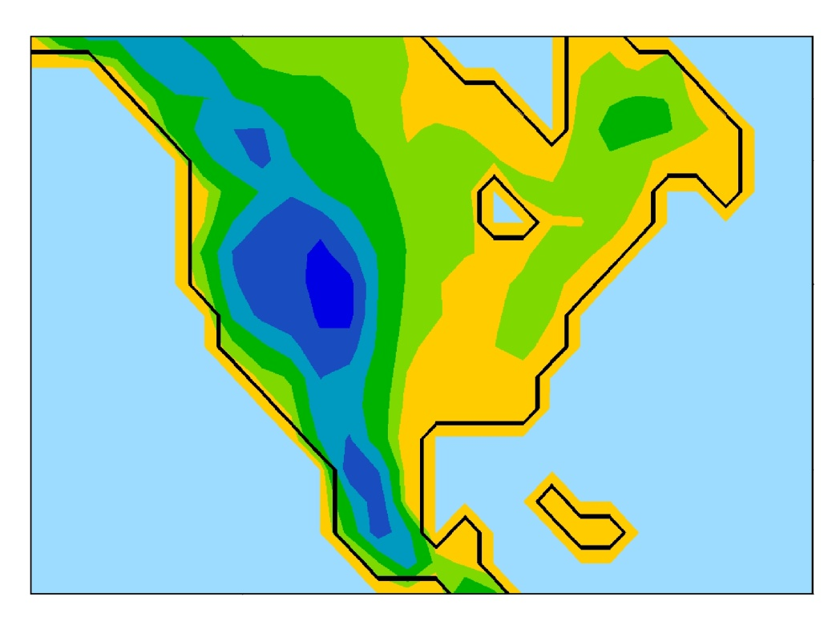
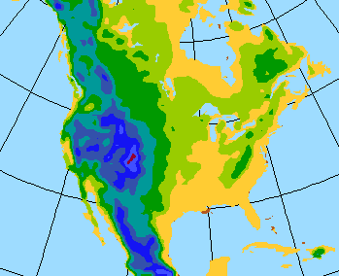
Advantages of higher resolution
North America at typical global climate model resolution
Hadley Centre AOGCM (HadCM3), 2.5˚ (lat) x 3.75˚ (lon), ~ 280 km
North America at 50 km grid spacing

Slide 10
Regional climate models allow use of finer resolution
HadCM3 grid spacing is about 280 km.
To reduce the spacing to 50 km, we would need (280/50)³ = 175 times the computing power.
Proposal: Use a finer-scale model over only a limited region of interest.

Slide 11
Regional Modeling Strategy
Nested regional modeling technique
Global model provides:
  initial conditions – soil moisture, sea surface temperatures, sea ice
  lateral meteorological conditions (temperature, pressure, humidity) every 6-8 hours.
  Large scale response to forcing (100s kms)
Regional model provides finer scale (10s km)
response

Slide 12
Examples Where
Regional Modeling Is Useful
Complex topography (mountains)
Regions with small irregular land masses (e.g., the Caribbean)
Complex coastlines (e.g., Italy)
Heterogeneous landscapes

Slide 13
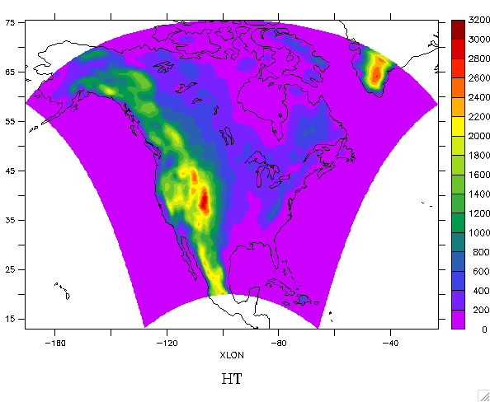
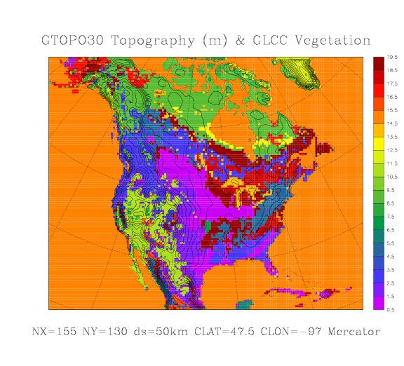
  The North American Regional Climate Change Assessment Program (NARCCAP)
www.narccap.ucar.edu
Explores multiple uncertainties in regional
and global climate model projections
4 global climate models x 6 regional climate models
Develops multiple high resolution (50 km)
regional climate scenarios for use in impacts
and adaptation assessments
Evaluates regional model performance to establish
credibility of individual simulations for the future
Participants: Iowa State, PNNL, LLNL, UC Santa Cruz, Ouranos (Canada), UK Hadley Centre, Scripps, NCAR
Initiated in 2006, funded by NOAA-OGP, NSF, DOE, USEPA-ORD

Slide 14
NARCCAP Domain

Slide 15
NARCCAP - Team
Linda O. Mearns, NCAR
Ray Arritt, Iowa State, Dave Bader, LLNL, Wilfran Moufouma-Okia, Hadley Centre, Sébastien Biner, Daniel Caya, Ouranos, Phil Duffy, LLNL,Climate Central, Dave Flory, Iowa State, William Gutowski, Iowa State, Isaac Held, GFDL, Richard Jones,Simon Tucker, Hadley Centre, Bill Kuo, NCAR; René Laprise, UQAM, Ruby Leung, PNNL, Larry McDaniel, Seth McGinnis, Don Middleton, NCAR, Ana Nunes, U. Rio de Janeiro, Scripps, Doug Nychka, NCAR, John Roads*, Scripps, Steve Sain, NCAR, Lisa Sloan, Mark Snyder, UC Santa Cruz, Ron Stouffer, GFDL, Gene Takle, Iowa State
* Deceased June 2008

Slide 16
Organization of Program
Phase I: 25-year simulations using NCEP-Reanalysis boundary conditions (1980—2004)
Phase II: Climate Change Simulations
  Phase IIa: RCM runs (50 km res.) nested in AOGCMs current and future
  Phase IIb: Time-slice experiments at 50 km res. (GFDL and NCAR CAM3). For comparison with RCM runs.
Quantification of uncertainty at regional scales – probabilistic approaches
Scenario formation and provision to impacts community led by NCAR.
Opportunity for double nesting (over specific regions) to include participation of other RCM groups (e.g., for NOAA OGP RISAs, CEC, New York Climate and Health Project, U. Nebraska).

Slide 17
Phase I
6 RCMs (RegCM3, WRF, CRCM*, ECPC RSM*, MM5, HadRM3): Reanalysis (NCEP)-driven runs
Time period: 1980-2004 for all selected RCMs
Configuration:
  common North America domain (some differences due to horizontal coordinates)
  horizontal grid spacing 50 km
  boundary data from NCEP/DOE Reanalysis 2
  boundaries, SST and sea ice updated every 6 hours
  * Spectral nudging applied
Mearns et al., 2012 BAMS (in press)
Notes:
17
Explain what NCEP Reanalysis 2 is
Using six different regional models – they differ in the model subcomponents
RCM = regional climate model
RegCM3 – model developed and maintained by Filippo Giorgi at ICTP
WRF – NCAR model
CRCM – Canadian regional model
ECPC RSM – Scripps Regional Spectral Model
MM5 – NCAR/PSU model
HadRM3 - Hadley Center regional model v. 3

Slide 18
NARCCAP PLAN – Phase II
A2 Emissions Scenario
GFDL
CGCM3
HADCM3
CCSM3
GFDL
Time slice
50 km
CAM3
Time slice
50km
1971-2000 current
Provide boundary conditions
2041-2070 future
MM5
Iowa State
RegCM3
UC Santa Cruz
CRCM
Quebec,
Ouranos
HADRM3
Hadley Centre
RSM
Scripps
WRF
PNNL
Notes:
Interesting problem to determine expected relationship between time slice experiments and AOGCM runs and with RCMs using the same
AOGCM boundary

Slide 19
Quantification of Uncertainty
The four GCM simulations already ‘situated’ probabilistically based on earlier work (Tebaldi et al., 2004)
RCM results nested in particular GCM would be represented by a probabilisitc model (derived assuming probabilistic context of GCM simulation)
Use of performance metrics to differentially weight the various model results

Slide 20
The NARCCAP User Community
Three user groups:
Further dynamical or statistical downscaling
Regional analysis of NARCCAP results
Use results as scenarios for impacts studies
  www.narccap.ucar.edu
  Over 500 users
  To sign up as user, go to web site – contact Seth McGinnis,
  mcginnis@ucar.edu
Notes:
20
Three main user groups – Encourage people to visit web site and sign up for using data. End NARCCAP part of presentation

Slide 21
Articles Using NARCCAP
Wang et al., 2009: Evaluation of precipitation in the intermountain region as simulated by the NARCCAP regional climate models,GRL 36: L11704, doi:10.1029/2009GL037930
Leung, L. R. and Qian, Y.,2009: "Atmospheric Rivers Induced Heavy Precipitation and Flooding in the Western U. S. Simulated by the WRF Regional Model, GRL 36: 10.1029/2008GLO36445
Mearns, L. O., et al., 2009: A regional climate change assessment program for North America, EOS 90: 311
Gutowski, W. J., et al., 2010: Regional extreme monthly precipitation simulated by NARCCAP RCMs, J. of Hydrometeorology, 10.1175/2010JHM1297.1

Slide 22
Articles (cont’d)
Schliep, E.M., et al., 2010: A comparison study of extreme precipitation from six different regional climate models via spatial hierarchical modeling, Extremes 13: 219-239, doi:10.1007/s10687-009-0098-2.
Christensen, W.F. and S. Sain, 2011: Spatial latent variable modeling for integrating output from multiple climate models, Mathematical Geosciences, doi: 10.1007/s11004- 011-9321-1.
Greasby, T.A. and S. Sain, 2011, Multivariate spatial analysis of climate change projections, J. of Agricultural, Biological, and Environmental Statistics, 16, 571- 585, doi: 10.1007/s13253-011-0072-8
Sain, S.R., D. Nychka, and L. Mearns, 2011: Functional ANOVA and regional climate experiments: A statistical analysis of dynamic downscaling, Environmetrics, 22, 700- 711, doi: 10.1002/env.1068

Slide 23
Articles (cont’d)
Bukovsky, M. S., 2012: Temperature trends in the NARCCAP regional models, J. of Climate (in press)
Rangwala, I. et al., 2012: Mid-21st century projections in temperature extremes in the southern Colorado Rocky Mountains from regional climate models. Clim. Dyn. DOI 10.1007/s00382-011-1282-z
Salzmann, N. and L. O. Mearns, 2012: Assessing the performance of multiple regional climate model simulations for seasonal mountain snow in the upper Colorado River Basin, J. of Hydrometeorology (in press).
Sobolowski, S. and T. Pavelsky, 2012: Evaluation of present and future North American Regional Climate Change Assessment Program (NARCCAP) regional climate simulations over the southeast U.S. JGR 117:

Slide 24

Courtesy M. Bukovsky

Slide 25
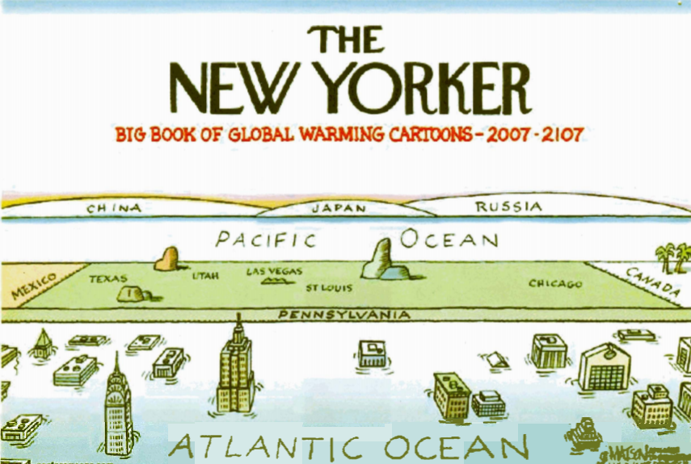
THE END

Slide 26
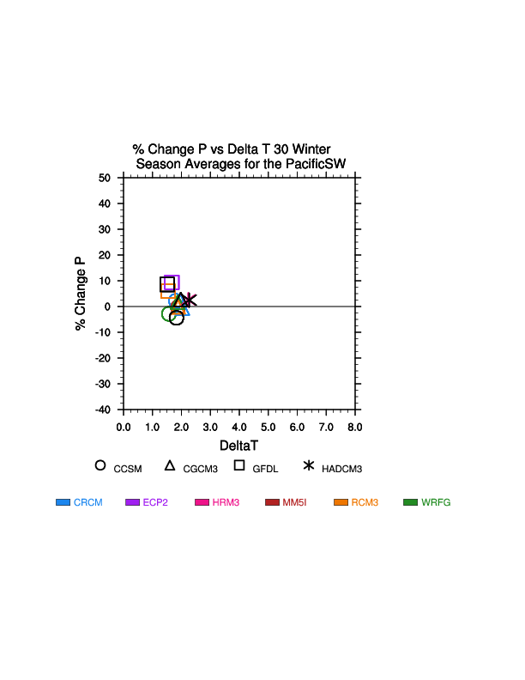
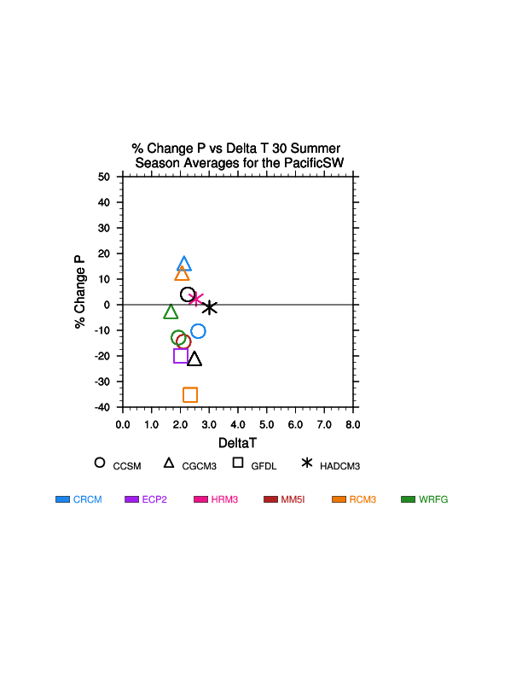
Pacific South West
Notes:
Series of three slides showing scatter plots of dp vs. dt. Can observe patterns across models. Also Steve Sain is working on algorithms to determine the distance between the model results. Can then determine patterns of changes, for example, of
RCMs all using same driving GCM.
Note very strong cluster of dp and dt in winter – due to large scale forcing in winter, and also strong oceanic effects
Summer we see much wider scatter in both temperature and precip. Note in summer that Hadley models show almost identical response. Three CCSM driven models are similar in summer. Also note very small precip amounts in summer, so % change not that meaningful in summer. GFDL AOGCM response is off the scale in summer – large precip decrease.

Slide 27
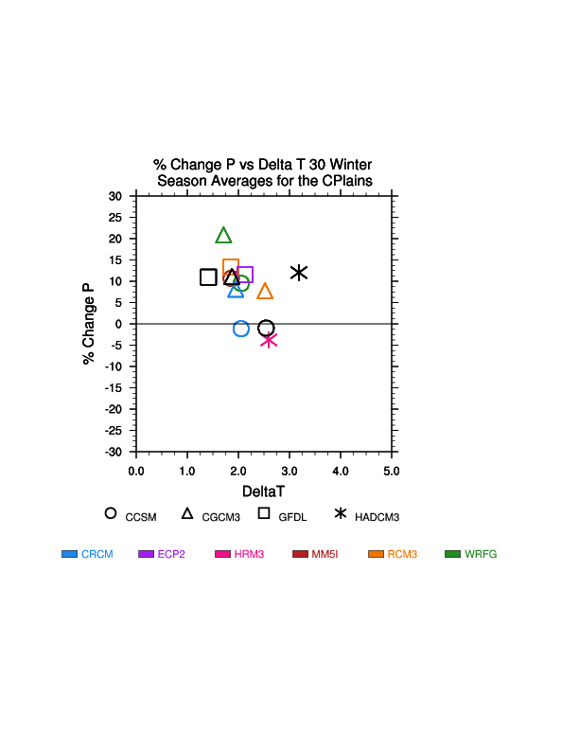
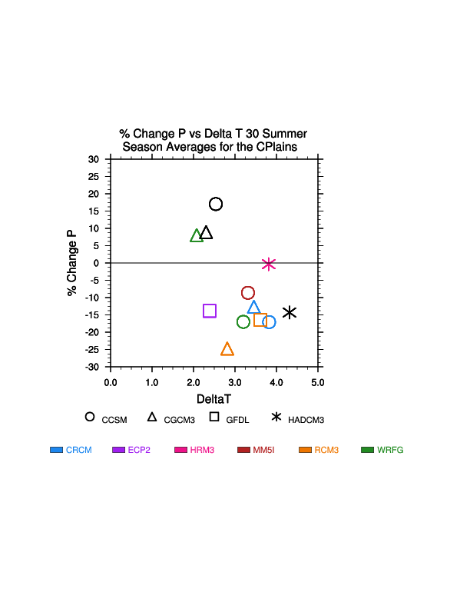
Central Plains
Notes:
Much wider scatter in winter compared to PSW. (But note scales for these plots and next plots are different from that of PSW). And even greater diversity of response in summer. Very large diffs between GCMs and RCMs driven by them (e.g., CCSM, CGCM3). Note that GFDL AOGCM response is off scale in summer because very large decrease in precip.

Slide 28
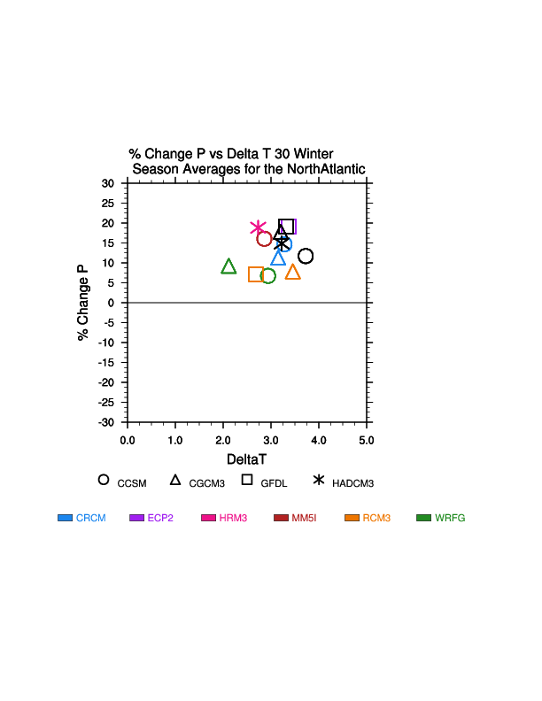
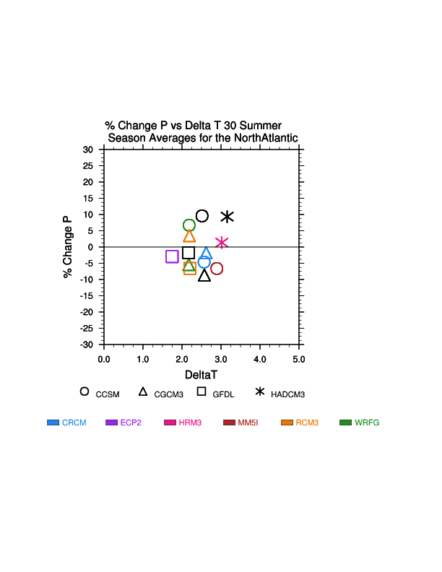
North Atlantic
Notes:
Agreement on precip change sign in winter, but temperature change range is medium large (2-4 deg.). Summer temp range is a little smaller, but precip range greater. Note clustering of summer response of GFDL and GFDL driven RCMs in summer. But bifurcated response (in terms of precip.) for CCSM driven RCMs in summer regarding precip. A lot to look at – much analysis needed.

