Slide 1



NARCCAP Fourth
Users’ Meeting
Overview of
Climate Change Results
Linda O. Mearns
National Center for Atmospheric Research
Boulder, CO
April 10 -11, 2012

Slide 2
NARCCAP PLAN – Phase II
A2 Emissions Scenario
GFDL
CGCM3
HADCM3
CCSM3
GFDL
Time slice
50 km
CAM3
Time slice
50km
1971-2000 current
Provide boundary conditions
2041-2070 future
MM5
Iowa State
RegCM3
UC Santa Cruz
CRCM
Quebec,
Ouranos
HadRM3
Hadley Centre
ECPC
RSM
Scripps
WRF
PNNL
Notes:
Interesting problem to determine expected relationship between time slice experiments and AOGCM runs and with RCMs using the same
AOGCM boundary

Slide 3
Temperature and precipitation changes with model agreement
(2080-2099 minus 1980-1999) A1B Scenario

Slide 4
AOGCM-RCM Matrix
AOGCMS
 | GFDL | CGCM3 | HADCM3 | CCSM3
MM5 |  |  | X | X1**
RegCM | X1** | X**
CRCM |  | X1** |  | X**
HadRM | X** |  | X1**
RSM | X1** |  | X
WRF |  | X** |  | X1**
*CAM3 |  |  |  | X
*GFDL | X**
1 = chosen first GCM
*= time slice experiments Red = run completed ** = data loaded
RCMs
Notes:
4
We use a fractional factorial design – so each Global model provides boundary conditions for 3 RCMs, and each RCM uses two different AOGCMs. Red indicates simulations that are completed. Both time slice sets are complete.

Slide 5
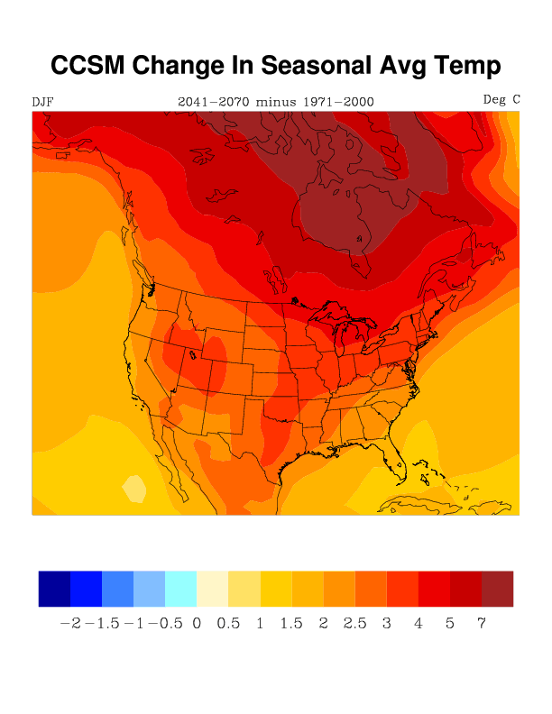
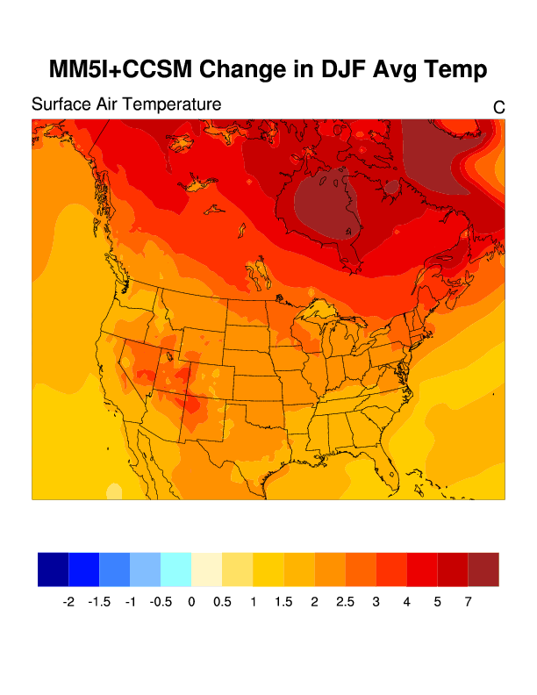
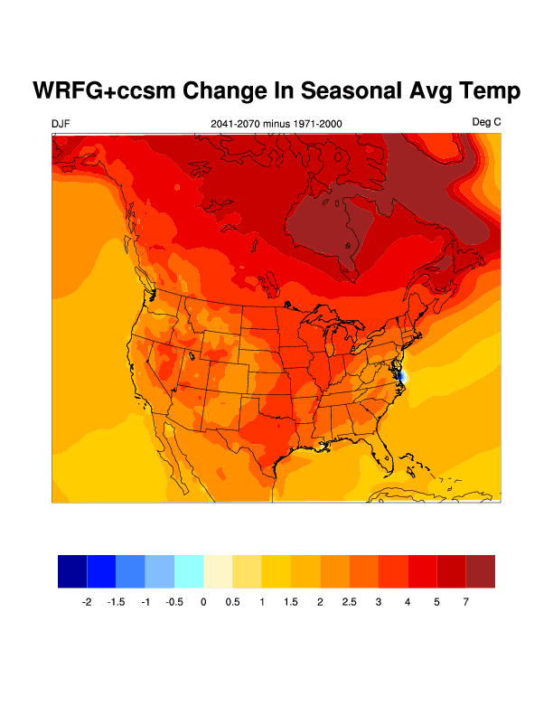
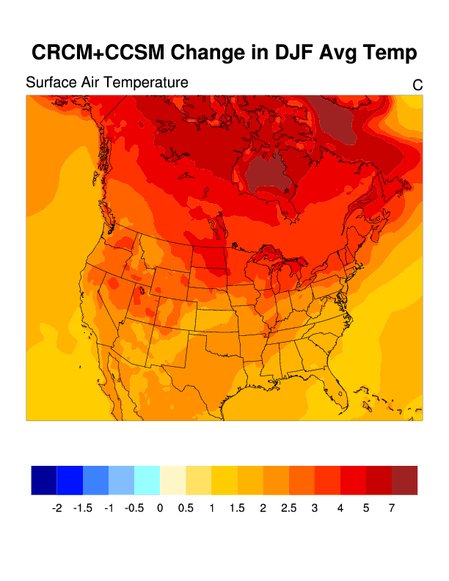
Global - CCSM3
MM5 RCM
Change in Winter Temperature
CCSM3,
3 RCMs
WRF RCM
CRCM

Slide 6
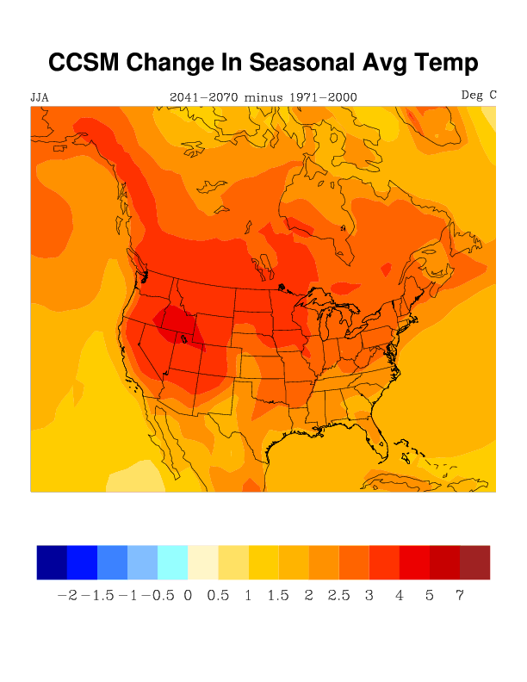
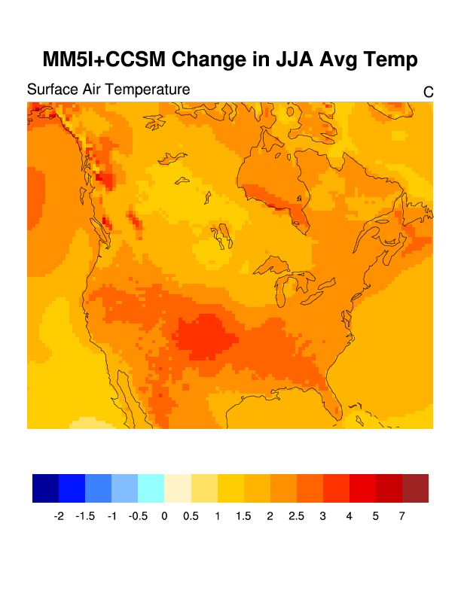
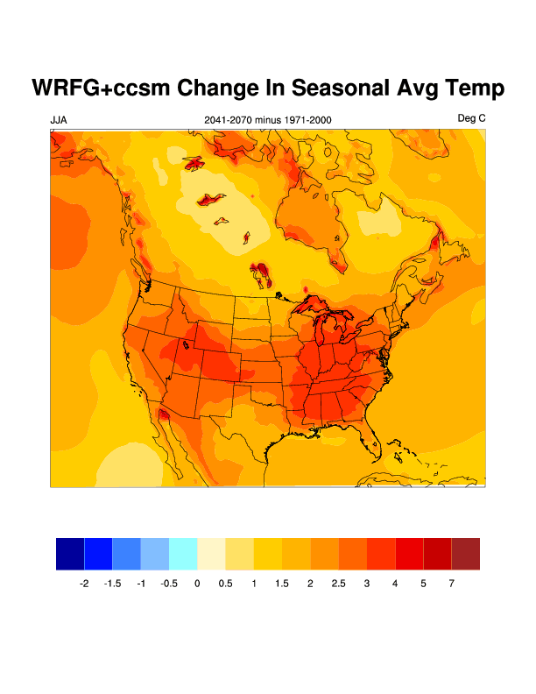
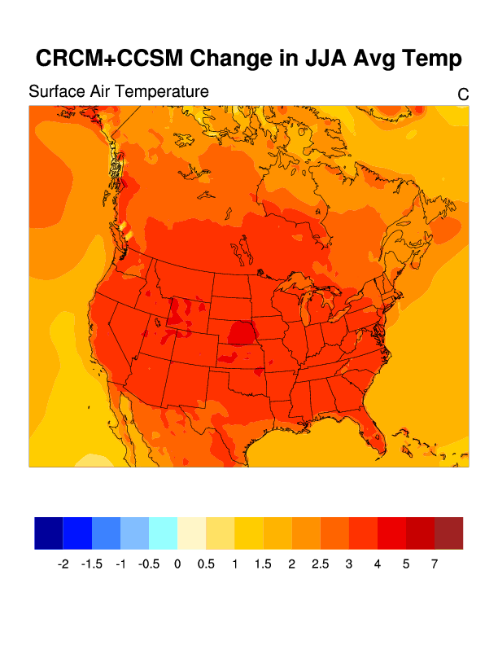
Change in Summer Temperature
CCSM-driven

Slide 7
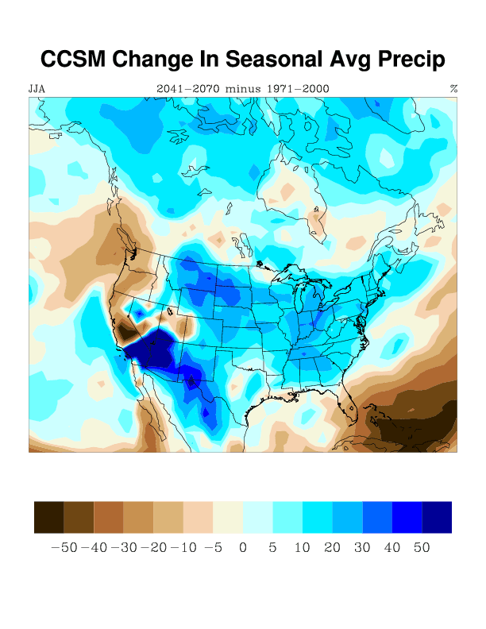
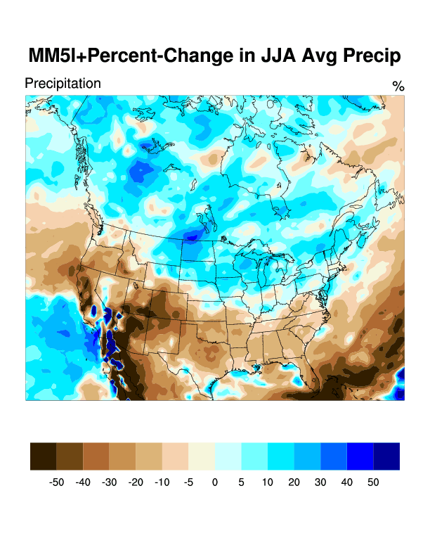
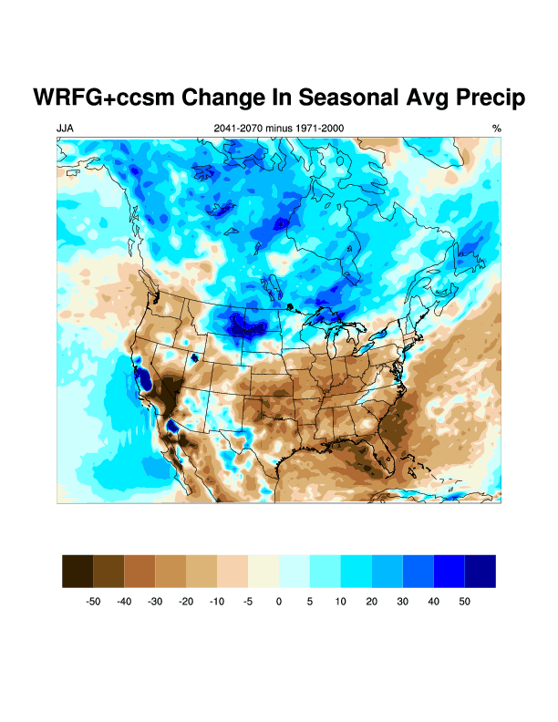
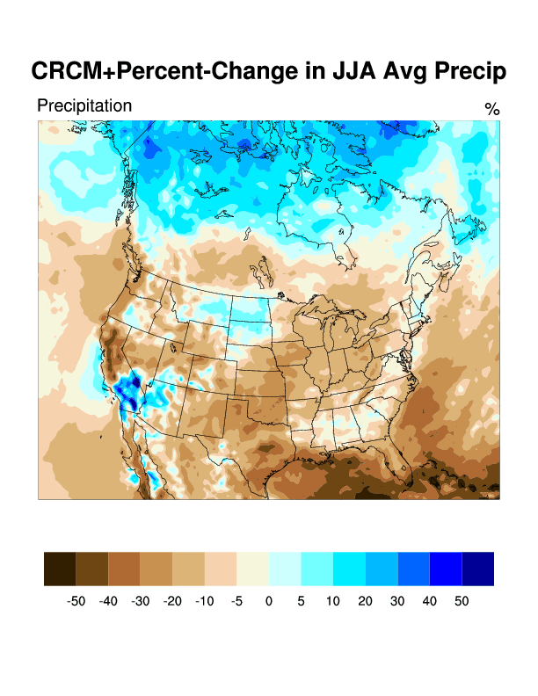
CCSM
CCSM-driven change in summer precipitation
CRCM

Slide 8
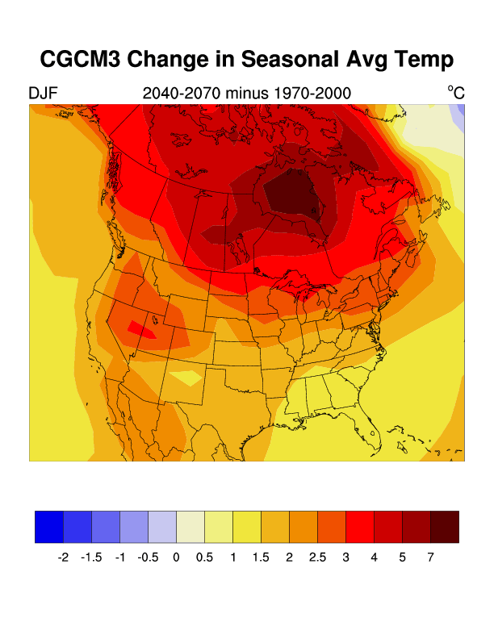
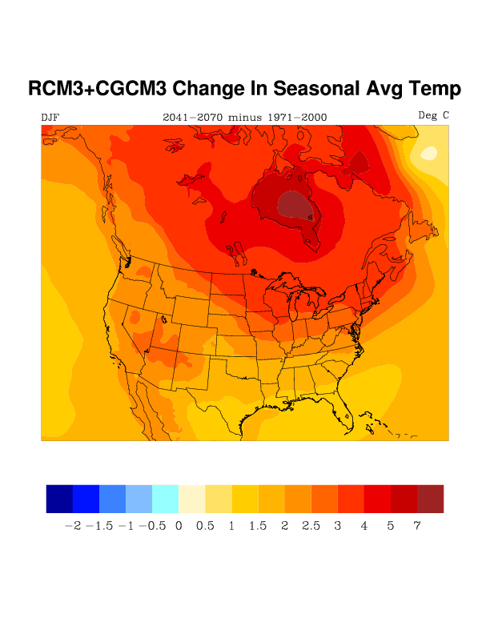
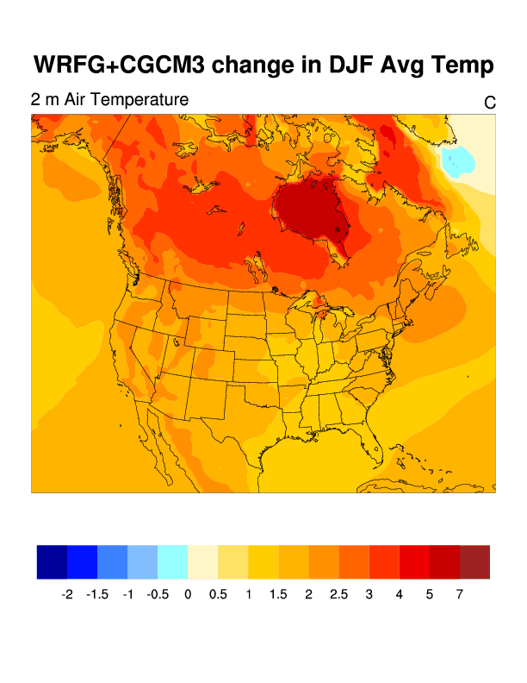
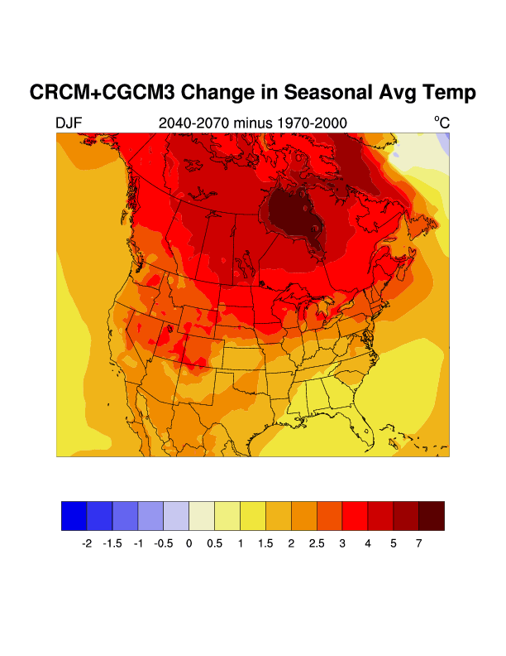
CGCM3 Global Model
RegCM3
CGCM - driven
Change in Winter Temperature
WRFG
CRCM

Slide 9
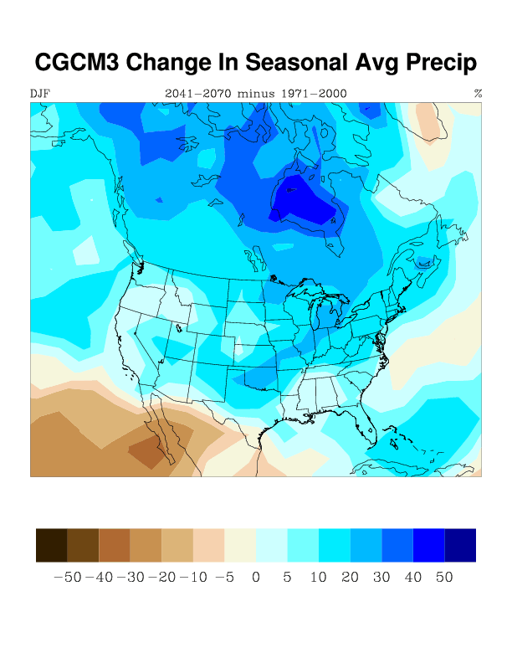
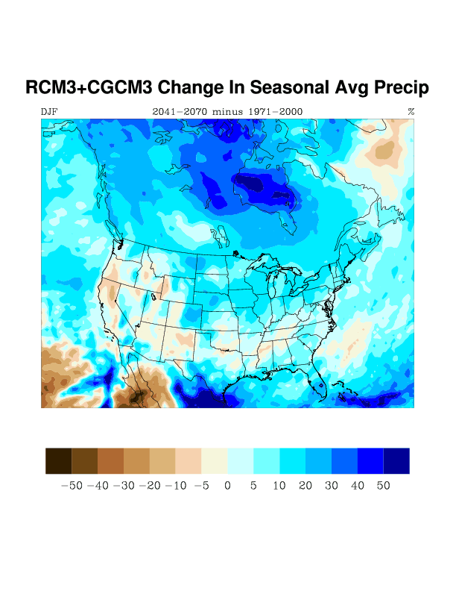
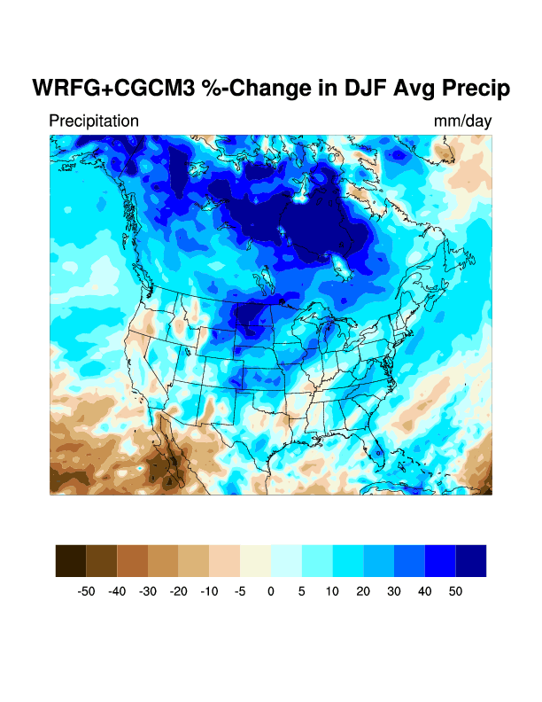
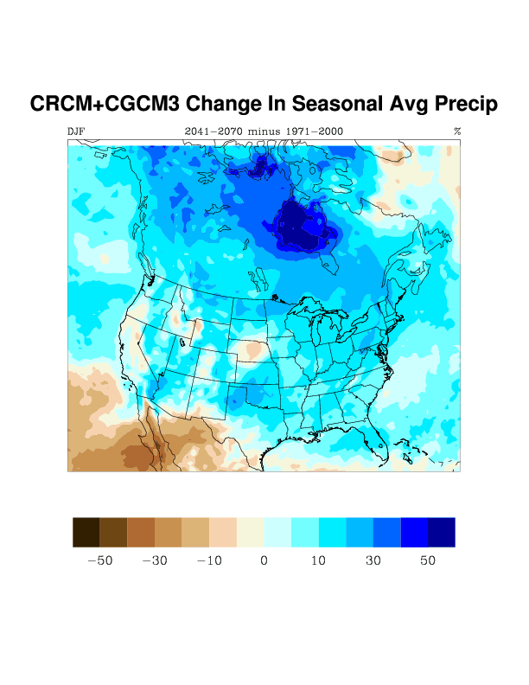
CGCM3 – Global
RegCM3
CGCM-driven % Change in Winter Precipitation
WRFG
CRCM
Notes:
Will actually provide two slides showing two different types of contrasts - comparing 3 different RCMs nested in the same AOGCM (Canadian global model and the CRCM and RegCM) and one RCM nested in two different Global Models (this will be RegCM3 nested in Canadian global model and HadCM) probably for winter precipitation

Slide 10
WRF
WRF

Slide 11
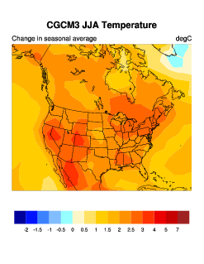
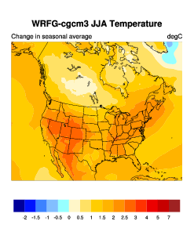
Change in Summer Temperature
WRF

Slide 12
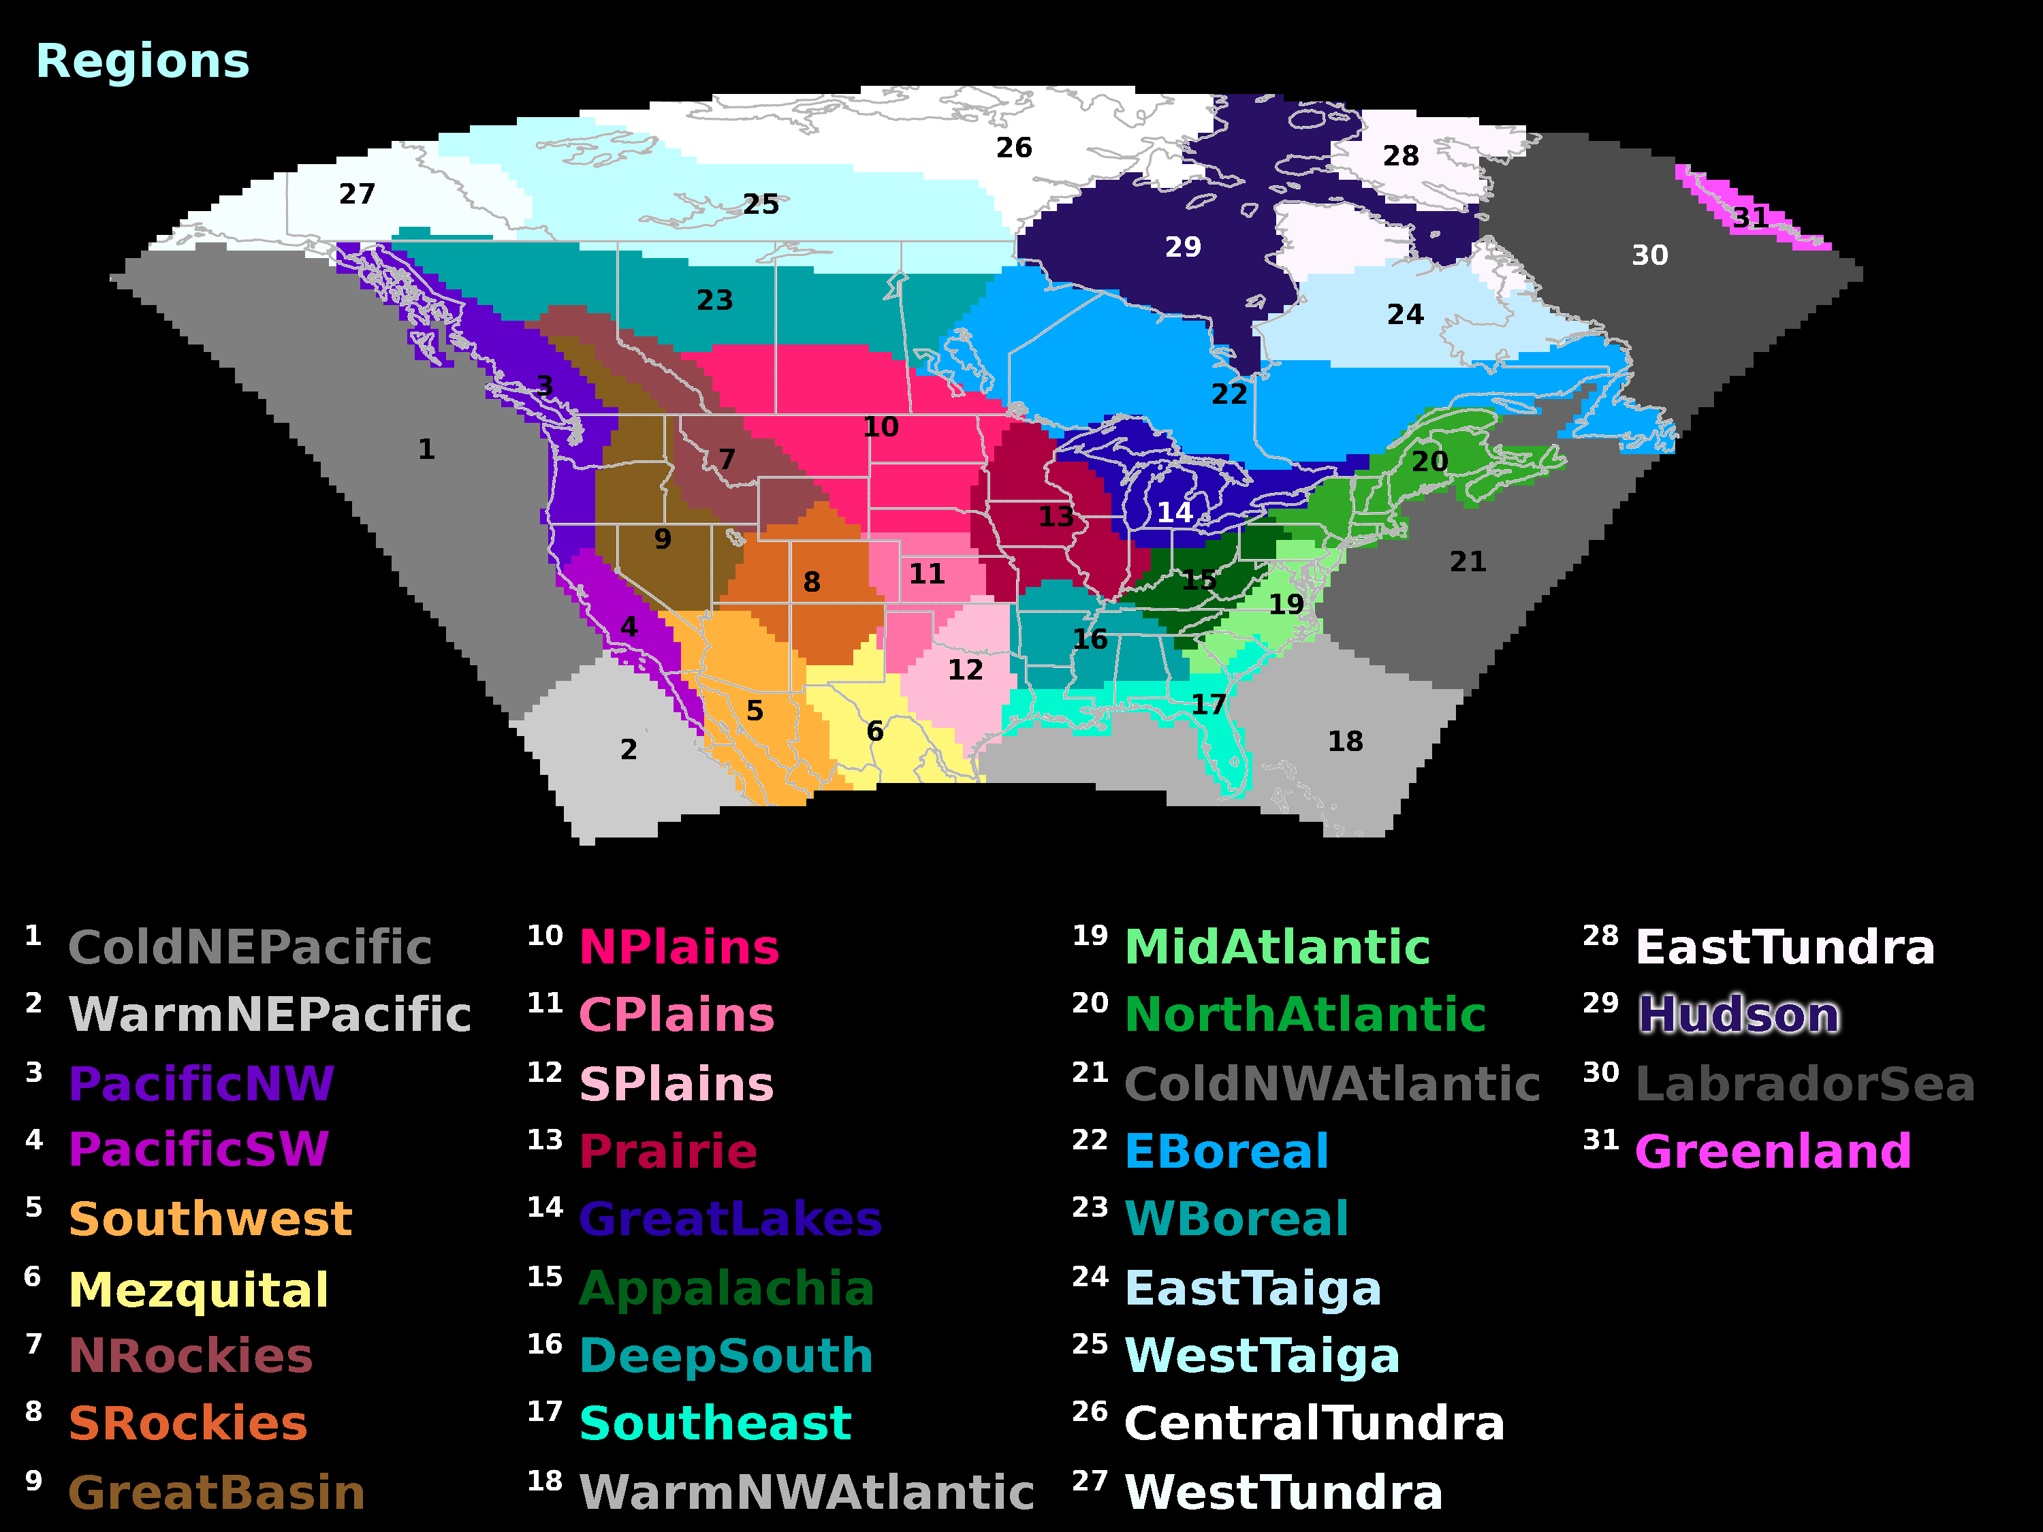
Bukovsky Regions

Slide 13
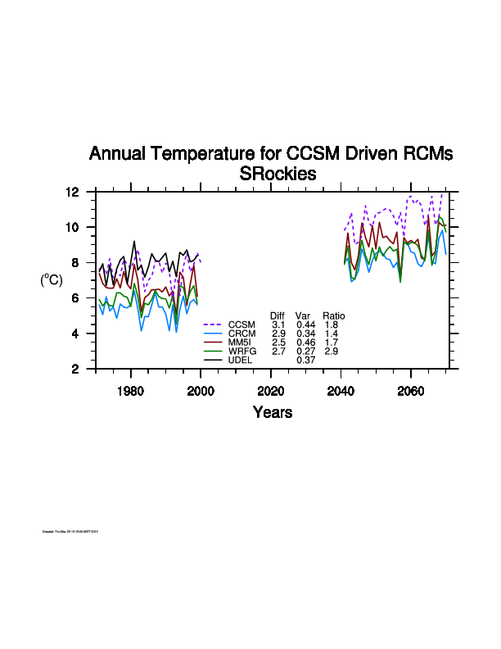
Southern Rocky Mountains
Notes:
Note lack of trend in current period – compare with CGCM3-driven runs

Slide 14
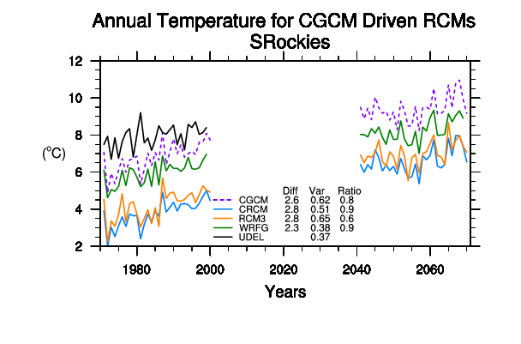
Southern Rocky Mountains
Notes:
Note relatively strong trend in current period

Slide 15
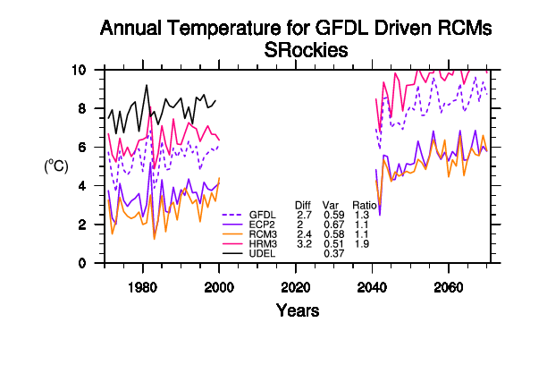
Southern Rocky Mountains
GFDL-driven Annual Temperature
Notes:
Note relatively strong trend in current period

Slide 16
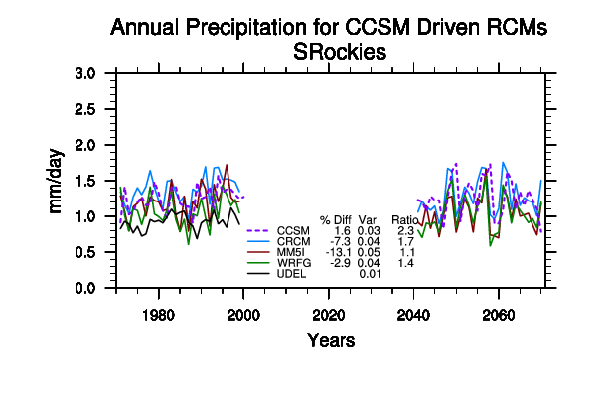
Southern Rocky Mountains
CRCM ΔP = - 8 %
MM5 ΔP = -15%
WRFG ΔP = - 3%

Slide 17
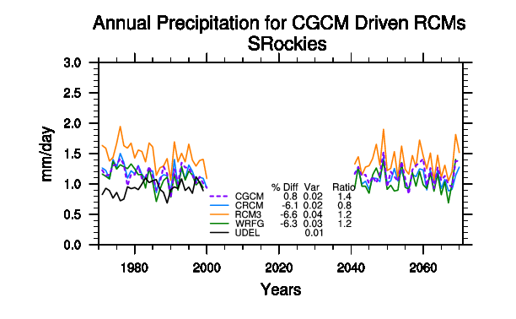

Slide 18
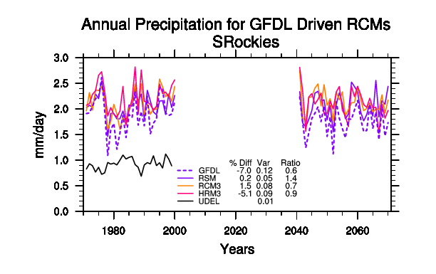

Slide 19
Bukovsky Regions

Slide 20
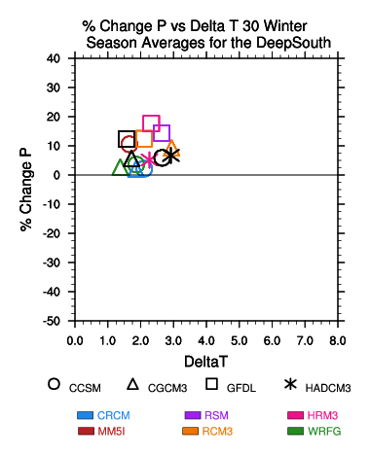
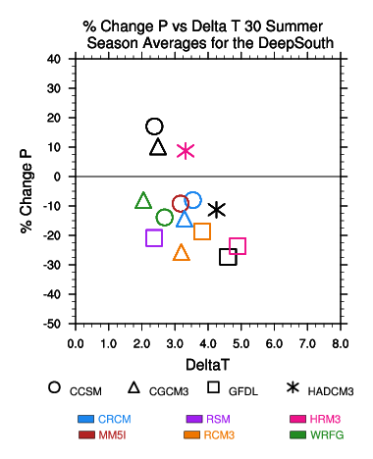
Deep South

Slide 21
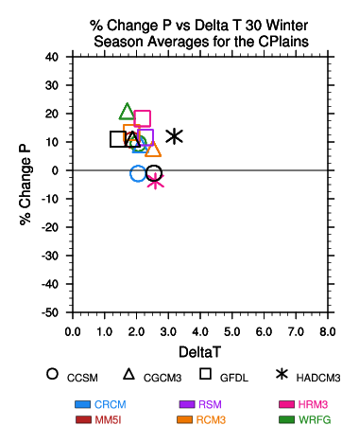
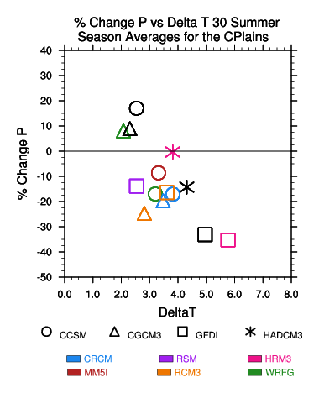
Central Plains

Slide 22
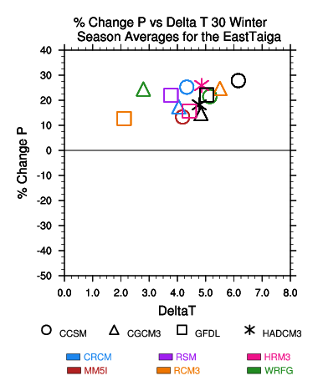
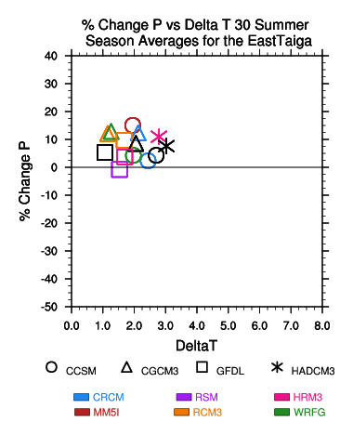
East Taiga

Slide 23
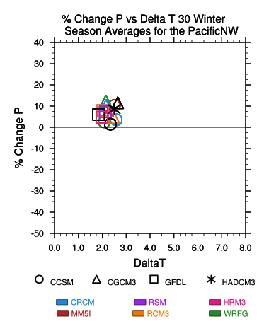
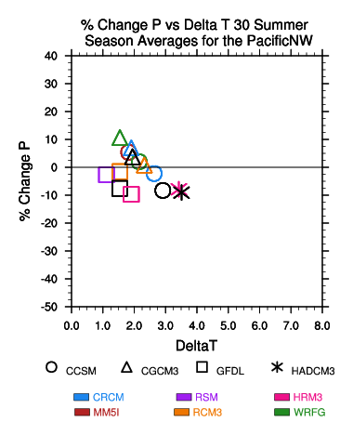
Pacific NW

Slide 24
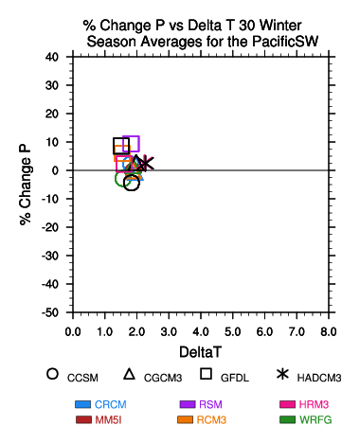
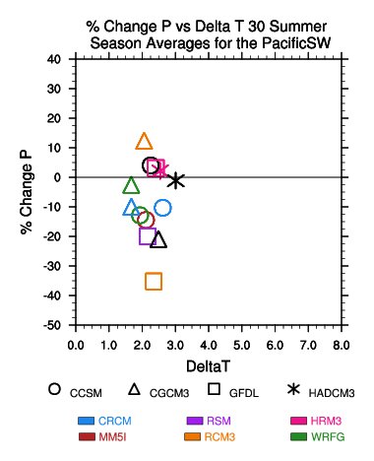
Pacific SW

Slide 25
Global Time Slice / RCM Comparison
at same resolution (50km)
A2 Emissions Scenario
GFDL
AOGCM
NCAR
CCSM3
Six RCMS
50 km
GFDL
AGCM
Time slice
50 km
CAM3
Time slice
50km
compare
compare

Slide 26
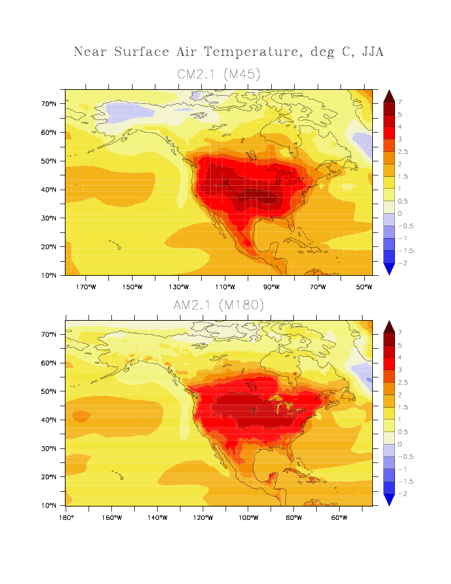
Future-current Summer Temperatures
GFDL CM2.1
GFDL AM2.1
Notes:
Differences, 2041-2070 -- 1971-2000.
26

Slide 27
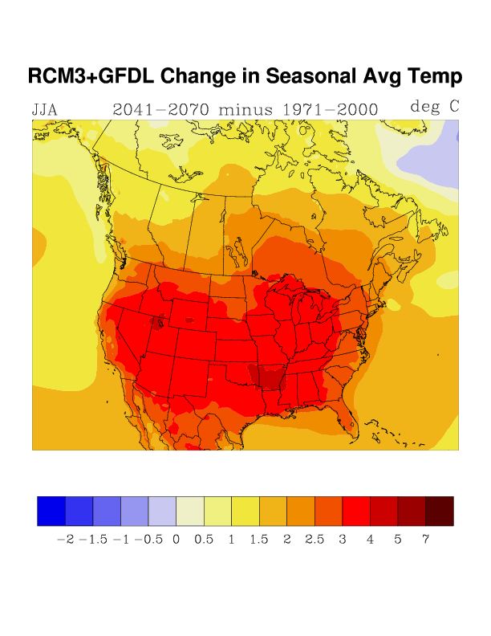
RegCM3 in GFDL
Change in Summer Temperature

Slide 28
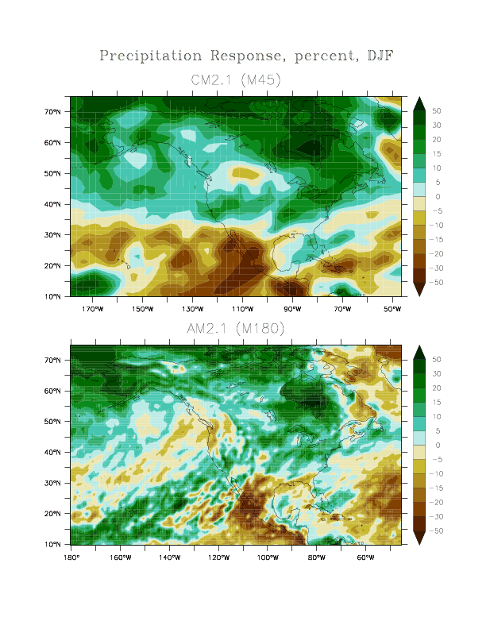

Slide 29
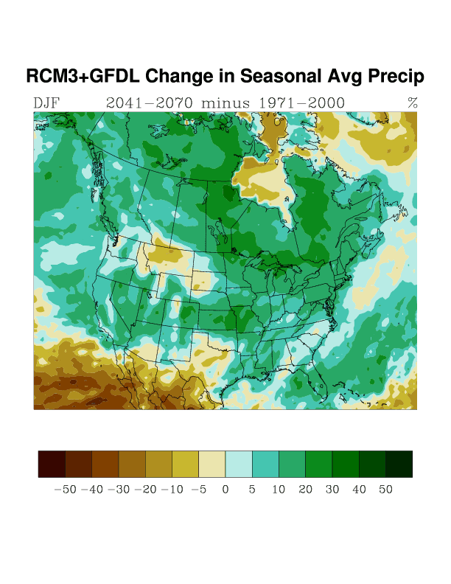
RegCM3 in GFDL
% Change Precip - Winter

Slide 30
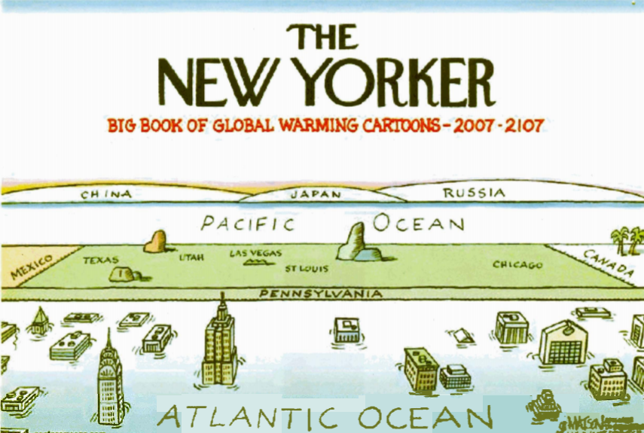
THE END

Slide 31
Change in Precipitation (%)
North Atlantic
CCSM3
CGCM3
 | Winter | Summer | Annual | Winter | Summer | Annual
CRCM | 12 | -5 | 1 | 14 | -7 | 5
WRFG | 7 | 7 | 2 | 8 | -6 | 7
RCM3 |  |  |  | 10 | -2 | 4
MM5I | 7 | 4 | 6
Southern Rockies
 | Winter | Summer | Annual | Winter | Summer | Annual
CRCM | 1 | -15 | -8 | 6 | -22 | -7
WRFG | 8 | - 9 | - 3 | 7 | -17 | -7
RCM3 |  |  |  | 1 | -23 | -7
MM5I | 1 | -50 | -15
Notes:
North Atlantic - from both drivers, winter in general bigger delta than summer.
Southern Rockies – bigger changes in summer.
In summer in the South Rockies, see a bigger change across the three CCSM-driven RCMs, and CGCM-driven RCMs than you see for each RCM across the two different GCMs

Slide 32
Change in Temperature °C
North Atlantic
CCSM3
CGCM3
 | Winter | Summer | Annual | Winter | Summer | Annual
CRCM | 3.3 | 2.6 | 2.7 | 2.8 | 2.9 | 2.7
WRFG | 3.4 | 2.2 | 2.7 | 2.1 | 2.2 | 2.1
RCM3 |  |  |  | 3.2 | 2.6 | 2.6
MM5I | 3.0 | 2.2 | 2.5
Southern Rockies
 | Winter | Summer | Annual | Winter | Summer | Annual
CRCM | 2.4 | 3.7 | 2.6 | 2.6 | 3.4 | 2.8
WRFG | 2.6 | 3.0 | 2.7 | 1.9 | 2.6 | 2.8
RCM3 |  |  |  | 2.4 | 3.4 | 2.3
MM5I | 2.6 | 2.7 | 2.5
Notes:
North Atlantic - from both drivers, winter in general bigger delta than summer.
Southern Rockies – bigger changes in summer.
In summer in the South Rockies, see a bigger change across the three CCSM-driven RCMs, and CGCM-driven RCMs than you see for each RCM across the two different GCMs

Slide 33
Bukovsky Regions

