Slide 1

NARCCAP Data Tutorial
Seth McGinnis
IMAGe – NCAR
mcginnis@ucar.edu

Slide 2
Outline
Basic concepts of numerical modeling
The netCDF data format
NARCCAP project overview
Finding the data you want
Fiddly details
Extracting data

Slide 3

The fundamental element of climate simulation is a big box of air
50 x 50 km in NARCCAP

Slide 4
Each box is represented by 6 numbers
hus: humidity
ps: pressure
ta: temperature
ua: E-W wind
va: N-S wind
zg: height
Simulation: apply PDEs for fluid flow to each box to update the 6 numbers and calculate flux between neighboring boxes. (“dynamical core”)

Slide 5
Sub-models for other processes (“physics”)
radiation transfer
land surface
planetary boundary layer
convection
microphysics (rain/clouds)
Sub-gridscale processes are handled by parameterization (e.g., thunderstorms)

Slide 6
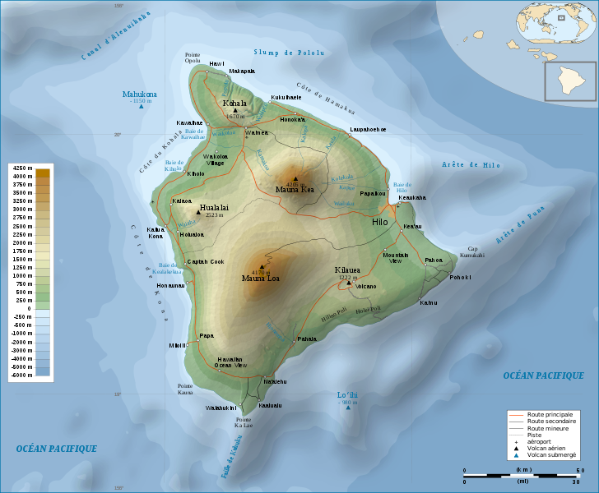
Climate models represent reality as big grids of numbers
-99 | 0.5 | -99 | -99 | -99 | -99 | -99 | -99
-99 | 0.8 | 1.7 | -99 | -99 | -99 | -99 | -99
-99 | -99 | 0.9 | 0.5 | -99 | -99 | -99 | -99
-99 | 0.7 | 1.1 | 0.9 | 0.3 | -99 | -99 | -99
0.4 | 1.2 | 1.6 | 1.9 | 2.3 | 1.2 | -99 | -99
0.9 | 2.5 | 2.2 | 2.8 | 4.1 | 1.8 | 0.2 | -99
-99 | 1.3 | 2.2 | 2.9 | 3.3 | 2.1 | 0.5 | -99
-99 | 0.8 | 2.6 | 3.1 | 2.8 | 2.2 | 0.8 | -99
-99 | 0.1 | 1.9 | 4.2 | 2.4 | 1.6 | 0.9 | 0.1
-99 | -99 | 0.4 | 2.9 | 1.8 | 0.5 | -99 | -99
-99 | -99 | 0.2 | 1.5 | 0.7 | -99 | -99 | -99
-99 | -99 | -99 | 0.3 | -99 | -99 | -99 | -99
-99 | -99 | -99 | -99 | -99 | -99 | -99 | -99
(“Raster data” in GIS parlance)

Slide 7
How do you store the data?
Binary: platform dependent, opaque
Plain text: huge files, format ambiguity
1 | 2 | 3 | 4
4 | 3 | 2 | 1
5 | 5 | 5 | 5
123443215555
541532523514
?

Slide 8
NetCDF
self-describing
platform-independent
array-oriented
scientific data
file format

Slide 9
NetCDF Data Model
orog
//GLOBAL
title: island topography
creator: Seth McGinnis
Conventions: CF-1.6
lat
0.4
0.3
0.2
0.1
0.0
-0.1
-0.2
-0.3
-0.4
-0.5
-0.6
-0.7
-0.8
-99 | 0.5 | -99 | -99 | -99 | -99 | -99 | -99
-99 | 0.8 | 1.7 | -99 | -99 | -99 | -99 | -99
-99 | -99 | 0.9 | 0.5 | -99 | -99 | -99 | -99
-99 | 0.7 | 1.1 | 0.9 | 0.3 | -99 | -99 | -99
0.4 | 1.2 | 1.6 | 1.9 | 2.3 | 1.2 | -99 | -99
0.9 | 2.5 | 2.2 | 2.8 | 4.1 | 1.8 | 0.2 | -99
-99 | 1.3 | 2.2 | 2.9 | 3.3 | 2.1 | 0.5 | -99
-99 | 0.8 | 2.6 | 3.1 | 2.8 | 2.2 | 0.8 | -99
-99 | 0.1 | 1.9 | 4.2 | 2.4 | 1.6 | 0.9 | 0.1
-99 | -99 | 0.4 | 2.9 | 1.8 | 0.5 | -99 | -99
-99 | -99 | 0.2 | 1.5 | 0.7 | -99 | -99 | -99
-99 | -99 | -99 | 0.3 | -99 | -99 | -99 | -99
-99 | -99 | -99 | -99 | -99 | -99 | -99 | -99
lat
units: km
missing_value: -99
units: degrees_north
71.4 | 71.6 | 71.8 | 72.0 | 72.2 | 72.4 | 72.6 | 72.8
units: degrees_east
lon
lon

Slide 10
Variables
orog
//GLOBAL
title: island topography
creator: Seth McGinnis
Conventions: CF-1.6
lat
0.4
0.3
0.2
0.1
0.0
-0.1
-0.2
-0.3
-0.4
-0.5
-0.6
-0.7
-0.8
-99 | 0.5 | -99 | -99 | -99 | -99 | -99 | -99
-99 | 0.8 | 1.7 | -99 | -99 | -99 | -99 | -99
-99 | -99 | 0.9 | 0.5 | -99 | -99 | -99 | -99
-99 | 0.7 | 1.1 | 0.9 | 0.3 | -99 | -99 | -99
0.4 | 1.2 | 1.6 | 1.9 | 2.3 | 1.2 | -99 | -99
0.9 | 2.5 | 2.2 | 2.8 | 4.1 | 1.8 | 0.2 | -99
-99 | 1.3 | 2.2 | 2.9 | 3.3 | 2.1 | 0.5 | -99
-99 | 0.8 | 2.6 | 3.1 | 2.8 | 2.2 | 0.8 | -99
-99 | 0.1 | 1.9 | 4.2 | 2.4 | 1.6 | 0.9 | 0.1
-99 | -99 | 0.4 | 2.9 | 1.8 | 0.5 | -99 | -99
-99 | -99 | 0.2 | 1.5 | 0.7 | -99 | -99 | -99
-99 | -99 | -99 | 0.3 | -99 | -99 | -99 | -99
-99 | -99 | -99 | -99 | -99 | -99 | -99 | -99
lat
units: km
missing_value: -99
units: degrees_north
71.4 | 71.6 | 71.8 | 72.0 | 72.2 | 72.4 | 72.6 | 72.8
units: degrees_east
lon
lon

Slide 11
Dimensions
orog
//GLOBAL
title: island topography
creator: Seth McGinnis
Conventions: CF-1.6
lat
0.4
0.3
0.2
0.1
0.0
-0.1
-0.2
-0.3
-0.4
-0.5
-0.6
-0.7
-0.8
-99 | 0.5 | -99 | -99 | -99 | -99 | -99 | -99
-99 | 0.8 | 1.7 | -99 | -99 | -99 | -99 | -99
-99 | -99 | 0.9 | 0.5 | -99 | -99 | -99 | -99
-99 | 0.7 | 1.1 | 0.9 | 0.3 | -99 | -99 | -99
0.4 | 1.2 | 1.6 | 1.9 | 2.3 | 1.2 | -99 | -99
0.9 | 2.5 | 2.2 | 2.8 | 4.1 | 1.8 | 0.2 | -99
-99 | 1.3 | 2.2 | 2.9 | 3.3 | 2.1 | 0.5 | -99
-99 | 0.8 | 2.6 | 3.1 | 2.8 | 2.2 | 0.8 | -99
-99 | 0.1 | 1.9 | 4.2 | 2.4 | 1.6 | 0.9 | 0.1
-99 | -99 | 0.4 | 2.9 | 1.8 | 0.5 | -99 | -99
-99 | -99 | 0.2 | 1.5 | 0.7 | -99 | -99 | -99
-99 | -99 | -99 | 0.3 | -99 | -99 | -99 | -99
-99 | -99 | -99 | -99 | -99 | -99 | -99 | -99
lat
units: km
missing_value: -99
units: degrees_north
71.4 | 71.6 | 71.8 | 72.0 | 72.2 | 72.4 | 72.6 | 72.8
units: degrees_east
lon
lon

Slide 12
Attributes
orog
//GLOBAL
title: island topography
creator: Seth McGinnis
Conventions: CF-1.6
lat
0.4
0.3
0.2
0.1
0.0
-0.1
-0.2
-0.3
-0.4
-0.5
-0.6
-0.7
-0.8
-99 | 0.5 | -99 | -99 | -99 | -99 | -99 | -99
-99 | 0.8 | 1.7 | -99 | -99 | -99 | -99 | -99
-99 | -99 | 0.9 | 0.5 | -99 | -99 | -99 | -99
-99 | 0.7 | 1.1 | 0.9 | 0.3 | -99 | -99 | -99
0.4 | 1.2 | 1.6 | 1.9 | 2.3 | 1.2 | -99 | -99
0.9 | 2.5 | 2.2 | 2.8 | 4.1 | 1.8 | 0.2 | -99
-99 | 1.3 | 2.2 | 2.9 | 3.3 | 2.1 | 0.5 | -99
-99 | 0.8 | 2.6 | 3.1 | 2.8 | 2.2 | 0.8 | -99
-99 | 0.1 | 1.9 | 4.2 | 2.4 | 1.6 | 0.9 | 0.1
-99 | -99 | 0.4 | 2.9 | 1.8 | 0.5 | -99 | -99
-99 | -99 | 0.2 | 1.5 | 0.7 | -99 | -99 | -99
-99 | -99 | -99 | 0.3 | -99 | -99 | -99 | -99
-99 | -99 | -99 | -99 | -99 | -99 | -99 | -99
lat
units: km
missing_value: -99
units: degrees_north
71.4 | 71.6 | 71.8 | 72.0 | 72.2 | 72.4 | 72.6 | 72.8
units: degrees_east
lon
lon

Slide 13
File Structure
Header defines contents, holds metadata; actual data comes after in body of file
NetCDF: binary. Plain-text equivalent: CDL
ncdump converts netcdf to CDL
ncgen converts CDL to netcdf
[demo]
ncdump –h file.nc

Slide 14
CF Metadata Standard
Set of rules about file naming conventions and metadata contents
Allows smart tools, GIS compatibility
standard_name, units attributes
NARCCAP data follows v 1.0
CF spec is extensive

Slide 15
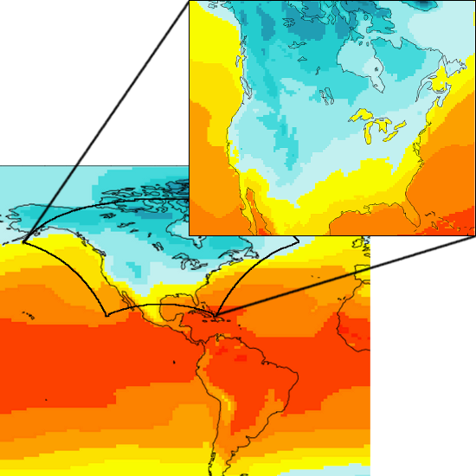
NARCCAP: North American Regional Climate Change Assessment Program
Nest high-res* regional models (RCMs) inside coarser global models (GCMs) over N. America
*50 km gridcells

Slide 16
Goals
Evaluate model performance and uncertainty
Generate high-res climate change scenario data for impacts analysis
Support further dynamical downscaling experiments

Slide 17
6 RCM Modeling Teams
CRCM - S. Biner, OURANOS
ECP2 - A. Nunes, Scripps
HRM3 - R. Jones, et al, Hadley Centre
MM5I - B. Gutowski, R. Arritt, ISU
RCM3 - M. Snyder, UC Santa Cruz
WRFG - R. Leung, PNNL
Details: narccap.ucar.edu/data/rcm-characteristics.html

Slide 18
Phase I: NCEP
Drive RCMs with NCEP-2 Reanalysis
Reanalysis: NWP with data assimilation
estimate of historic state of atmosphere
as close as we can come to “observations”
25 years: 1980-2004 (1 year of spin-up)

Slide 19
Phase II: Downscaling GCMs
4 GCMs: CCSM, CGCM3, GFDL, HadCM3
Two 30-year runs, current (1971-2000) and future (2041-2070). 3 years spin-up
SRES A2 emissions scenario for future run
narccap.ucar.edu/about/aogcms.html

Slide 20
Timeslice Experiments
Run GCM globally at ~50 km resolution but without the ocean model.
Historical run: Use observed SST
Scenario run: Observed SST + delta based on corresponding coarse AOGCM
2 models: GFDL, CCSM (aka CAM3)
Same time coverage as GCM-driven runs

Slide 21
Simulations
 | NCEP | CCSM | CGCM3 | GFDL | HadCM3
CRCM | done | done | done
ECP2 | done |  |  | done | setup
HRM3 | done |  |  | done | done
MM5I | done | done |  |  | running
RCM3 | done |  | done | done
WRFG | done | done | done
TMSL |  | done |  | done

Slide 22
Data Archive
Data distribution: earthsystemgrid.org
Organization: RCM → Driver → Table
1 variable per file, 5 years per file*
* (except at beginning of run)
Filenames: Var_Model_Driver_Time.nc
Time = yyyymmddhh of first timestep
http://narccap.ucar.edu/data/output_archive.html

Slide 23
Data Tables
Table 1: daily values (e.g. Tmin & Tmax)
Table 2: “big 7” variables for impacts:
temp, prec, pressure, wind, sun, humidity
Table 3: all the other 2-D variables
Table 4: static (unchanging) variables
Not on ESG! narccap.ucar.edu/data/table4
Table 5: all 3-D variables

Slide 24
Acquiring Data
1) Register!
2) Figure out what variables you want
3) Check Data Status Page
3) Login to ESG
4) Drill down from NARCCAP page
5) Authenticate
6) Download data
[demo]

Slide 25
Looking Into the Future
No crystal balls
Scenarios, not forecasts
Look at current and future
No “best” model
Look at multiple models
Embrace uncertainty

Slide 26
Fiddly Details
3 main issues:
Time
Missing Data
Map Projections
Also lots and lots of information on the website. Check “About NARCCAP” and “About Data” in particular.

Slide 27
Time
GCM runs don’t use standard (Gregorian) calendar! 365-day (“noleap”) or 360-day
Don’t use spin-up! (It’s for model analysis)
Check units – “days since”
If possible, don’t count timesteps – use dates
CCSM-current ends in 1999
Run | Rec. Start | Rec. End
NCEP | 1979/12/01 | 2004/11/30
GCM Current | 1970/12/01 | 2000/11/30
GCM Future | 2040/12/01 | 2070/11/30

Slide 28
Missing Data
Variety of causes: late start / early end, problems with model output or postproc
missing_value or _FillValue = 1e+20f
Listings of known missing timesteps:
http://www.narccap.ucar.edu/data/missing/

Slide 29
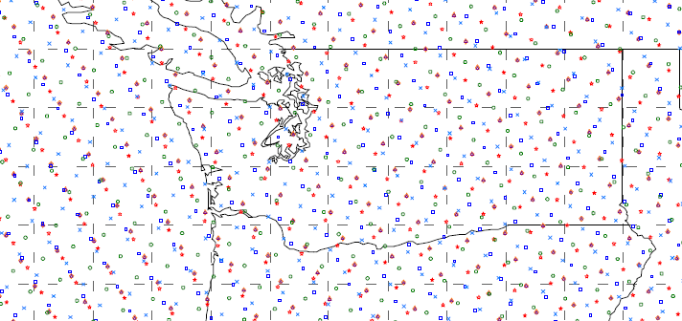
Map Projections
Earth is round; model arrays are square
This is highly inconvenient
GCMs use lat-lon grids
RCMs use projected coordinate systems:

Slide 30
Map Projections 2
NARCCAP X/Y dimensions: xc, yc
2-D lat & lon arrays in each file
Projection parameters in each file: see grid_mapping attribute on data variable
CRCM | Polar Stereographic
ECP2 | Polar Stereographic
HRM3 | Rotated Pole
MM5I | Lambert Conformal
RCM3 | Transverse Mercator
WRFG | Lambert Conformal

Slide 31
Extracting Data
Unix/OSX: ncdump, NCO, NCL, CDAT
ncks -d xc,22,25 -d yc,45,450 -d time,"1986-06-01 00:00","1986-09-01 00:00" in.nc out.nc; ncdump -v tas out.n | sed …
Windows: FAN – see ASCII Howto
Other options: IDL, Matlab, R, Python...
[demo]

Slide 32
Citation
When publishing results using NARCCAP data, please cite the dataset itself, in addition to papers about NARCCAP
Mearns, L.O., et al., 2007, updated 2011. The North American Regional Climate Change Assessment Program dataset, National Center for Atmospheric Research Earth System Grid data portal, Boulder, CO. Data downloaded 2012-04-11.
[http://www.earthsystemgrid.org/project/NARCCAP.html]

Slide 33
Other Details
ECPC→ECP2, WRFP→WRFG
RCM3 reruns and other caveats
User Directory
Papers, Presentations, Software
Acknowledgements
Analysis and Results

Slide 34
Software
http://nco.sourceforge.net/
http://www.narccap.ucar.edu/contrib/tools/
util/: shellscripts using NCO
ncl/: NCL scripts for plotting, file manip
R/: interpolation using thin-plate-spline

Slide 35
GIS
Import directly into ArcMAP 9+ using the multidimension toolbox
Instructions on website
Can’t import HRM3 yet – doesn’t understand map projection
Datum is ill-defined; use WGS84 probably
Do averaging, subsetting, etc outside Arc

Slide 36
array[-1]

