Slide 1
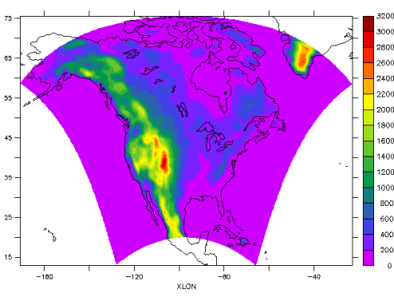
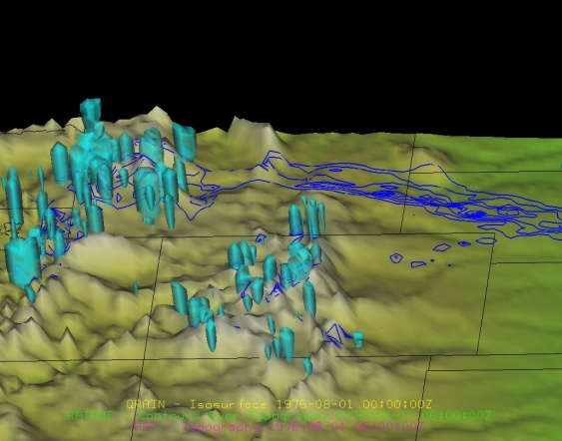
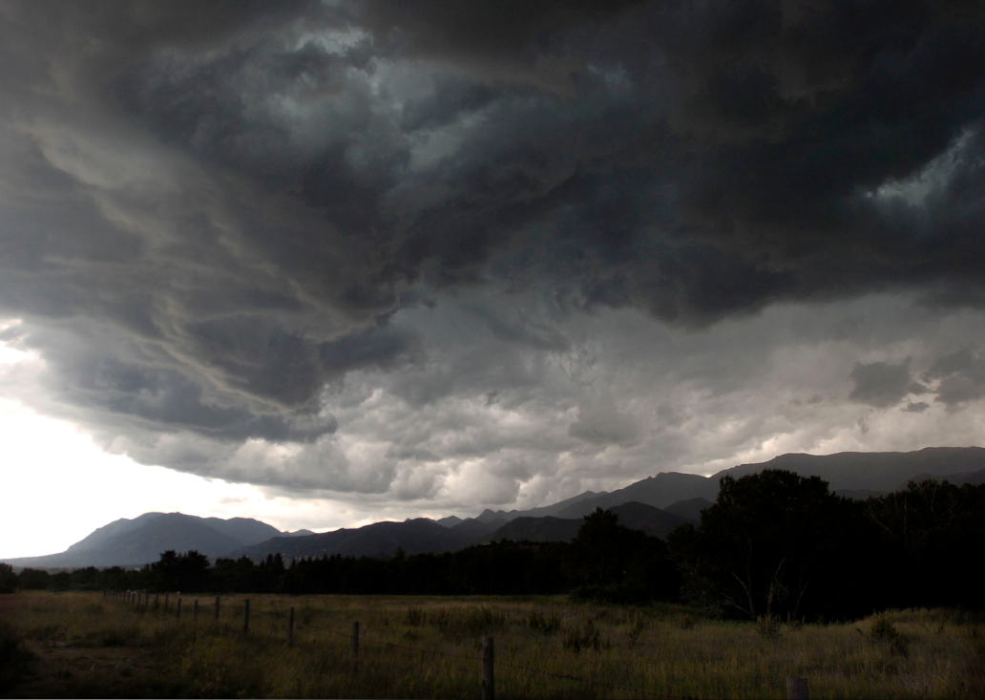
Dynamical downscaling of NARCCAP using WRF:
High-resolution simulations of extreme precipitation events in three NARCCAP climate experiments
Kelly Mahoney
Michael Alexander, Jamie Scott, Joe Barsugli
NARCCAP User’s Workshop
April 11 2012

Slide 2
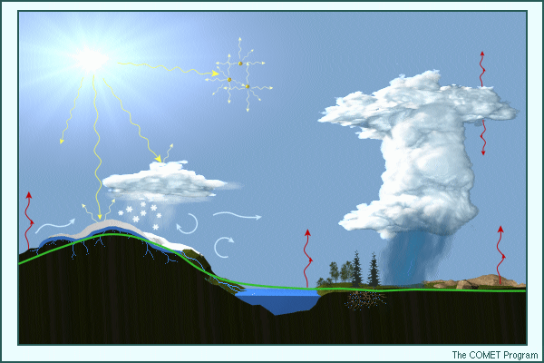
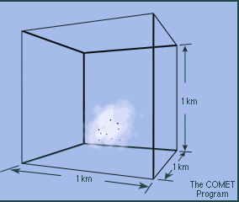
Motivation: Why downscale extreme precipitation?
Extreme precipitation events generally predicted to increase with warming climate…but why, when, where, and by how much?
Global climate models not suited for simulation of extreme precipitation (resolution, parameterizations)
Regional climate models often still too coarse, use CP schemes
Projections, predictions most valuable at local, “weather” scales to users (public, planners) (especially in mountainous, complex terrain)
Physical processes to be represented by a model
“It is likely that the frequency of heavy precipitation or the proportion of total rainfall from heavy falls will increase in the 21st century over many areas of the globe.”
Precipitation forming in a 1-km gridbox
IPCC (2012)

Slide 3
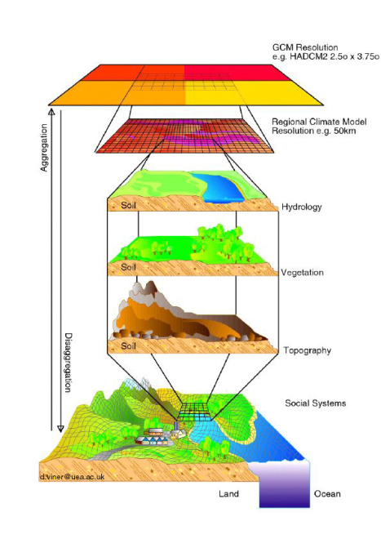
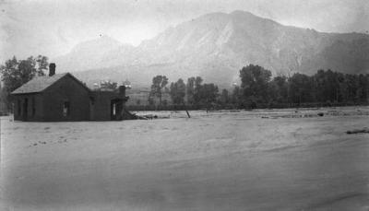
Research objectives
Use high-resolution dynamical downscaling to address:
Do elevation thresholds for storms, flooding, hail change in future scenarios?
Which storm-scale physical processes are most affected by changes in large-scale climate? (e.g., updraft strength, precipitation efficiency, entrainment?)
What are the strengths, limitations of various dynamical downscaling approaches?
What is the “best” way to downscale climate extremes?
Space, time scales required? Statistical significance of limited case sample size?
Research- and decision-making communities:
Improved understanding of strengths, limitations of downscaling approaches → inform selection of most appropriate approach to specific problem
Regional dynamical downscaling
Water Street (now Canyon Blvd.) in Boulder, CO during 1894 flood
Denver Public Library
Canadian Climate Change Scenarios Network

Slide 4
Outline
Methodology
3 different approaches: Overview
1 approach; 3 different NARCCAP models
Results
The “Good”
The “Bad”
The Confusing
Challenges & What’s next?

Slide 5
Methodology: Overview
Select extreme cases from regional climate model data
Create initial conditions for WRF simulations
Execute high-resolution simulations
Compare past, future high-resolution simulations
50-km gridspacing…………1-km gridspacing

Slide 6
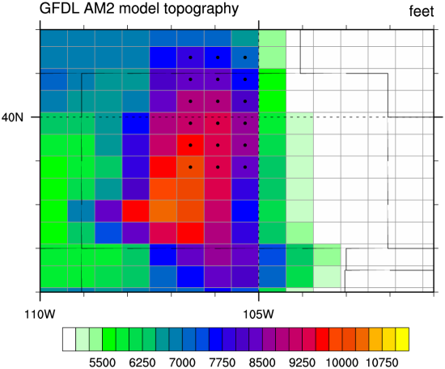
Methodology
NARCCAP: North American Regional Climate Change Assessment Program
Initial, boundary conditions from 20th, 21st century AOGCM experiments
GFDL-timeslice, CCSM-WRF, CGCM3-RCM3
Extreme event selection:
Target region: Colorado Front Range
For past (1971-2000), future (2041-2070) simulations:
Sort all warm-season (June-July-August) daily precipitation values in target region
10 largest precipitation values ≈ Top 0.3% of events
Limited QC, but did remove spin-up storms, obviously unrealistic cases (e.g., 10²⁰ mm/day)
Colorado
Target region

Slide 7
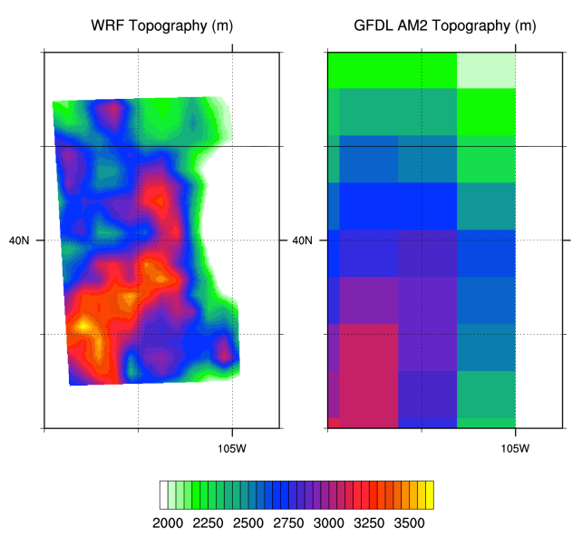
WRF runs: Model set-up
WRFV3.1
4km outer domain: 450x450 gridpoints
1.33 km inner domain: 574x601 gridpoints
Hourly output for 24-h
Parameterizations:
WSM6 microphysics
YSU Planetary Boundary Layer scheme
RRTM, Dudhia LW/SW radiation physics
Noah land surface model (4-layers)
Initial conditions for runs shown here:
GFDL – “Timeslice”
CCSM-WRFG
CGCM3-RCM3 (done-ish)
Domain 1 (4-km)
Domain 2 (1.3-km)
WRF
GFDL
Topography over target region (m)

Slide 8
WRF runs: Initial conditions
3 NARCCAP models downscaled
GFDL – “Timeslice”
CCSM-WRFG
CGCM3-RCM3
Over Colorado:
RCM3-CGCM3
RCM3-CGCM3
GFDL-timeslices
GFDL-timeslices
GFDL-timeslices
CCSM-WRFG
RCM3-CGCM3
CCSM-WRFG
CCSM-WRFG

Slide 9
Results
The “Good”
The “Bad”
The Confusing

Slide 10
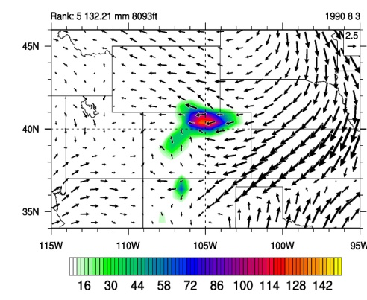
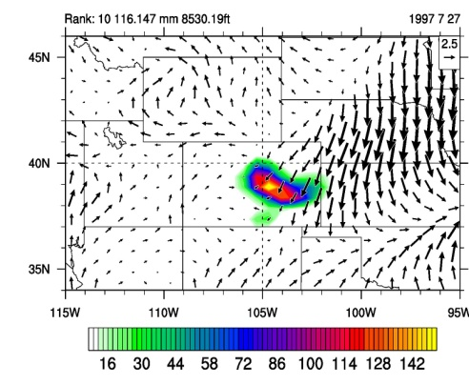
As seen at 50-km regional climate scale (GFDL-Timeslices experiment): Top 10 Past vs. Top 10 Future Events
Past Top 10
1
2
3
4
5
Target region
CO
WRF model domain
6
7
8
9
10
Future Top 10
Total precipitation/24h (mm, shaded), surface winds (vectors)
1
2
3
4
5
WRF model domain
6
7
8
9
10

Slide 11
Top 10 Past vs. Top 10 future: WRF
1
2
3
4
5
TR
Past Top 10
6
7
8
9
10
 | Whole domain (Average of all 10 cases)
 | Average precipitation (mm/24h) | Maximum gridpoint precipitation (mm/24h)
PAST | 5.1 | 125
FUTURE | 9.3 | 207
Total precipitation/24h (mm, shaded)
1
2
3
4
5
TR
Future Top 10
6
7
8
9
10
Total precipitation/24h (mm, shaded)

Slide 12
Changes in hail?
Past
(GFDL-timeslices)
Future
(GFDL-timeslices)
What happens to surface hail?
Average accumulated surface graupel/hail fields in Top 10 past vs. Top 10 future individual cases for 3 RCM combinations
Event-total (24-h) surface hail
Event-total (24-h) surface hail
Past
(WRF-CCSM)
Future
(WRF-CCSM)
Event-total (24-h) surface hail
Event-total (24-h) surface hail
Past
(CGCM3-RCM3)
Future
(CGCM3-RCM3)
Event-total (24-h) surface hail
Event-total (24-h) surface hail

Slide 13
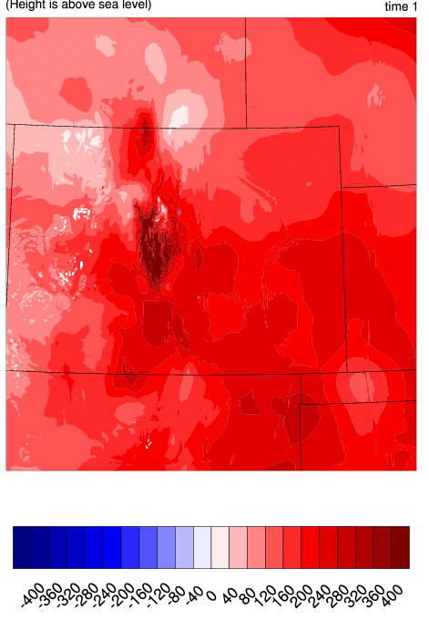
Changes in hail?
Changes in melting-level height:
> 400m (1300 ft) over high terrain
Height of melting level increases in future (~400 m difference) → decreases hail found at surface through increased melting
Caveats:
Sensitivity to model cloud physics parameterization
Our approach focuses on small (i.e., non-damaging) hail at high-elevation locations
Results mostly likely not relevant to hail-producing thunderstorms in other regions (especially the US Midwest/Great Plains!)
Changes in melting level height (m)
Yet: A robust change in physical process identified (we’ll call it “good”)!
Mahoney, K. M., M. A. Alexander, G. Thompson, J. J. Barsugli, and J. D. Scott, 2012: Changes in hail and flood risk in high-resolution simulations over Colorado’s mountains. Nature Climate Change. 10 January 2012 | DOI: 10.1038/NCLIMATE1344

Slide 14
Results
The “Good”
The “Bad”
The Confusing
2 examples:
Too many “dud” cases (CGCM3-RCM3)
Large model comparison differences

Slide 15
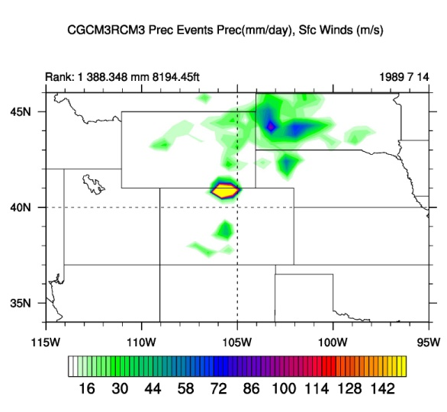
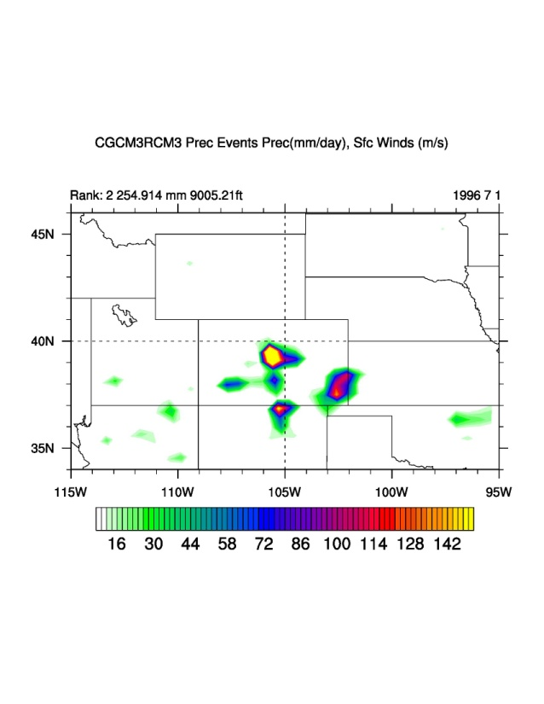
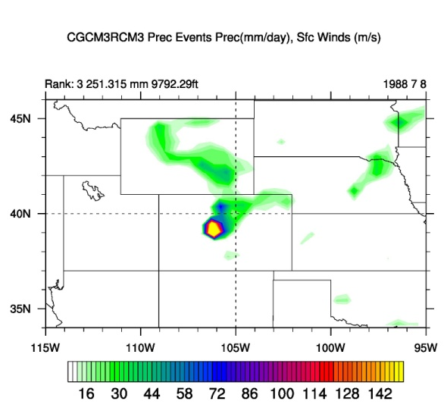
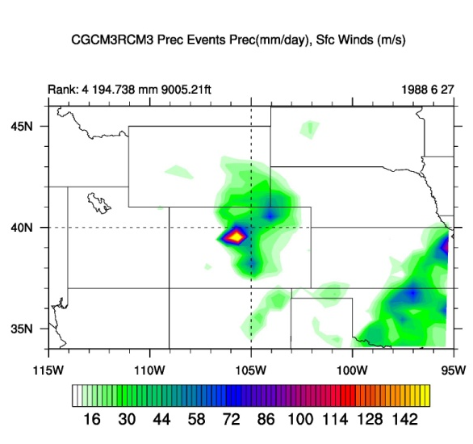
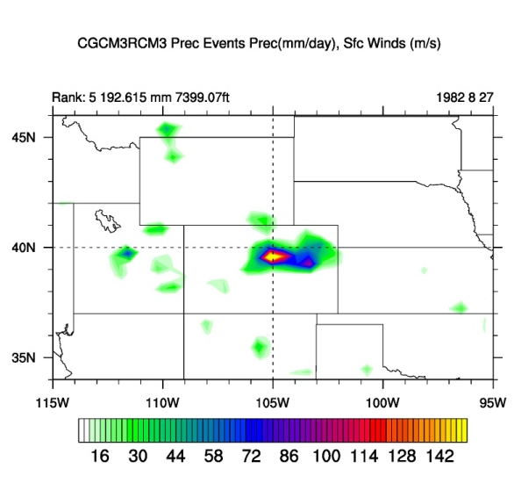
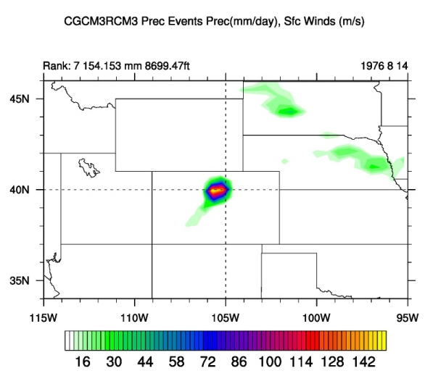
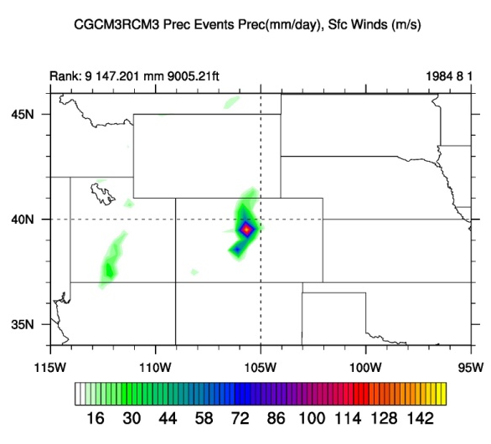
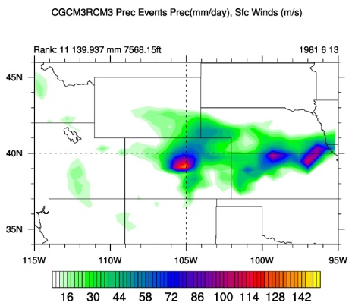
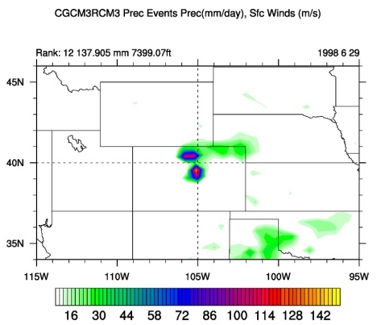
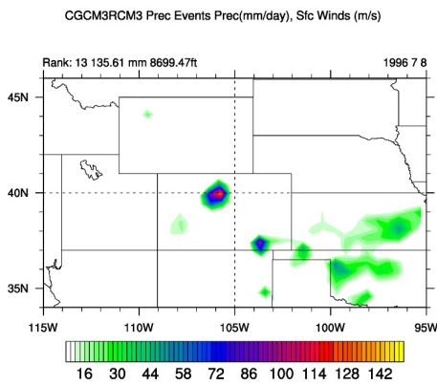
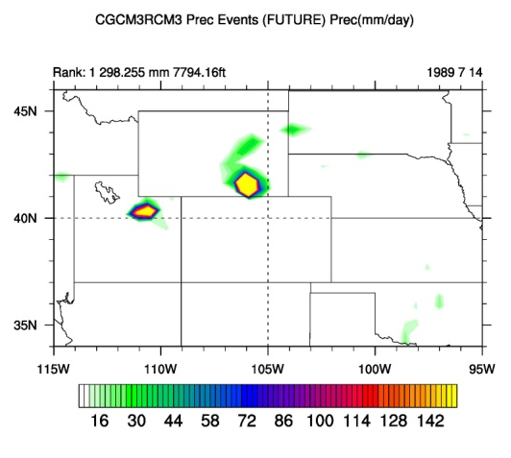
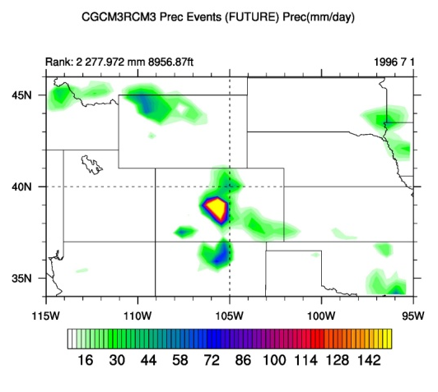
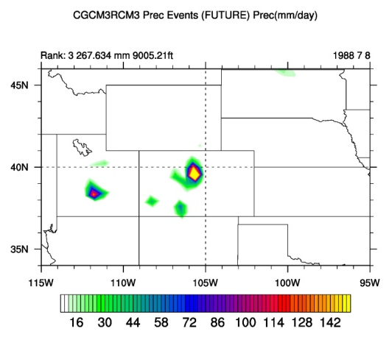
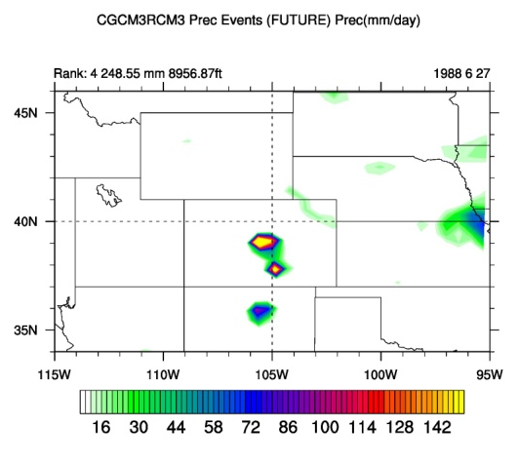
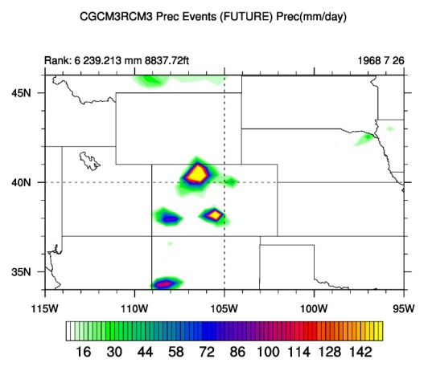
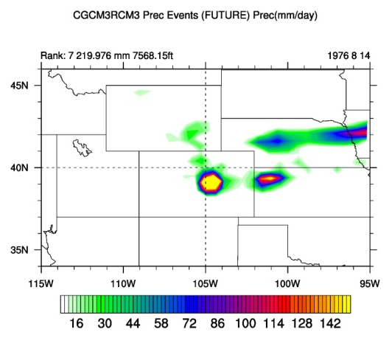
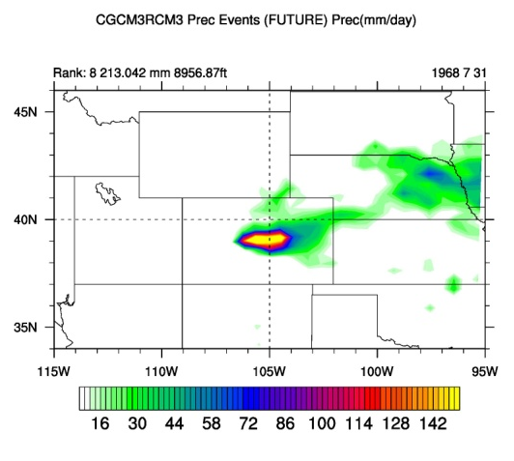
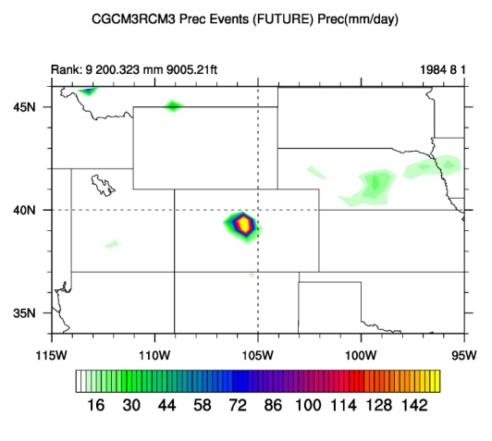
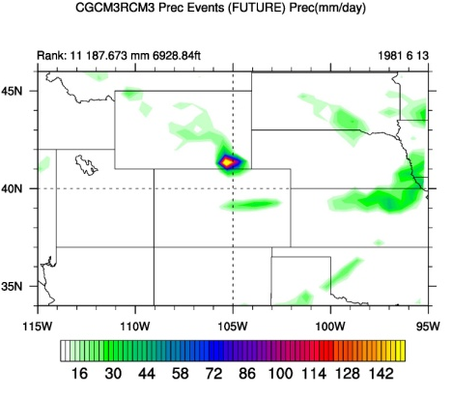
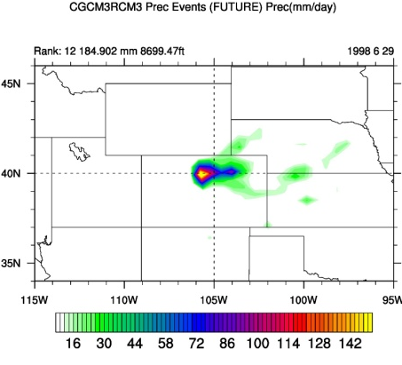
CGCM3-RCM3 Top 10 Past, Future Events
Past
1
2
3
4
5
6
7
8
9
10
Future
1
2
3
4
5
6
7
8
9
10

Slide 16
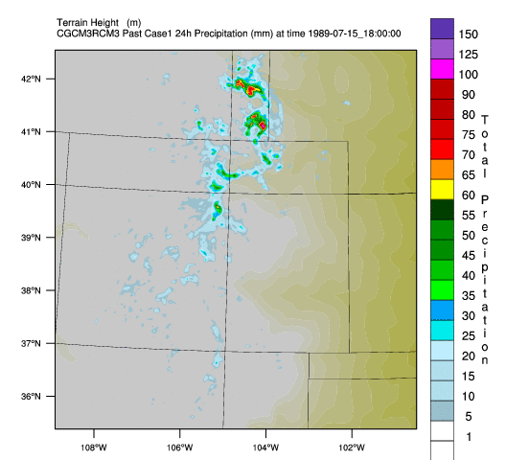
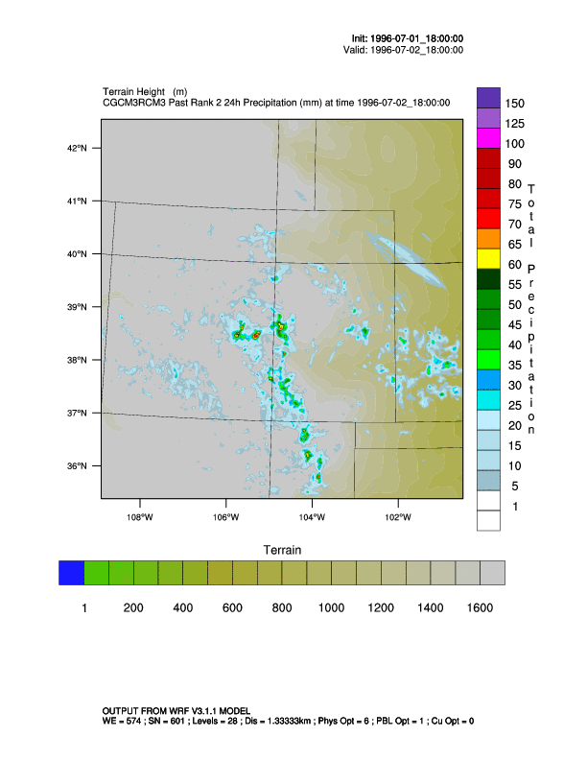
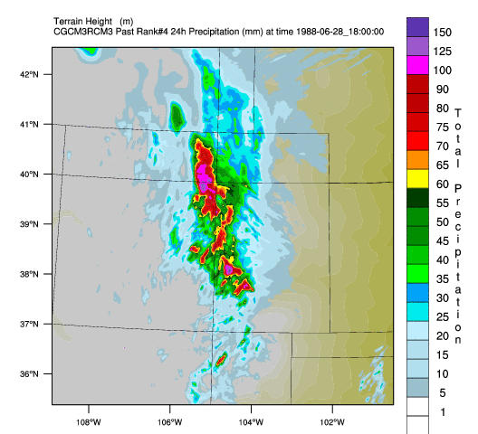
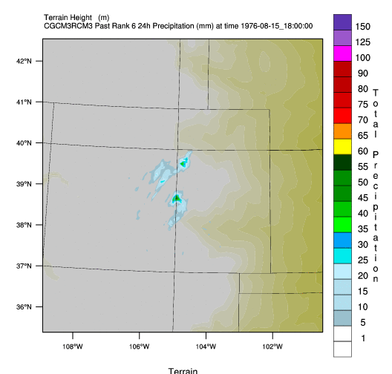
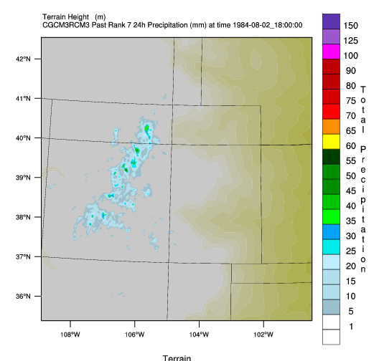
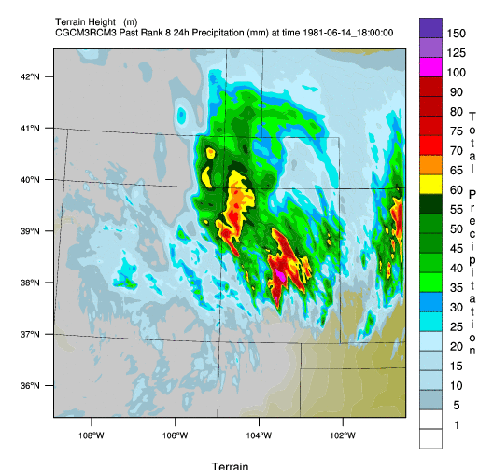
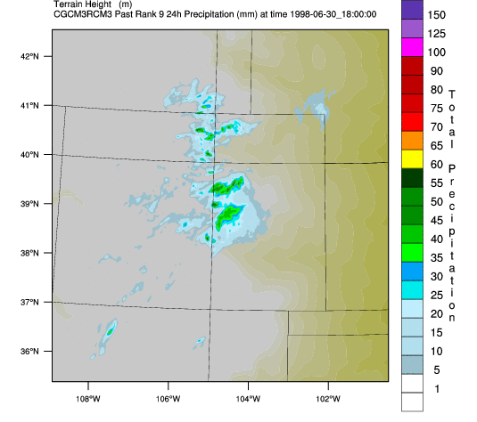
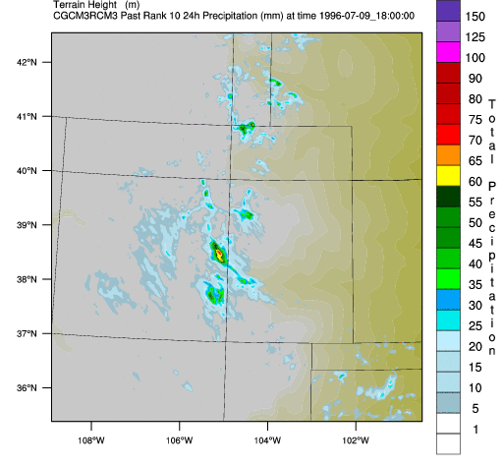
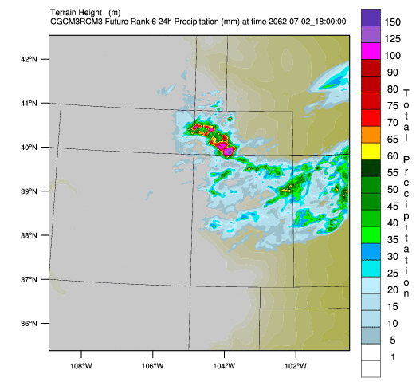
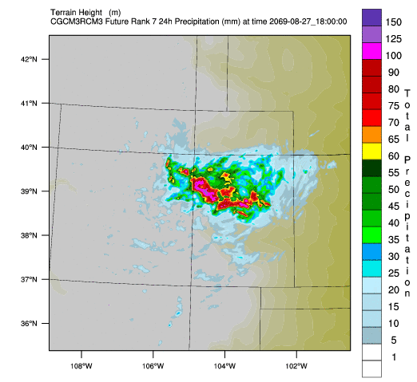
WRF-downscaled CGCM3-RCM3 Top 10 Past, Future Events
1
2
3
4
5
Past
6
7
8
9
10
Future
2
3
4
5
1
6
7
8
9
10

Slide 17
WRF-downscaled CGCM3-RCM3 Top 10 Past, Future Events
1
2
3
4
5
Past
DUD
6
7
8
9
10
DUD
DUD
DUD
DUD
If (nominally) every case with less than 2mm precipitation/24h averaged over domain is a “dud”, then…
Future
2
3
4
5
1
DUD
DUD
DUD
Over half of the cases are “duds”
(and 2mm is probably a conservative definition!)
6
7
8
9
10
DUD
DUD

Slide 18
The “Bad” Reality: 3-model average and max precip comparisons
WRF 1-km Top 10 events from GFDL-ts:
WRF 1-km Top 10 events from WRF-CCSM:
WRF 1-km Top 10 events from CGCM3-RCM3:
 | Whole domain (Average of all 10 cases)
 | Average precip (mm/24h) | Maximum precip (mm/24h)
PAST | 5.1 | 125
FUT | 9.3 | 207
 | Whole domain (Average of all 10 cases)
 | Average precip (mm/24h) | Maximum precip (mm/24h)
PAST | 6.1 | 101
FUT | 4.0 | 103
 | Whole domain (Average of all 10 cases)
 | Average precip (mm/24h) | Maximum precip (mm/24h)
PAST | 3.9 | 100.7
FUT | 2.1 | 80.1
GFDL-Timeslices
WRF-CCSM
CGCM3-RCM3
Large increases from past → future
Small changes from past → future
Moderate decreases from past → future*
* So many duds, signal determined by a few (4-5) cases
3 models downscaled…3 different “answers”
While there is much more analysis that we can do here…
Has our “enhanced detail” only enhanced our number of questions?

Slide 19
How do NARCCAP RCM projections of extremes compare with the high-res downscaled version of the same cases?
21c – 20c Top 10 Cases Avg precip
(NARCCAP)
21c – 20c Top 10 Cases Avg precip
(WRF)
NARCCAP: GFDL-timeslices
WRF: GFDL-timeslices
NARCCAP: CCSM-WRFG
WRF: CCSM-WRFG
NARCCAP: CGCM3-RCM3
WRF: CGCM3-RCM3

Slide 20
Results
The “Good”
The “Bad”
The Confusing…

Slide 21
The Confusing
The “duds”: What are RCM CP schemes/precipitation processes “convecting on” that high-resolution model isn’t?
Statistical significance of results in general…but especially when significant subset of “extreme” cases in the RCM are weak in high-resolution runs?
Example of CGCM3-RCM3 dud case:

Slide 22
Example of “dud” case mystery
CGCM3-RCM3
Past Rank #2:
RCM:
255mm precip/ 24h
WRF high-res:
77mm max
(but only in very small location)
We’ve got CAPE (1500+), we’ve got moisture (PW > 25mm), we’ve got upslope flow from surface - ~700mb
Is it a systematic problem that would be of scientific value to understand, or is it a different, inconsistent issue for each individual case?

Slide 23
The Confusing/What’s next
Going forward, we can/should/could:
Investigate the underbellies of the RCM convective/gridscale precipitation production
Consider not choosing cases based on RCM precip, and instead focus on other environmental quantities (e.g., moisture flux, easterly/upslope flow, CAPE, etc?)
Reconsider methodology in general?

Slide 24
Three different downscaling methodologies (quick overview)
Individual simulations
Composite-initialized simulations
Delta method/“PGW”/climate-perturbed simulations of observed extreme event
2. Composite approach
1. Individual simulations: Comparison of top 10 past individual events vs. top 10 future individual events
3. Big Thompson Canyon Flood in “GFDL-TS Future”
24h total precip (mm)
Notes:
Limited in what we can do in case study approach – limited model projections, limited # of cases

Slide 25
Logistical Downscaling Challenges
NARCCAP output not designed for WRF input: construction of initial conditions complex, highly-nuanced, time-consuming
WRF ingest of initial conditions nuanced: e.g., interpolation from RCM surface to higher-resolution surface can affect results
Input data incongruities create challenges
Differences in data organization makes dynamical downscaling very challenging (e.g., different vertical coordinates, map projections, calendars, fields provided) → reinventing (13+ step) process each time
Data errors: “GIGO” (e.g., RCM3 zg500, WRFG SLP)
Unrealistic cases (spin-up storms, unphysical precipitation) throw off case selection, analysis of extremes, e.g.,
WRF-CCSM: has several days with 10²⁰ mm of precip
CGCM3-RCM3 produces (very) large precip maxima – real?
Discuss more in Topic Pod breakouts?

Slide 26
Summary
High-resolution simulations offer insight into past, future extreme events: spatial/temporal detail, assessment of storm-scale physical processes
But…added complexity also yields…more complexity! (interpretation, compounding of errors, etc., …)
Preliminary results (GFDL-timeslices, WRF-CCSM) might suggest:
More or equally intense precipitation extremes in future even when overall precipitation decreases (for the CO Front Range in 3 specific future climate experiments) (CGCM3-RCM3 cases likely too “dud”-filled to include)
Potential for changes in small hail amount/hail size distribution at surface due to sub-cloud melting (all models)
High-resolution methodologies likely offer value for specific, carefully thought-out purposes.
Developmental nature of regional climate model input → limited (direct) use of downscaled simulations for certain practical (e.g., planning, decision-making) purposes…
But for testing hypotheses, assessing physical process changes, etc., promising potential
Avg difference (Future – Past) of high-res downscaled Top 10 events
(red/orange = drier in future; blue/green = wetter in future)
GFDL-Timeslice
CCSM-WRF
CGCM3-RCM3

Slide 27
Acknowledgments
US Bureau of Reclamation:
Victoria Sankovich, Levi Brekke, Jason Caldwell, Dave Raff, Chuck Hennig, John England
Greg Thompson (NCAR)
NOAA ESRL High-Performance Computing System
NARCCAP Project (NCAR)
UCAR/CLIVAR/PACE program
Western Water Assessment (WWA)
NCAR, National Science Foundation for WRF, NCL
Unidata (UCAR) for IDV, GEMPAK
Contact:
Kelly Mahoney
kelly.mahoney@noaa.gov

