Slide 1


Analyzing Global Warming on Linear Infrastructure using NARCCAP data sets: A Case Study in the Northeastern U.S.
What are the IMPACTS of Climate Change on Asphalt Concrete Pavements?
Jennifer Jacobs Ph.D., P.E.
William C. Meagher III
Jo Sias Daniel Ph.D., P.E.
Ernst Linder Ph.D.
Notes:
The IPCC attributes the observed pattern of change to the influence of anthropogenic forcing.
Consequently, much effort has been focused on understanding the contribution of road transportation to the emissions of greenhouse gases.
To date, little has been put forth to understand the implications of climate change of the design and performance of the road infrastructure.
The only quantitative analyses of climate change impacts to pavement performance have been conducted by Mill et al. for southern Canada
Close to 3000 climate change and impact studies annually – one paper on roads.

Slide 2
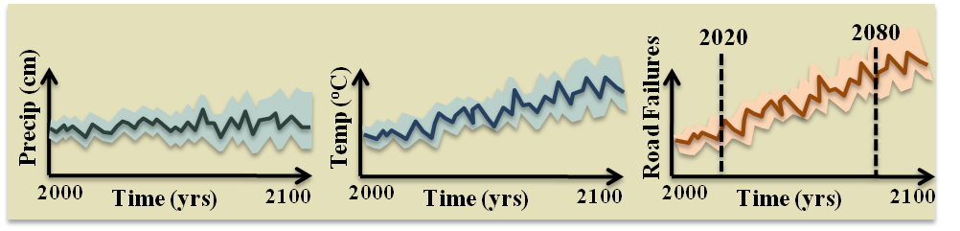
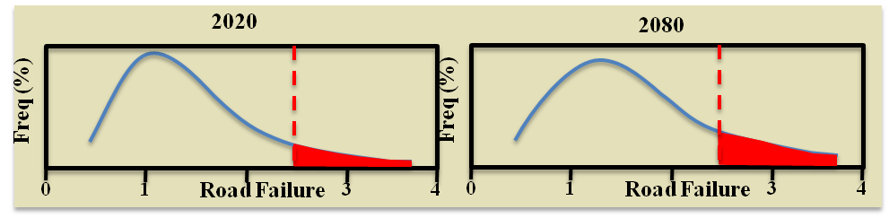
System Uncertainty Propagation Framework
Failure Threshold
Failure Threshold
2

Slide 3
Motivation & Implications
The U.S. spends nearly $200,000,000 per day building and rebuilding roads
Driving delays are expected to waste 7.3 billion gallons of fuel per year over the next two decades, increasing travelers’ costs by $41,000,000,000, and add 73 million tons of carbon dioxide to the atmosphere.
Climate is an important consideration in three major road deterioration processes: thermal cracking, frost heave and thaw weakening, and rutting.
Almost no literature exists to guide roadway design in light of climate change (Mills et al. 2007; Meagher et al. 2012)
Notes:
Best estimates of global average annual temperature increase from 3.2 to 7 degree Fahrenheit.
Increase in hot days & heat waves
Potential increase in rutting & the migration of liquid asphalt
Increase in precipitation volume & intensity
Potential increase in soil moisture, therefore lowering the strength of unbound layers
Later onset of seasonal freeze & earlier thaw
Potential increase in freeze-thaw conditions
The Intergovernmental Panel on Climate Change (IPCC) attributes the observed pattern of change to the influence of anthropogenic forcing, stating that it is very likely that greenhouse gases caused the warming globally over the last 50 years. Consequently, much effort has been focused on understanding the contribution of road transportation and construction to the emissions of greenhouse gases. Little research has been put forth to date to understand the implications of climate change on the performance and design of the road infrastructure. The only quantitative analyses of climate change impacts on pavement performance have been conducted by Mills et al. (2007a, 2007b).

Slide 4
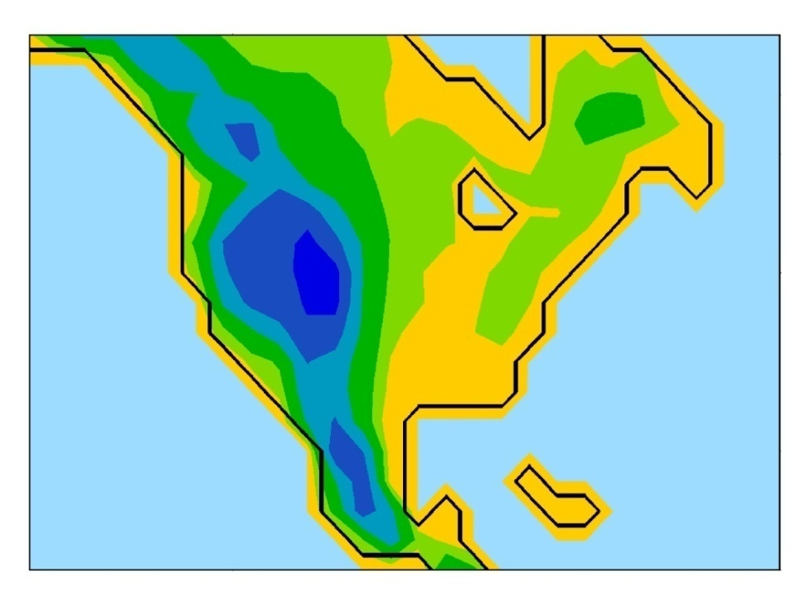
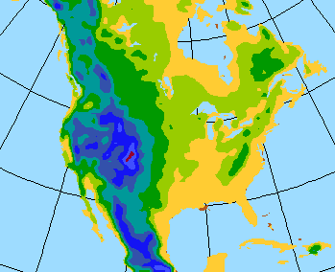
Q. Why NARCCAP? A. RCM Datasets
Source: http://www.narccap.ucar.edu
Spatial Resolution
~ 50 x 50 km pixels
North America
Temporal Resolution
Current : 1970 – 2000
Future: 2040 – 2070
30 to 100 Year Records
3-Hourly, Daily, & Weekly
Notes:
Dynamic downscaling uses GCM as boundary conditions to drive a higher-resolution regional model
North America at typical global climate model resolution
Hadley Centre AOGCM (HadCM3), 2.5˚ (lat) x 3.75˚ (lon), ~ 280 km
North America at 50 km grid spacing

Slide 5
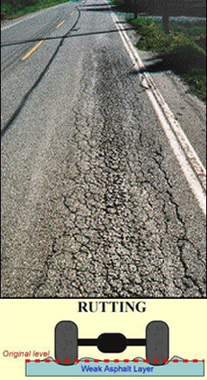
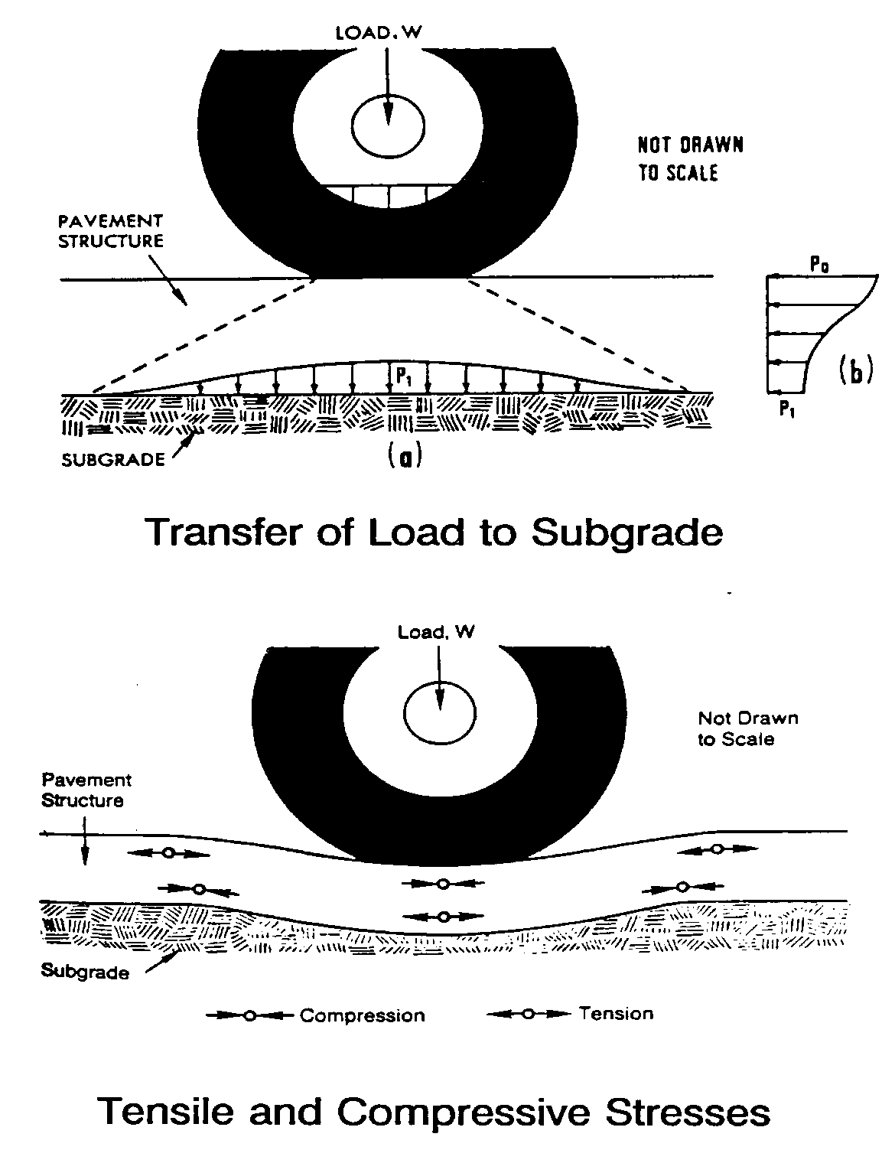

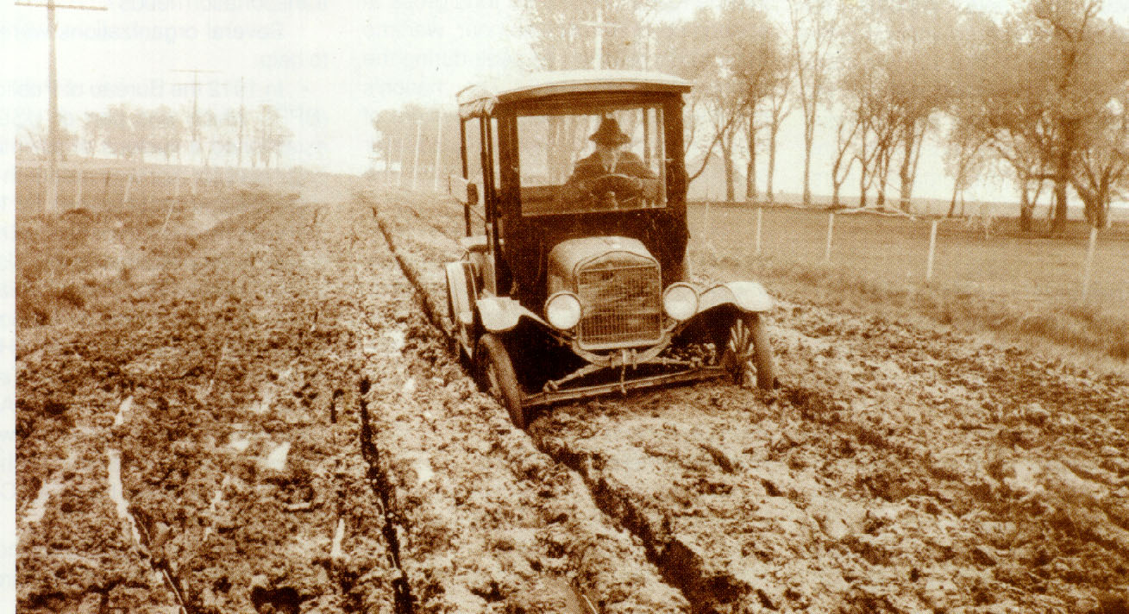
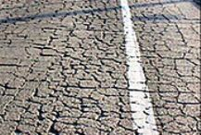
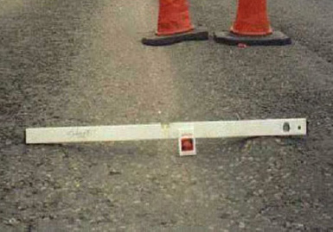
Pavements 101
5
Notes:
Visco-elasto-plastic
Takes time to respond, permanent deformation
Response function of loading rate & temperature
Stiff at fast loading/low temperature
Soft at slow loading /high temperature
Complex chemistry
Large hydrocarbon molecules
Dependent upon crude source & refining
Oxidize with time – become more polar
Associate/dissociate with load & temperature
Properties constantly changing
5

Slide 6
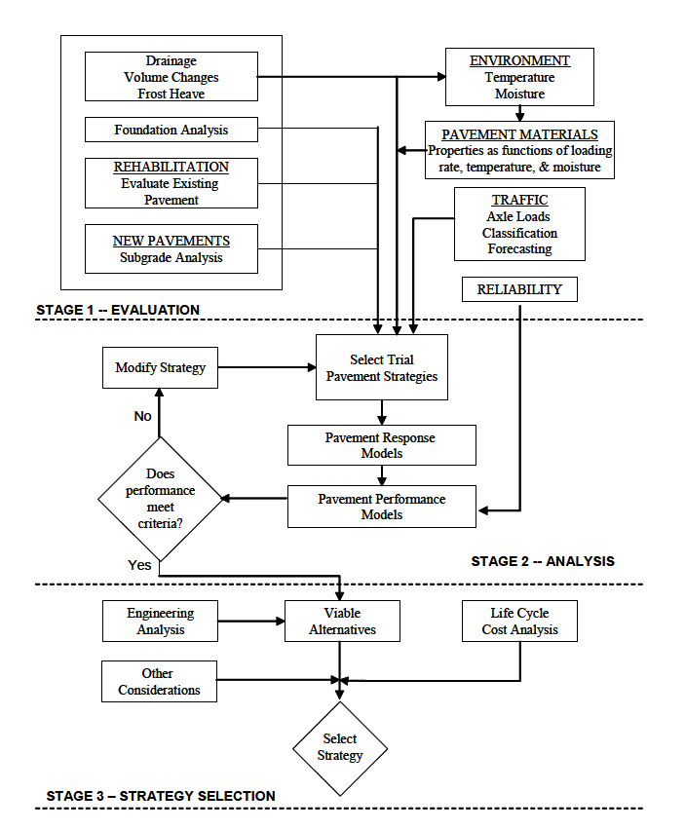
Pavement Design Mechanistic-Empirical Pavement Design Guide (M-E PDG)
Mechanistic modeling based on material behavior including:
the relationship between stress and strain,
the time dependency of strain under constant stress, and
the ability of the material to recover strain after stress removal.
The “empirical” approaches are:
characterization of materials and traffic
relation of stresses and strains to observed damage (field performance)
Source: Mechanistic-Empirical Pavement Design Guide
Notes:
Traditional Design Based on Limited Empirical Performance Equations Developed in the 1950’s AASHTO Road Test
The term “mechanistic” describes an approach of explaining phenomena in purely physical or deterministic terms. This is at its’ core the principles of engineering mechanics. For the mechanistic approach three material behavioral response characteristics are considered in the Design Guide. They are the relationship between stress and strain, the time dependency of strain under constant stress, and the ability of the material to recover strain after stress removal. The “empirical” approach, which is based on observation and experiment, of the Design Guide is of two parts. The first relates to the characterization of materials and also to inputs of the design process of the environment and traffic. The second is the relation of field performance data correlated to accumulated damage.

Slide 7
Pavement Model Considerations Materials, traffic, & the environment
Endogenous Variables : Materials
Bound Layers
Unbound Layers
Exogenous Variables: Nonstationary Traffic
Volume and Trends
Axel Load Distribution
Exogenous Variables: Stationary Climate
Temperature, % sunshine, wind, relative humidity and precipitation
Notes:
Bound Layers inputs determine → (E*)

Slide 8
Enhanced Integrated Climatic Model (EICM)
One-dimensional coupled heat and moisture flow model consisting of:
The Climatic-Materials-Structural Model (CMS Model),
The CRREL Frost Heave and Thaw Settlement Model (CRREL Model), and
The Infiltration and Drainage Model (ID Model).
EICM output is used in structural response models to
Compute stresses, strains, and displacements
Predict pavement performance and deterioration over time
8
Notes:
Three Major Components: Climatic-Materials-Structural Model (Univ. of Illinios), CRREL Frost Heave and Thaw Settlement Model, and Infiltration & Drainage Model (Texas A&M)
Simulates changes in behavior and characteristics of pavement and subgrade materials in conjunction with climatic conditions over the design life of the pavement
Computes & Predicts: Temperature, Resilient Modulus, Adjustment Factors, Pore Water Pressure, Water Content, Frost & Thaw Depths, Frost Heave, and Drainage Performance
8

Slide 9
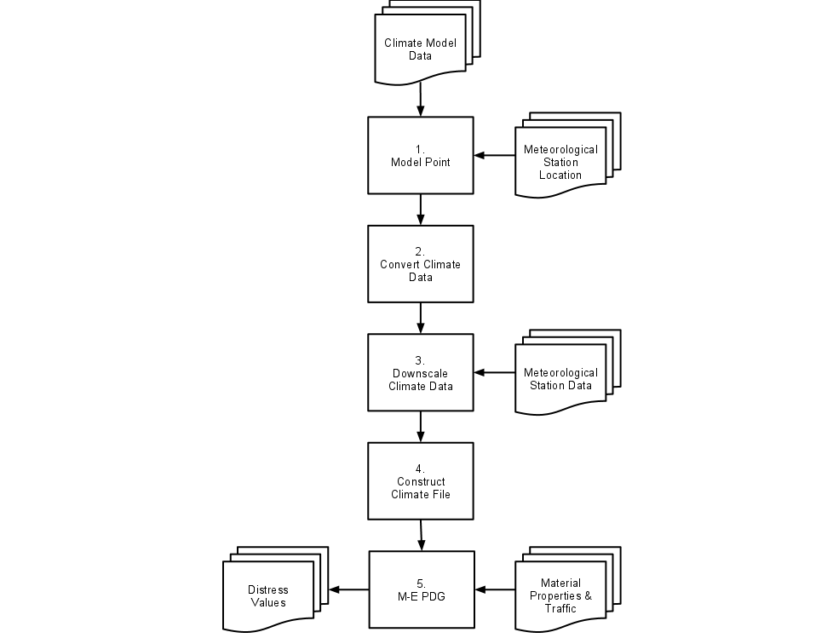
Methodology
Objectives:
Develop and Test Methodology
Apply Methodology to New England Sites
Notes:
The proposed methodology consists of a series of steps which translates the raw RCM climate datasets to data that can combined with M-E PDG climate datasets, then used with materials and traffic properties to predict distress using the M-E PDG model.
Of the four datasets, three would be used for a traditional M-E PDG analysis. The new dataset is the climate model data from an RCM model.
Of the five steps in the methodology, the first four are required to prepare the RCM dataset for use in the M-E PDG model. Thus, a traditional M-E PDG analysis would only require the fifth step presented in this methodology.

Slide 10
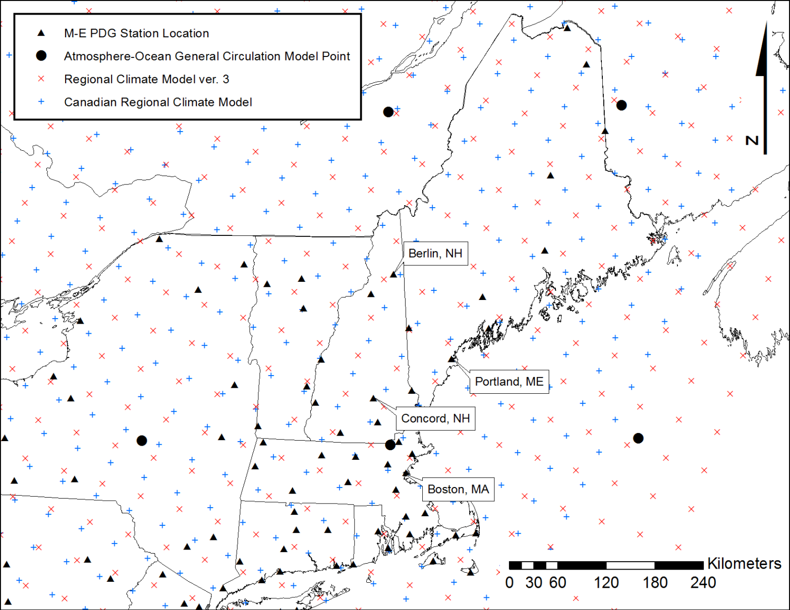
Step 1: Model Point Selection
CRCM + CGCM3: Canadian Regional Climate Model (CRCM) combined with the Canadian Global Climate Model version 3 (CGCM3) AOGCM.
RCM3 + CGCM3: Regional Climate Model version 3 (RCM3) combined with the Canadian Global Climate Model version 3 AOGCM.
RCM3 + GFDL: Regional Climate Model version 3 combined with the Geophysical Fluid Dynamics Laboratory Climate Model version 2.1 (GFDL) AOGCM
Notes:
The maximum possible overlap between RCM hindcast model and observed station data was sought; therefore limiting the selection of stations to those whose record began in 1996
Select the nearest RCM model point that is collocated with the pavement design location
A challenge to this step is that the datasets from the two collocated points must have a period of overlap between the RCM current period dataset, July 1, 1970 to June 30, 2000, and M-E PDG station record.
The earliest M-E PDG station records begin July 1, 1996 with most stations starting later

Slide 11
Step 2: Conversion of Climate Data
NARCCAP → M-E PDG
RCM Temperature (K) → Temperature (°F)
Precipitation (kg m² s⁻¹) → Precipitation (in)
Zonal + Meridional Wind Speed (m s^-2) → Wind Speed (mi h⁻¹)
Downwelling Shortwave Radiation (W m^-2) → Percent Sunshine
Specific Humidity (kg kg⁻¹) + Surface Pressure (Pa) → Rel. Humidity (%)
3-Hourly → Hourly
Notes:
Discuss Avg. versus Instantaneous Time Variables

Slide 12
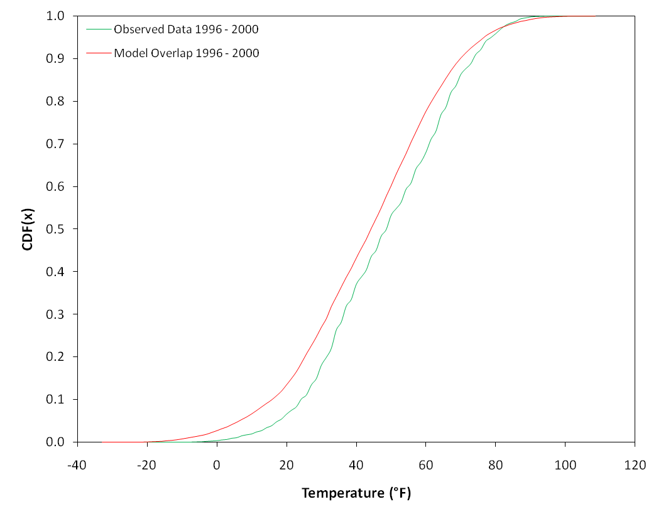
Step 3: Downscaling
Approach: Cumulative Distribution Function Transformation (CDF-t)
(Michelangeli et al., 2009)
(1)
(2)
(3)
(4)
(5)
Notes:
Fs is local-scale CDF & Fg large-scale CDF
To downscale a large-scale value xg, the basic idea of
this method is to select a local-scale value xs based on the
Assumption (See (1))
However, this method does not take into account the information on the distribution of the future modeled dataset.
CDF-t - based on the assumption that there exists a transformation T allowing to ‘‘translate’’ the CDF of a GCM variable (such as temperature, precipitation or wind intensity), i.e., the predictor, into the CDF representing the local-scale climate variable, i.e., predictand, at a given weather station
Fsh local-scale CDF Fgh Large-scale CDF
Assume me know Fgf (from GCM model)
Can approximate Fsf by applying T to Fgf
The “CDF-transformation” (CDF-t) is one method that generates local-scale variables (site-specific) from large-scale outputs
A cumulative distribution function (CDF) of the M-E PDG climate data is compared to the corresponding RCM CDF for the overlap period
CDF-t is based on the assumption that a relationship exists such that the CDF of an AOGCM+RCM (predictor) variable (e.g., temperature, precipitation) can be “transformed” into a CDF representing the local-scale variable (predictand) and that this relationship is constant with time
The CDF-t is a non-parametric method that makes no assumptions about the underlying distribution of the data

Slide 13
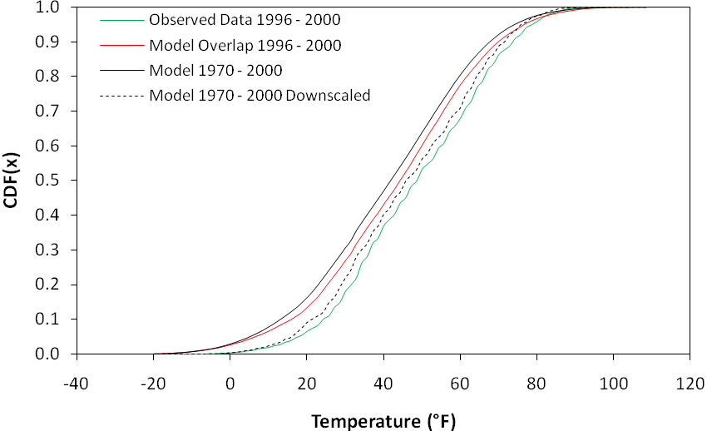
CDF-t Results Typical Historical Model Period CDF-t

Slide 14
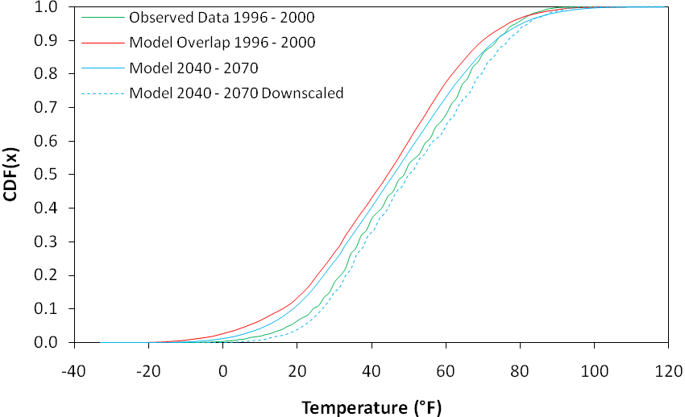
CDF-t Results Typical Future Model Period CDF-t
14
Notes:
14

Slide 15
Historical
Historical
Historical
Historical

Slide 16
Future
Future
Future
Future
Notes:
The models predict higher temperatures for much of the year, with larger differences in the spring and early summer months and minimal differences in the late summer and fall
The average annual temperature change for 10 of the 12 cases fall within the IPCC range (3.2 to 7°F) of the best estimates of global average annual temperature increase over the next century
The two cases where the annual average temperature change is lower than the IPCC estimates is the RCM3+CGCM3 scenarios for Concord, NH and Portland, ME.
However, when the model scenarios are averaged at each location, Portland, ME falls within the global average annual range and Concord, NH only falls 0.02 degrees Fahrenheit below the IPPC estimates

Slide 17
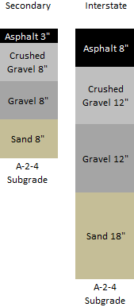
Methodology – Step 5 Execute the M-E PDG
Performance Grade Asphalt
Secondary: PG 58-28
Interstate: PG 64-28
Average Annual Daily Traffic Count
Secondary: 6,500
Interstate: 25,000
20-Year design life
1980 – 2000
2050 - 2070
Notes:
Two typical pavement structures were evaluated: secondary & interstate
Unbound material properties typical for those used by the New Hampshire Dept. of Transportation
Average Annual Daily Traffic Count w/4% compounding growth

Slide 18
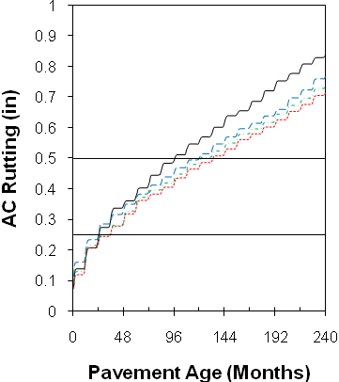
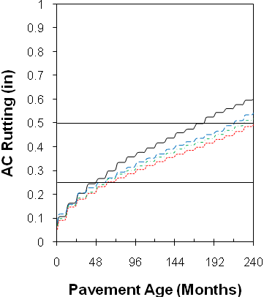
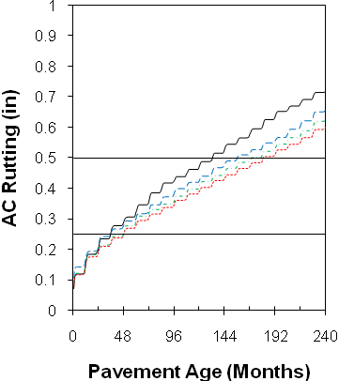
Berlin
Boston
Results Hindcast Model versus Baseline
Horizontal lines at 0.25 inch and 0.50 inch indicate acceptable levels of distress for AC rutting.
Concord
Portland
18
Notes:
The difference in alligator cracking is predicted to be less than 2.1% for both secondary and interstate pavements across all scenarios.
In 10 of the 12 secondary cases and in 5 of 12 interstate cases, alligator cracking becomes less severe under the under the future scenario.
In the cases in which cracking worsened it was less than a 1% increase.
Both coastal locations (Boston, MA and Portland, ME) exhibited an increase in interstate alligator cracking.
For all interstate cases, the GFDL AOGCM temperatures predict greater cracking than the CGCM3 AOGCM temperatures.
No pattern was evident for the secondary cases.
18

Slide 19
M-E PDG Results Hindcast Model versus Baseline
 | Alligator Cracking (%) |  | AC Rutting (in)
 | Secondary | Interstate | Secondary | Interstate
Berlin, NH (M-E PDG) | 57.0 | 8.73 | 0.927 | 0.838
CRCM+CGCM3 | 55.9 | 7.61 | 0.813 | 0.715
RCM3+CGCM3 | 55.5 | 7.68 | 0.828 | 0.736
RCM3+GFDL | 55.5 | 7.87 | 0.861 | 0.770
Boston, MA (M-E PDG) | 51.1 | 6.18 | 0.681 | 0.600
CRCM+CGCM3 | 49.8 | 5.49 | 0.577 | 0.492
RCM3+CGCM3 | 50.0 | 5.65 | 0.597 | 0.517
RCM3+GFDL | 50.0 | 5.80 | 0.623 | 0.542
Concord, NH (M-E PDG) | 56.3 | 8.62 | 0.933 | 0.900
CRCM+CGCM3 | 54.8 | 8.14 | 0.82 | 0.872
RCM3+CGCM3 | 53.9 | 8.28 | 0.848 | 0.887
RCM3+GFDL | 54.0 | 8.18 | 0.873 | 0.875
Portland, ME (M-E PDG) | 53.4 | 7.27 | 0.769 | 0.718
CRCM+CGCM3 | 53.4 | 6.68 | 0.676 | 0.601
RCM3+CGCM3 | 52.8 | 6.77 | 0.698 | 0.626
RCM3+GFDL | 52.7 | 6.93 | 0.721 | 0.659
Notes:
The CRCM+CGCM3 model scenario for the secondary cases exceeds a change of 0.1 inches in 3 of the 4 locations, the exception being Portland, ME where a change of 0.093 inches was seen.
For 4 of the 12 interstate cases a change greater than 0.1 inches was predicted. No apparent pattern was exhibited in the changes that exceeded 0.1 inches in magnitude.

Slide 20
M-E PDG Results Future Model versus Baseline
 | Alligator Cracking (%) |  | AC Rutting (in)
 | Secondary | Interstate | Secondary | Interstate
Berlin, NH (M-E PDG) | 57.0 | 8.73 | 0.927 | 0.838
CRCM+CGCM3 | 55.2 | 8.48 | 0.965 | 0.925
RCM3+CGCM3 | 55.2 | 8.60 | 0.977 | 0.934
RCM3+GFDL | 54.7 | 8.68 | 1.003 | 0.972
Boston, MA (M-E PDG) | 51.1 | 6.18 | 0.681 | 0.600
CRCM+CGCM3 | 50.0 | 6.35 | 0.738 | 0.645
RCM3+CGCM3 | 50.7 | 6.40 | 0.737 | 0.642
RCM3+GFDL | 50.8 | 6.49 | 0.753 | 0.661
Concord, NH (M-E PDG) | 56.3 | 8.62 | 0.933 | 0.900
CRCM+CGCM3 | 54.2 | 8.46 | 0.982 | 0.969
RCM3+CGCM3 | 54.6 | 8.57 | 0.994 | 0.980
RCM3+GFDL | 54.2 | 8.73 | 1.021 | 1.012
Portland, ME (M-E PDG) | 53.4 | 7.27 | 0.769 | 0.718
CRCM+CGCM3 | 53.2 | 7.45 | 0.805 | 0.760
RCM3+CGCM3 | 53.9 | 7.54 | 0.81 | 0.766
RCM3+GFDL | 53.6 | 7.67 | 0.834 | 0.792

Slide 21
Berlin, NH | Boston, MA
Concord, NH | Portland, ME
Results Future Model versus Baseline
Notes:
Increase for both secondary and interstate pavements for all locations and scenarios
The increase in AC rutting ranged from 0.036 to 0.134 inches (approximately 4-16%)
The RCM3+GFDL model scenario showed the largest change in rutting for secondary and interstate cases across all locations.

Slide 22
Berlin, NH | Boston, MA
Concord, NH | Portland, ME
Results Future Model versus Historical Model
Notes:
AC rutting is predicted to increase under the future model conditions for all cases and locations
The change is greater than 0.1 inches for each case
The difference ranges from 10.48% to 31.10%
For the secondary cases across all locations the CRCM+CGCM3 model scenario showed the largest difference from the hindcast model period
For the interstate case, 3 of the 4 locations showed the CRCM+CGCM3 model scenario with the largest difference
The RCM3+GFDL model scenario had the least difference from the hindcast period for all locations under the secondary case, while showing the least difference for 3 of the 4 locations for the interstate case.
The RCM3 RCM showed less difference than the CRCM RCM for all locations and cases

Slide 23
 | Months to Failure
 | Secondary | Interstate
Berlin, NH
CRCM+CGCM3 | -24 | -36
RCM3+CGCM3 | -24 | -26
RCM3+GFDL | -22 | -36
Boston, MA
CRCM+CGCM3 | -58 | -81
RCM3+CGCM3 | -47 | -62
RCM3+GFDL | -55 | -59
Concord, NH
CRCM+CGCM3 | -33 | -11
RCM3+CGCM3 | -23 | -2
RCM3+GFDL | -13 | -21
Portland, ME
CRCM+CGCM3 | -36 | -49
RCM3+CGCM3 | -25 | -48
RCM3+GFDL | -33 | -39
Results Future Model versus Hindcast Model Difference in Time to Distress (Future - Hindcast) in Months. Negative values indicate distress occurs earlier.
23
Notes:
The CRCM+CGCM3 model scenario for the secondary cases exceeds a change of 0.1 inches in 3 of the 4 locations, the exception being Portland, ME where a change of 0.093 inches was seen.
For 4 of the 12 interstate cases a change greater than 0.1 inches was predicted. No apparent pattern was exhibited in the changes that exceeded 0.1 inches in magnitude.
23

Slide 24
Conclusions
The simulated impact of future temperature changes on pavement performance was
Negligible for alligator cracking for the four study sites
AC rutting differences were great enough to warrant additional consideration
Adequate evidence exists to recommend the inclusion of a nonstationary climate in design
Proposed methodology provides a consistent and flexible means to evaluate the impact of other variables alone or in combination.

Slide 25
Conclusions
In lieu of pavement community datasets, North American Regional Climate Change Assessment Program’s (NARCCAP) climate change simulations are invaluable
Sustainability depends on multi-institution collaborations to support the integration of climate science forecasts into engineering research for transportation infrastructure
In contrast to popular opinion We Are NOT All Engineers when it comes to delivering Useful Projections Of Climate and Sea Level Rise
Notes:
Hindcast - mean annual temperature no more than 1.30°F different, largest deviation in the months of August and September
Future - IPCC range (3.2 to 7°F) of the best estimates of global average annual temperature increase over the next century

Slide 26
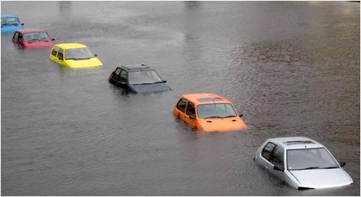
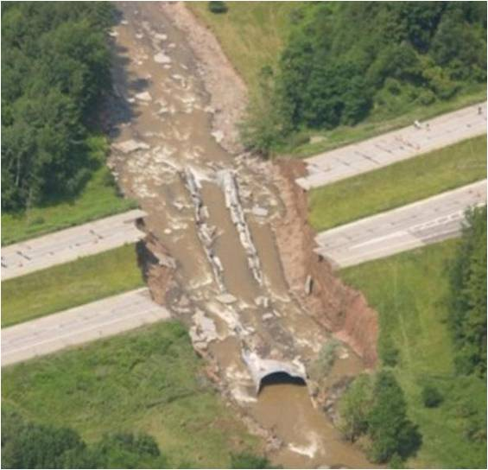
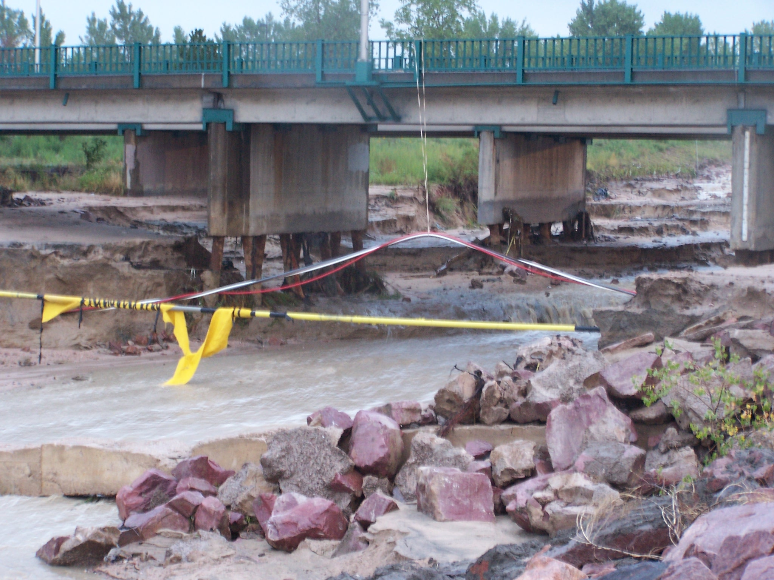
Pathway Impacts of Climate Change
Climate (C)
Water System Loadings (W)
Infrastructure Response (I)
Precipitation
Temperature
Sea Level Elevation
Hurricane Freq./Intensity
River Stage
Freeze/Thaw
Bed Stress
Scour
Morphologic Evolution
Thermal Expansion
Inundation
Pavement Deterioration
Road Washout
Bridge Failure
26
Notes:
26

Slide 27
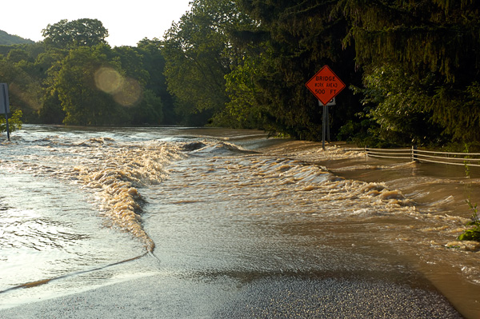
Questions
http://learningtoflyoriginals.com/flood.html

