Slide 1

CONSORTIUM SUR LA CLIMATOLOGIE RÉGIONALE
ET L’ADAPTATION AUX CHANGEMENTS CLIMATIQUES
2m Temperature interannual Variability and Climate Change Signal from the Narccap’s RCMs
Sébastien Biner, Ramon de Elia and Anne Frigon
April 2012

Slide 2
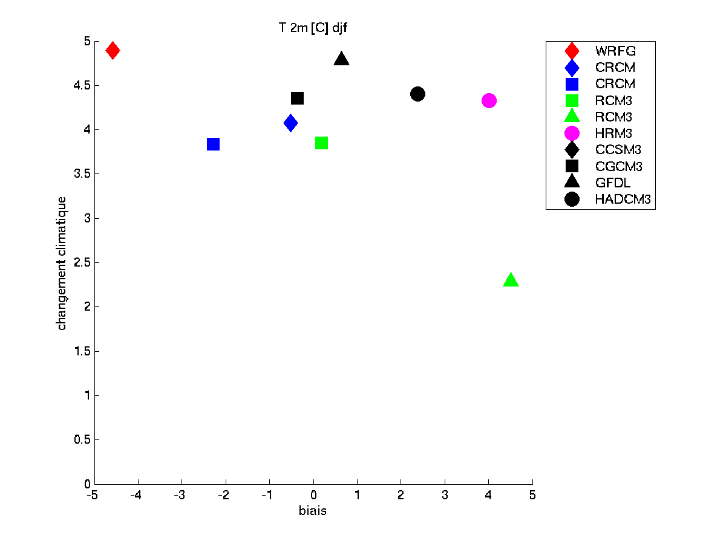
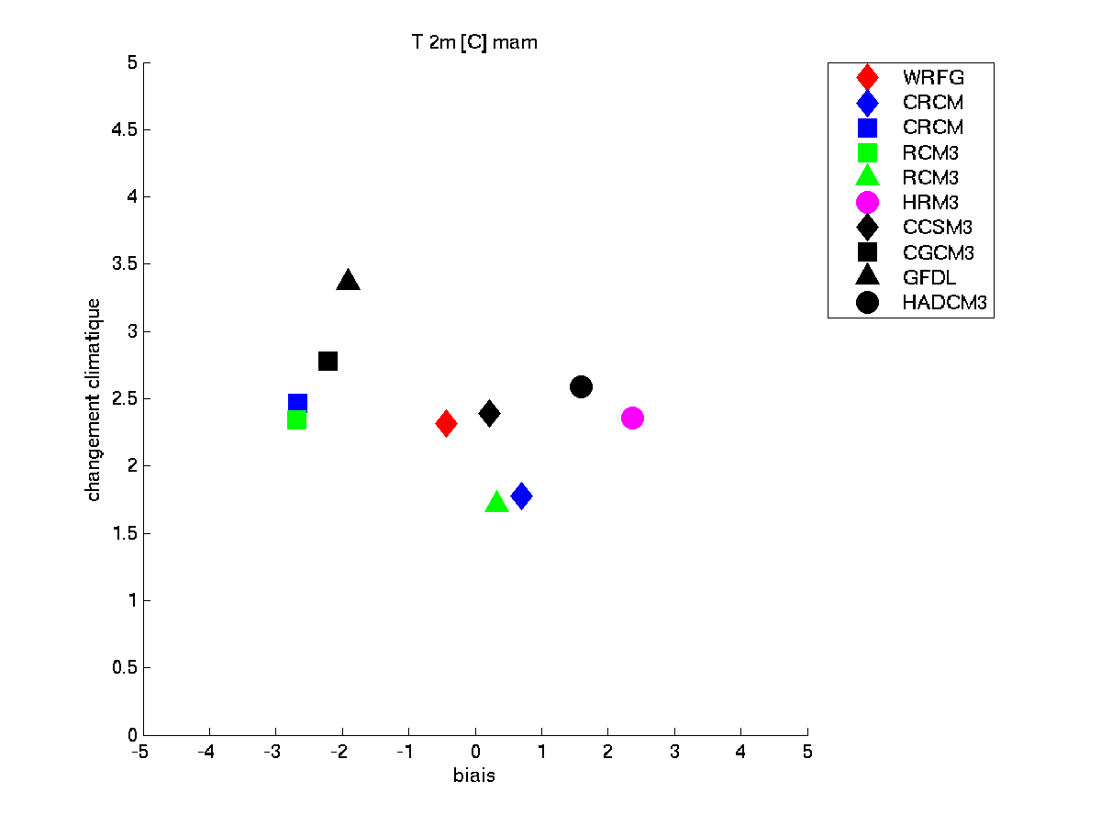
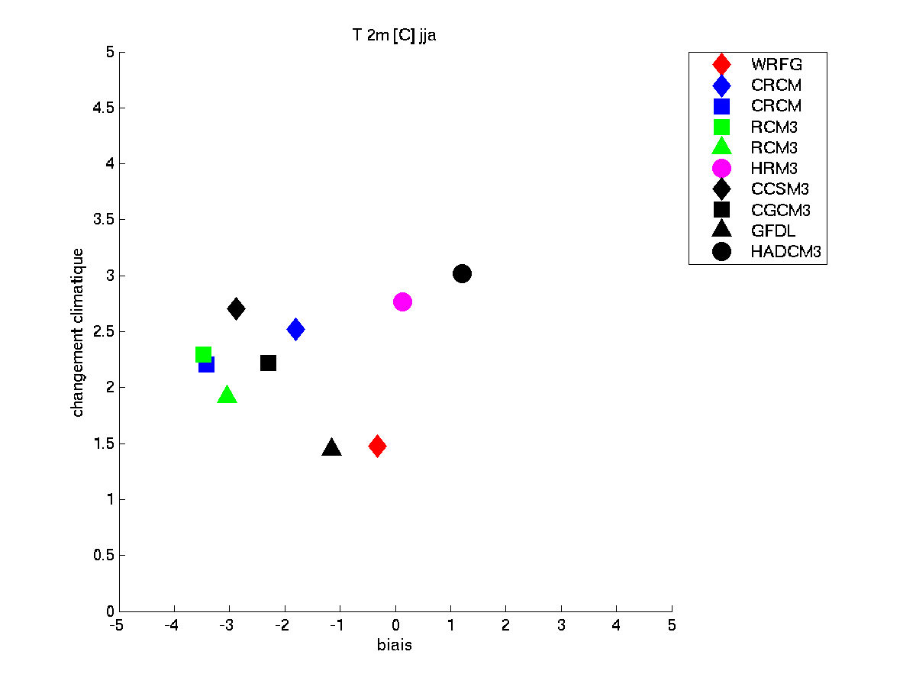
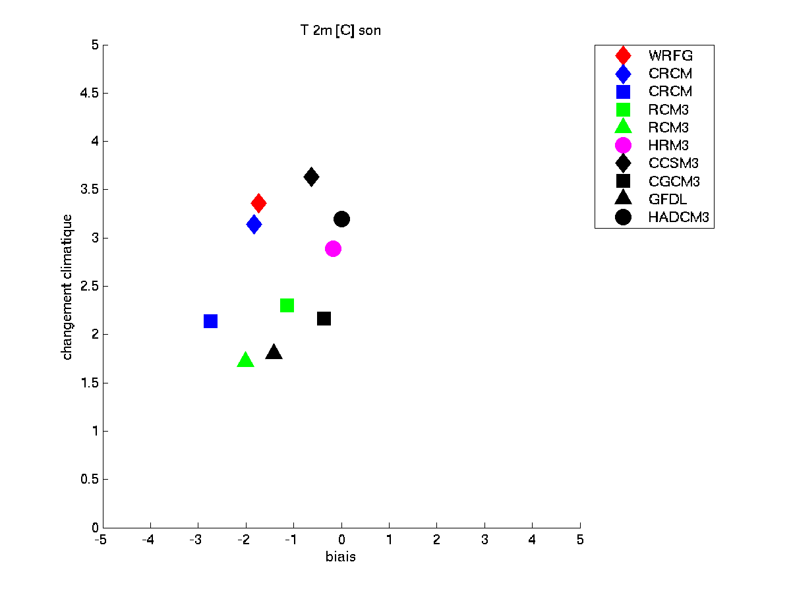
Motivations
Why looking at interannual variability?
It is a fundamental part of the climate
It is variable over North America
It is a « noise » to which we can compare the climate change « signal »

Slide 3
Temperature Interannual Variability
era40 [1958-1999]
From Scherrer 2010
NCEP 1948-2005
Szeto 2008

Slide 4
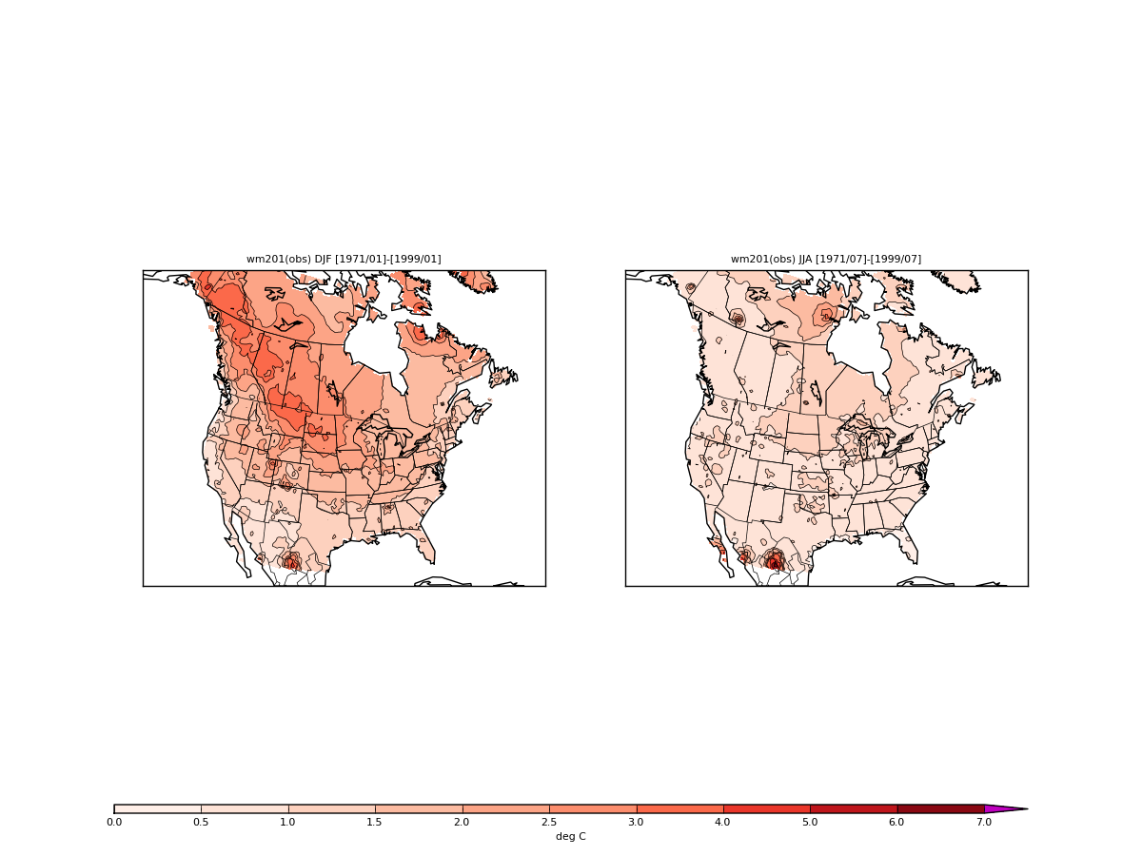
Temperature Interannual Variability
DJF
JJA
Synoptic scale Chinook effect
Sea-ice
Snow cover
Notes:
Saisonalité : systèmes plus intenses et durables (synoptique) en hiver et plus bruyants (orageux) en été
Régionalité : Max sur prairies : ENSO affecte l’ouest? Effet amplificateur de la topographie. Max au nord et Groenland : effet de la neige et de la glace.

Slide 5
How well do RCMs reproduce the interannual Variability?
Narccap
6 RCMs
Simulations driven by NCEP (1980-2003)
Notes:
Data downloaded Dec 2011

Slide 6
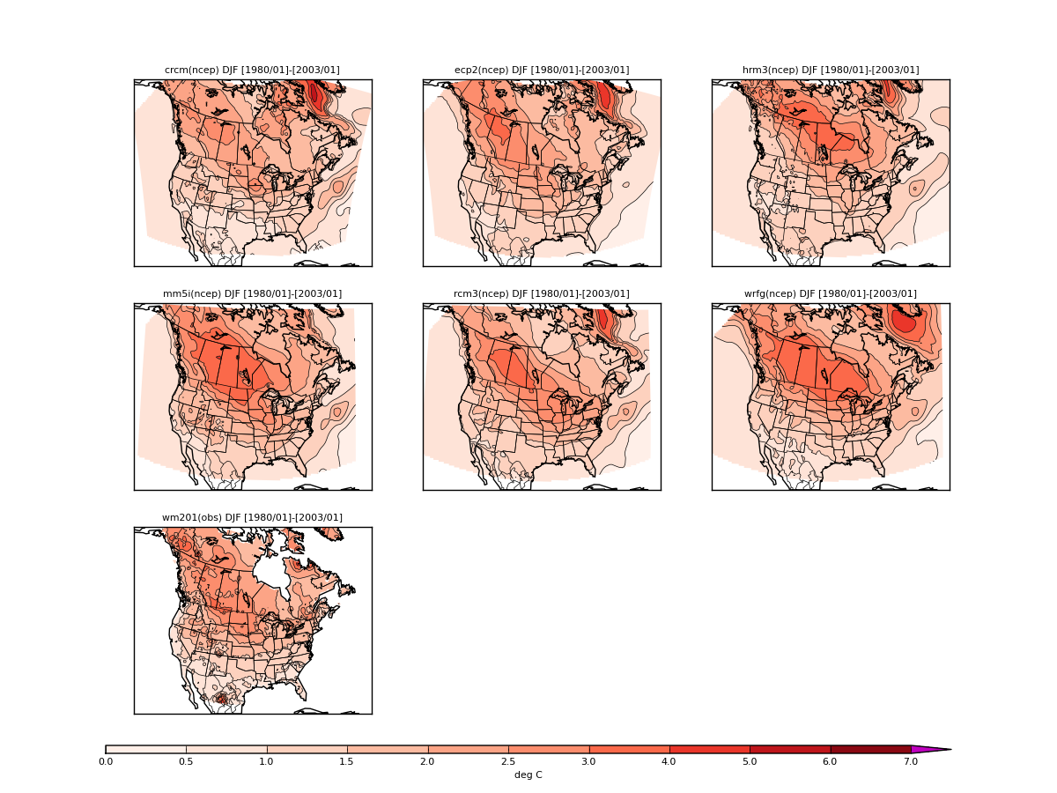
Narccap RCMs driven by NCEP

Slide 7
Definition of a new Index to compare interannual Variability
Inspired by Gleckler et al 2008 and Scherrer 2010 we define a new index :
if
if
Example :
VIR=-30% : underestimation by 30%
VIR=50% : overestimation by 50%

Slide 8
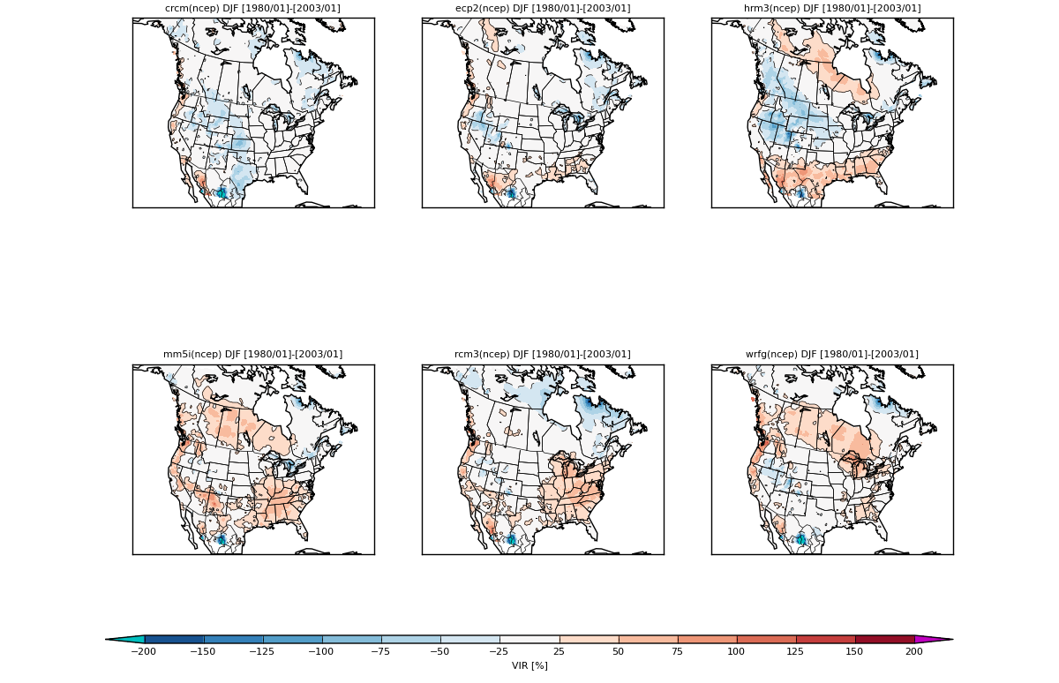
VIR for Winter 2m Temperature

Slide 9
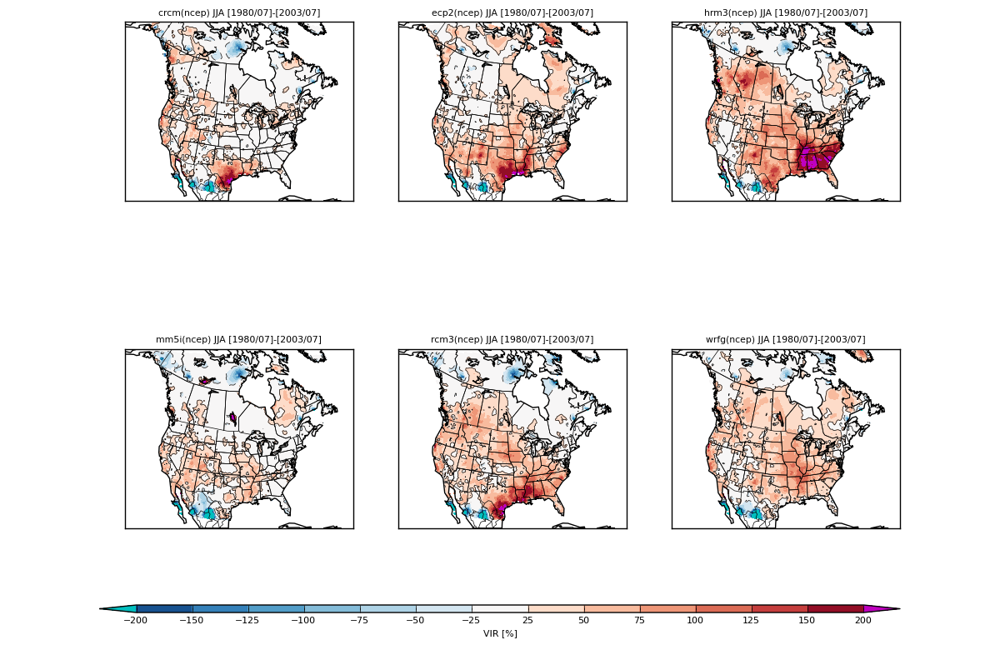
VIR for Summer 2m Temperature

Slide 10
How well do RCMs reproduce the interannual Variability?
Narccap
6 RCMs
Simulations driven by NCEP (1980-2003)
Simulations driven by GCMs (1971-1999)

Slide 11
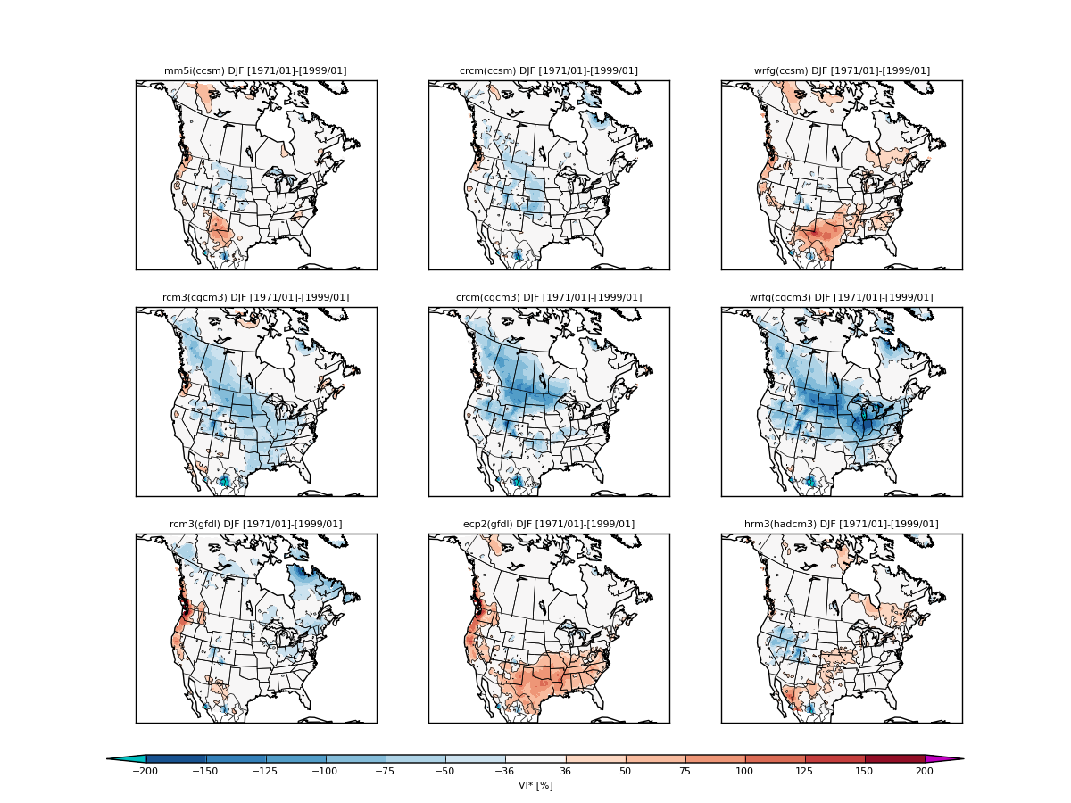
VIR for Winter 2m Temperature

Slide 12
VIR for Winter 2m Temperature
ccsm
cgcm
hadcm3
gfdl

Slide 13
VIR for Winter 2m Temperature
crcm
wrf
mm5
hadrm3
rcm3
ecp2

Slide 14
VIR for Winter 2m Temperature

Slide 15
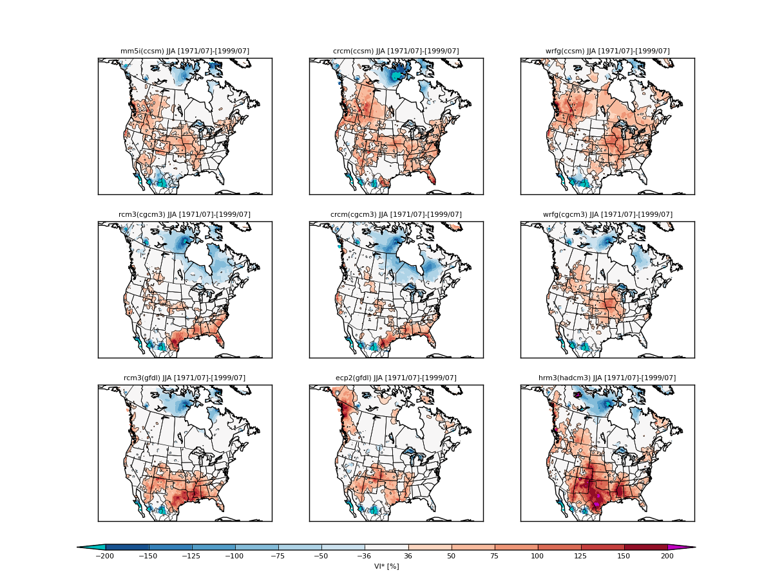
VIR for Summer 2m Temperature

Slide 16
Climate Change in a signal to noise Paradigm
In order to appreciate the strength of the climate change signal, it has to be compared to the variability which represents the range of temperature inside of which we are used to live (adapted).
Climate change = signal =
Variability = noise =
Expected number of Years before Emergence (EYE) :
Where t_{α} represent the student distribtution value for a given α % value

Slide 17
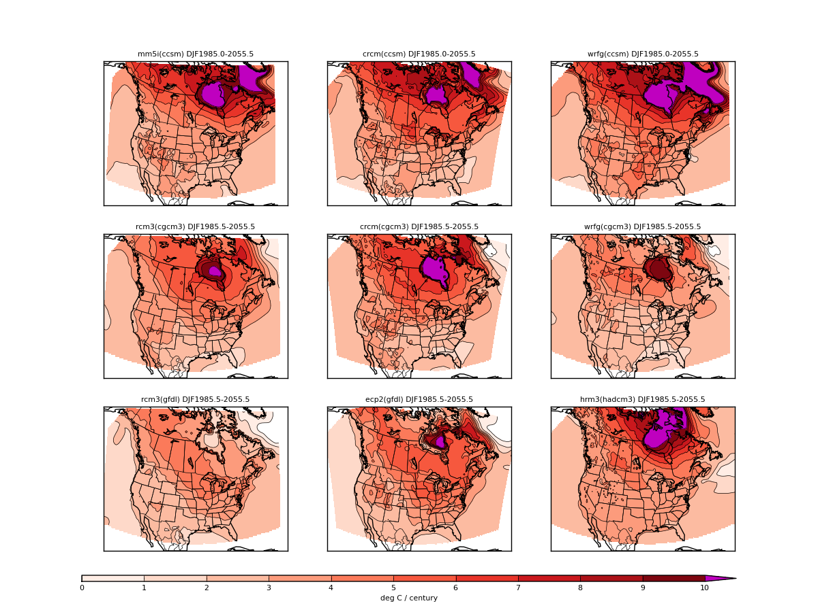
CC for Winter Temperature

Slide 18
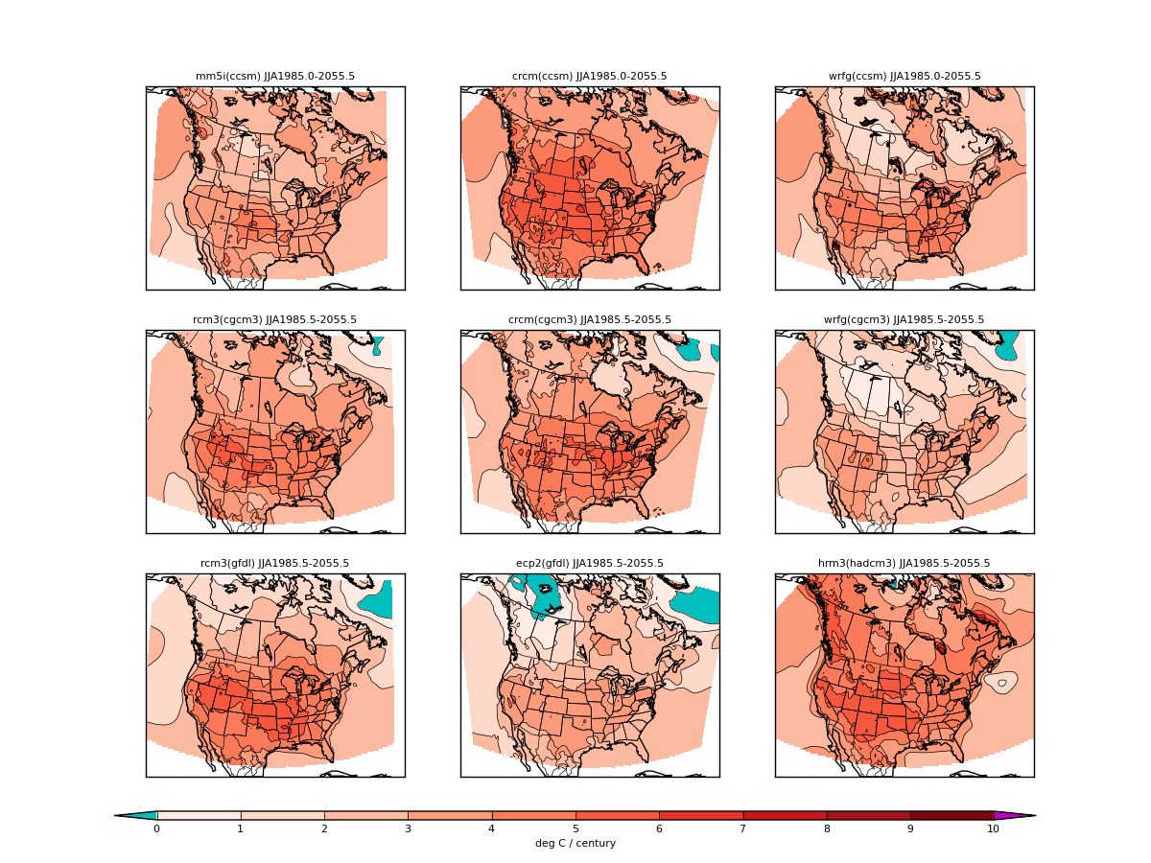
CC for Summer Temperature

Slide 19
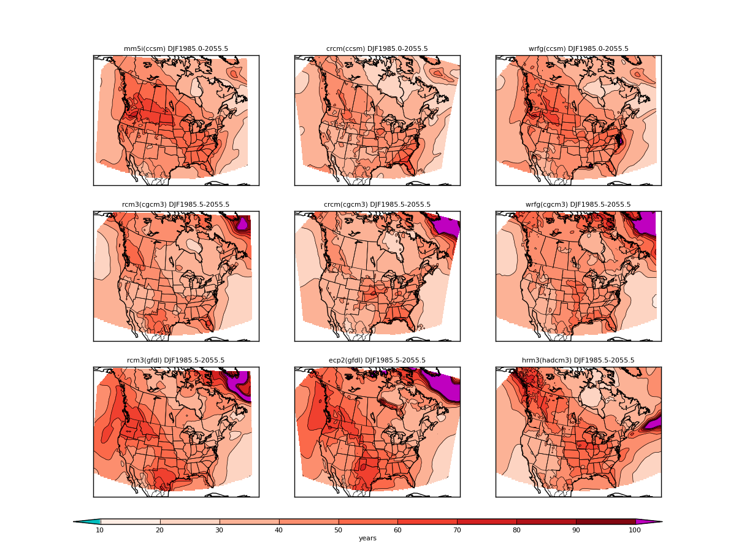
EYE for Winter Temperature

Slide 20
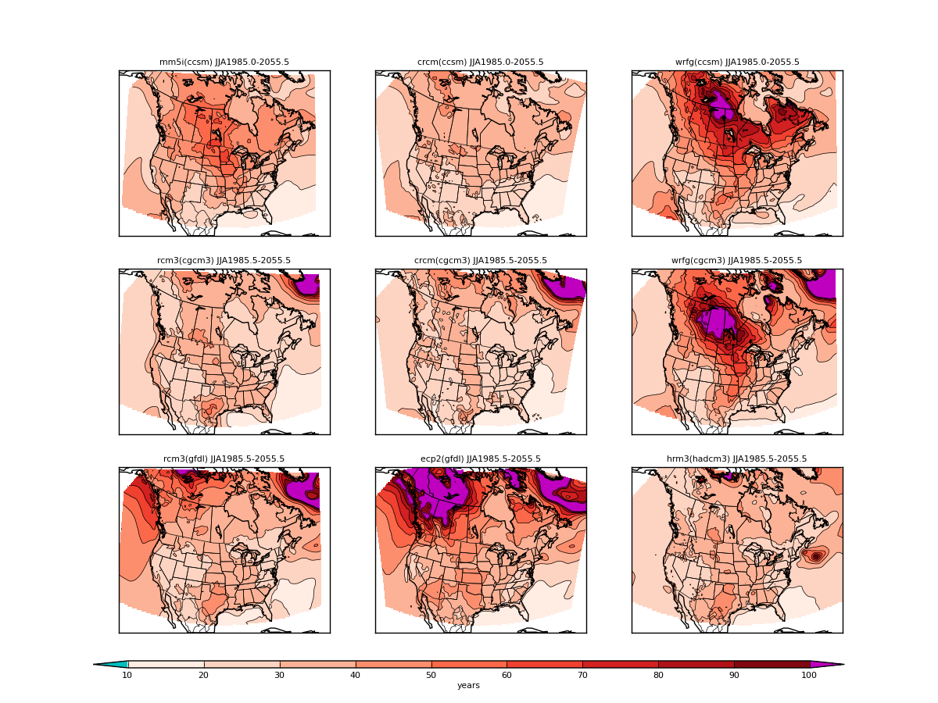
EYE for Summer Temperature

Slide 21
Conclusions
Ability of RCMs to reproduce interannual variability
Ncep driven :
relatively small over/under estimation over some regions during winter.
general noticeable overestimation during summer, especially over southeastern US
GCMs driven :
underestimation across the domain during winter (particularly cgcm3 driven)
underestimation around Hudson Bay and overestimation over southeastern US during summer
Climate change signal and its perception
CC signal similar among RCMs during winter with northern gradient heating.
CC signal variable among RCMs during summer, heating generally more important over central US. Some cooling.
During winter high variability over northwest North America slows the perception of the important warming (high EYE values)
During summer no general EYE pattern except for RCMs with regions of low CC signal
Perception of CC is expected to occur faster during summer than during winter, especially over the US
General Conclusions similar to Hawkins and Sutton 2010

Slide 22
Section 4: Role of noise in the perception of climate change
4a Number of years to get a significant trend (95%) assuming known variance and projected linear trend
Objective: put into perspective, in a familiar unit (years) the relative
Importance of signal and noise
instead of perception: discerning, discriminating

Slide 23
Number of years to get a significant trend (95%) knowing variance and projected trend
Analytical solution from equation
ETSSCC-ETISC
« Expected Time to Statistically Significant Climate Change »
Expected Time Interval to Statistically Significant Climate Change
Notes:
asymptotic trend and variance

Slide 24
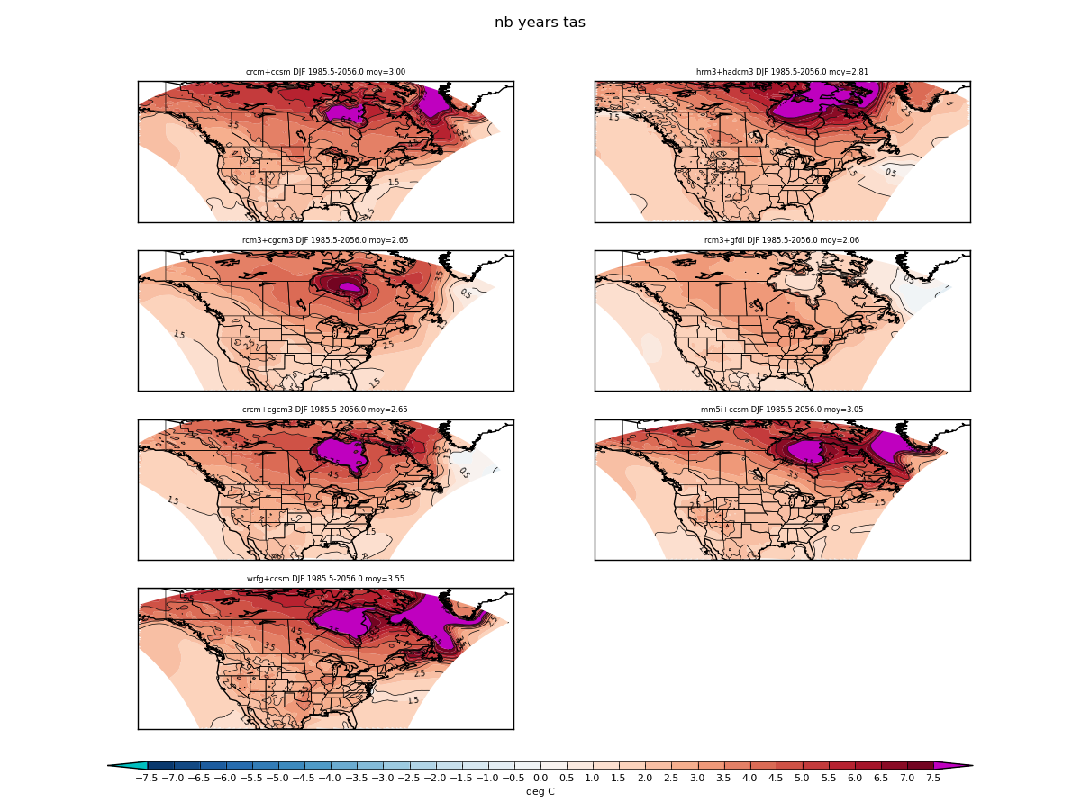
CC des MRCs de Narccap ..

Slide 25
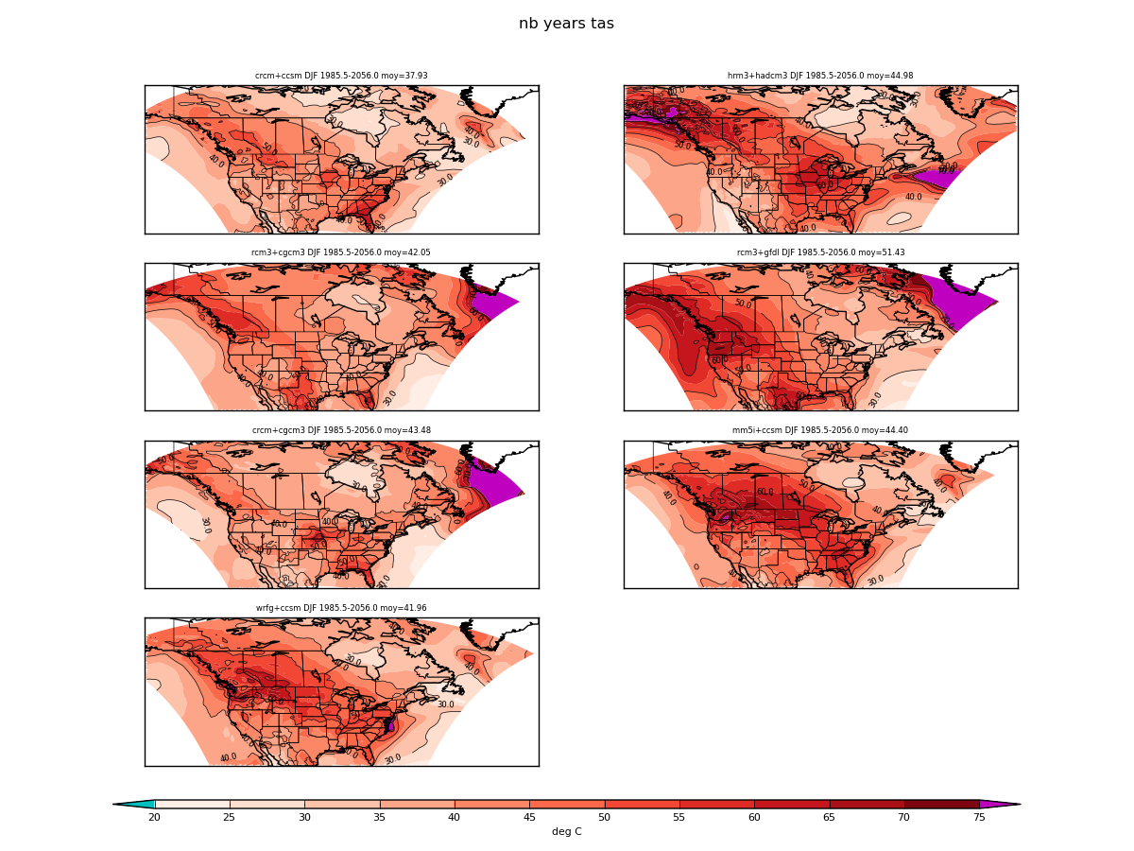
Nb d’années pour sortir du bruit (DJF)...
années

Slide 26
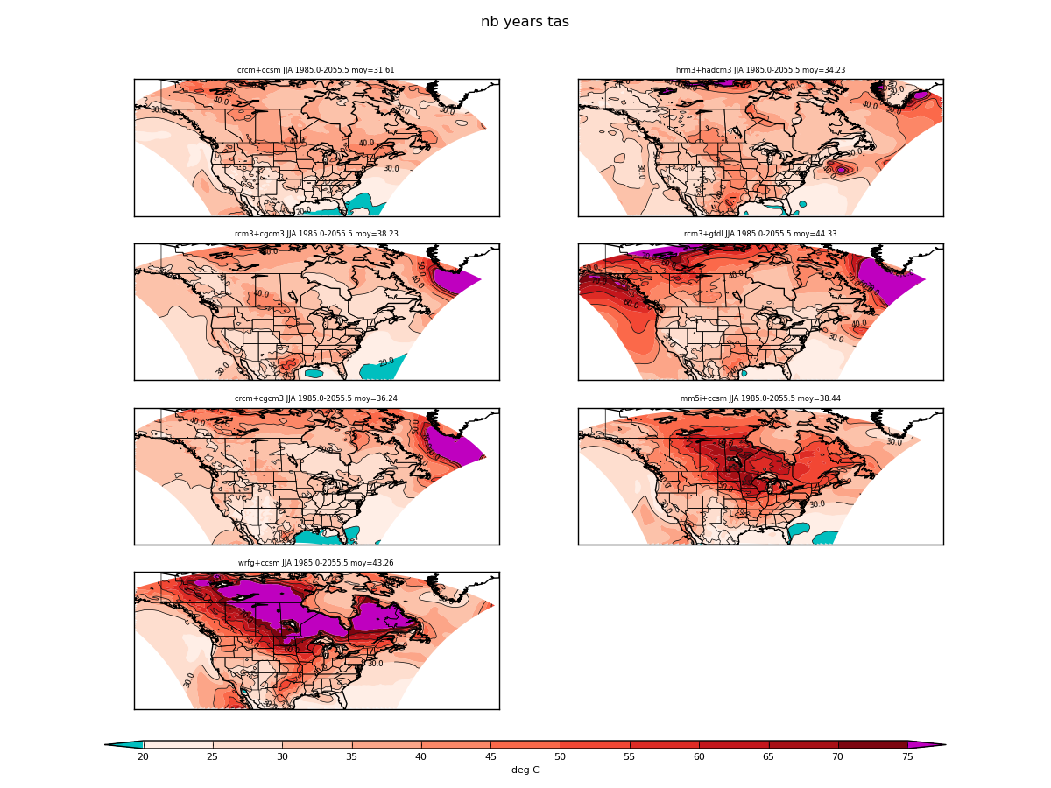
Nb d’années pour sortir du bruit (DJF)...
années

Slide 27
Conclusions
Reproduction de la variabilité interannuelle
MRC+NCEP : trop bas sur les Rocheuses et trop faible au sud de la Baie James. Certains MRCs ont des problèmes sur les grands Lacs.
MRC+GCM : Les MRCs utilisant cgcm3 ont des déficits de variabilité sur les Rocheuses.
MRC+NCEP, MRC+GCM et GCM sont relativement semblables.
Rapport signal/bruit des CC
Le signal de CC et la variabilité sont plus fort en hiver qu’en été
Le rapport signal/bruit est plus grand en été qu’en hiver

Slide 28
Merci

Slide 29
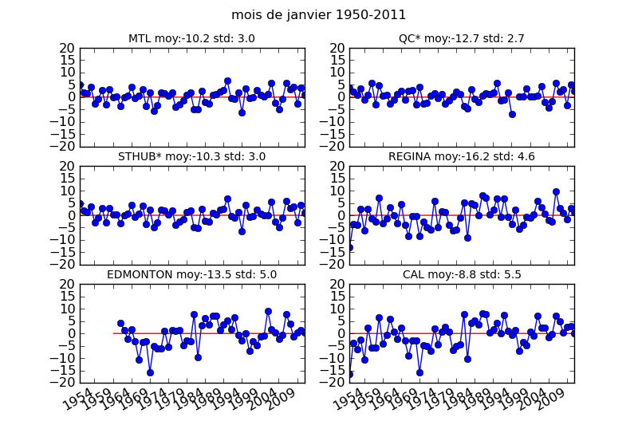
Anomalie de moyenne de janvier par rapport à 1971-2000
Notes:
Saisonalité : systèmes plus intenses et durables (synoptique) en hiver et plus bruyants (orageux) en été
Régionalité : Max sur prairies : ENSO affecte l’ouest? Effet amplificateur de la topographie. Max au nord et Groenland : effet de la neige et de la glace.

Slide 30
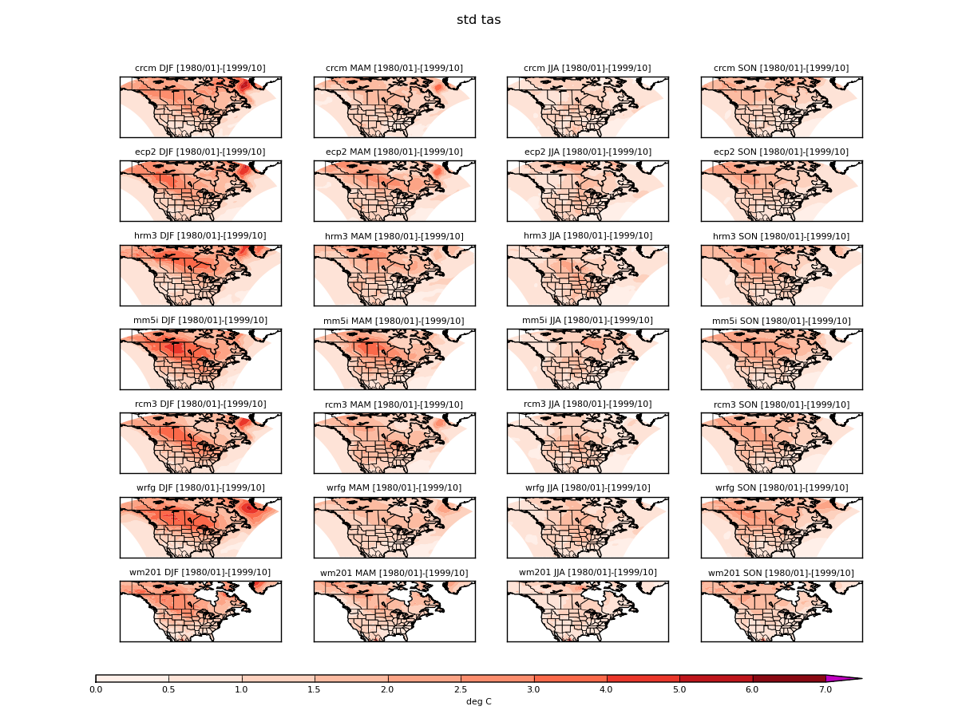
Saisonalité : check

