Slide 1

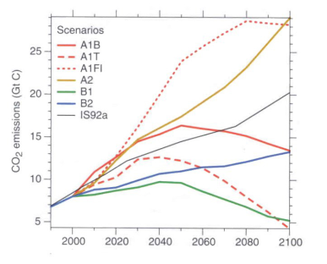
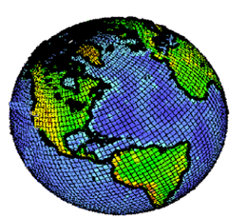
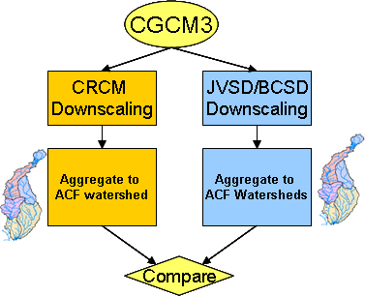
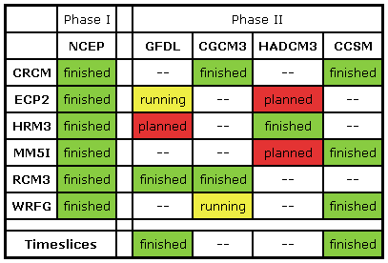


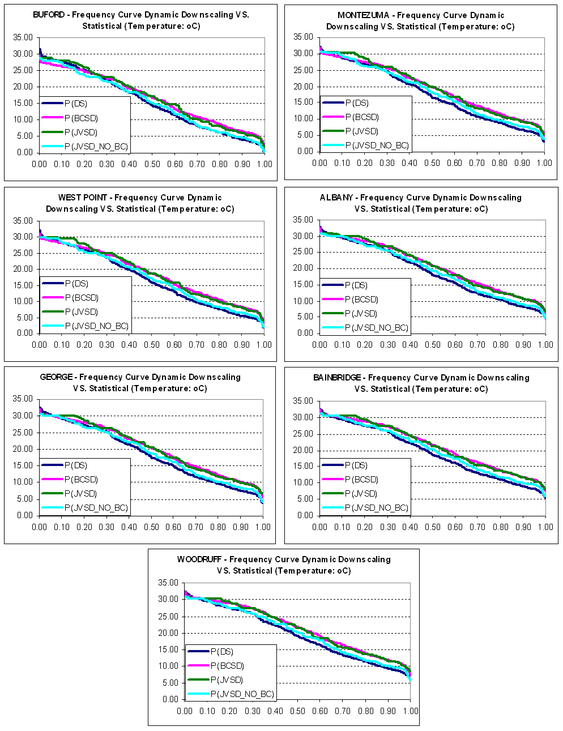
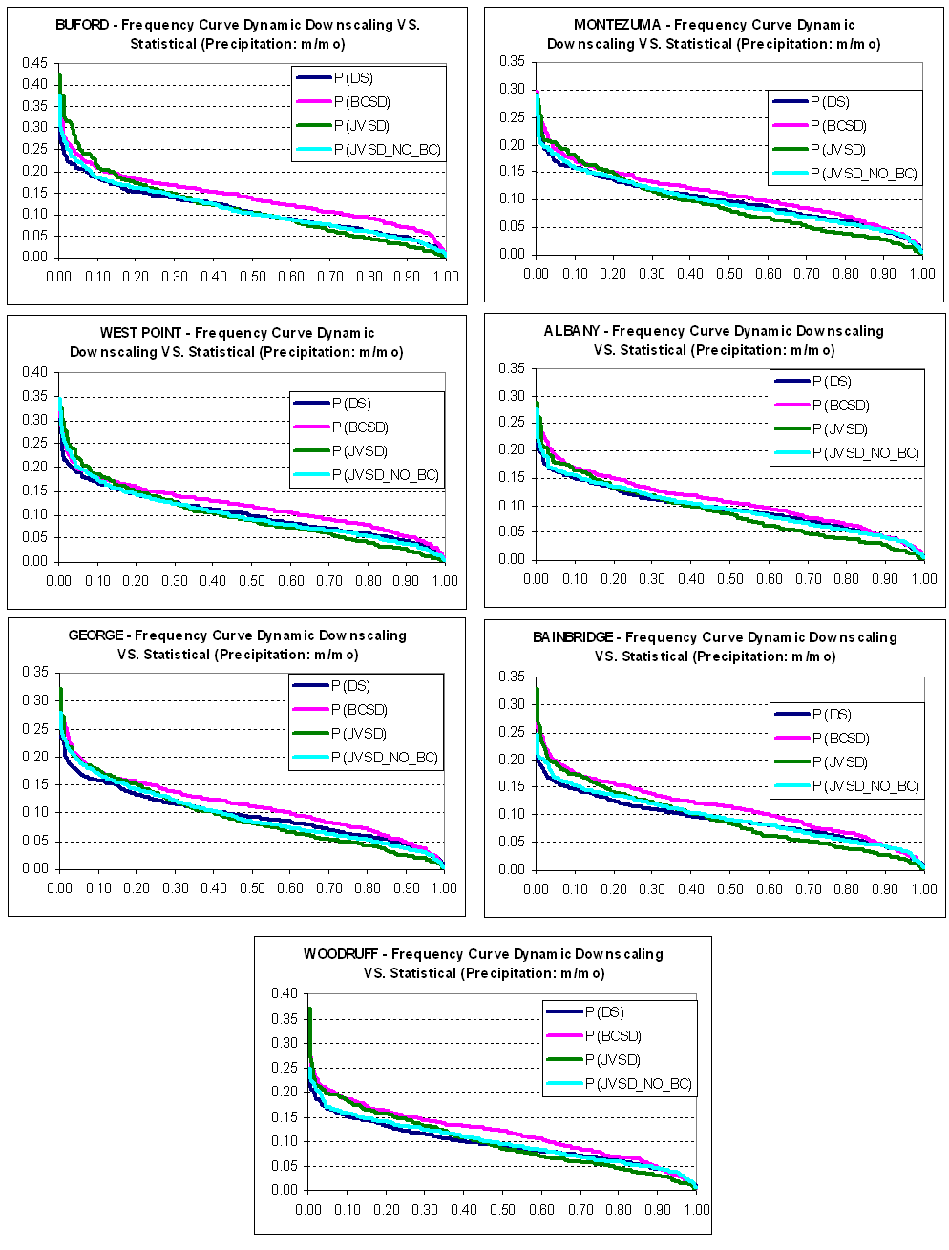
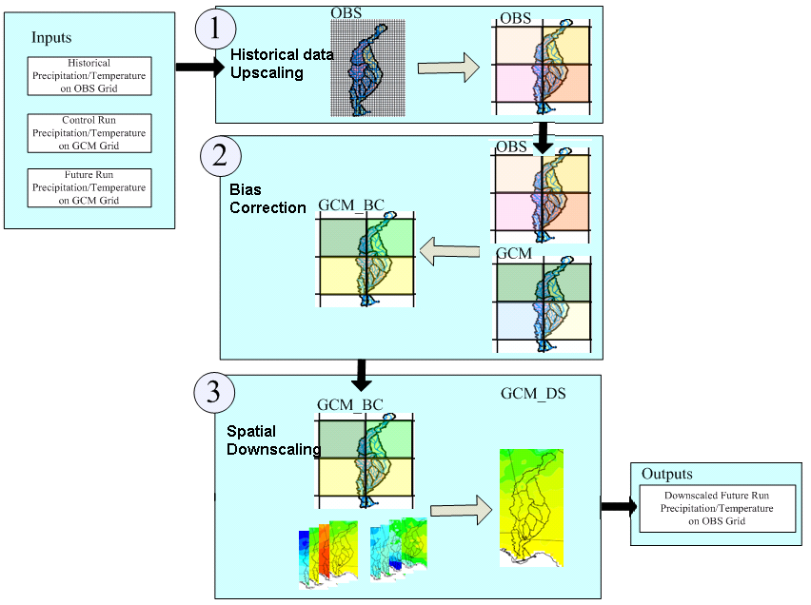




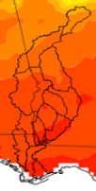



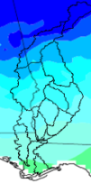
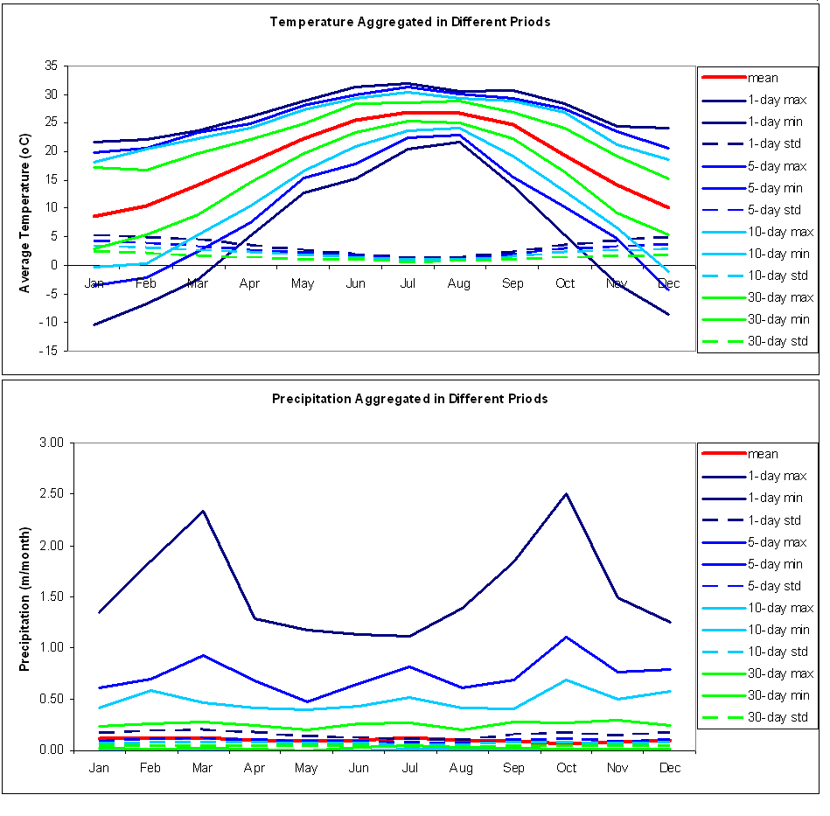





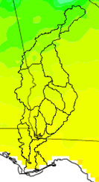


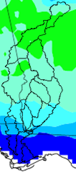














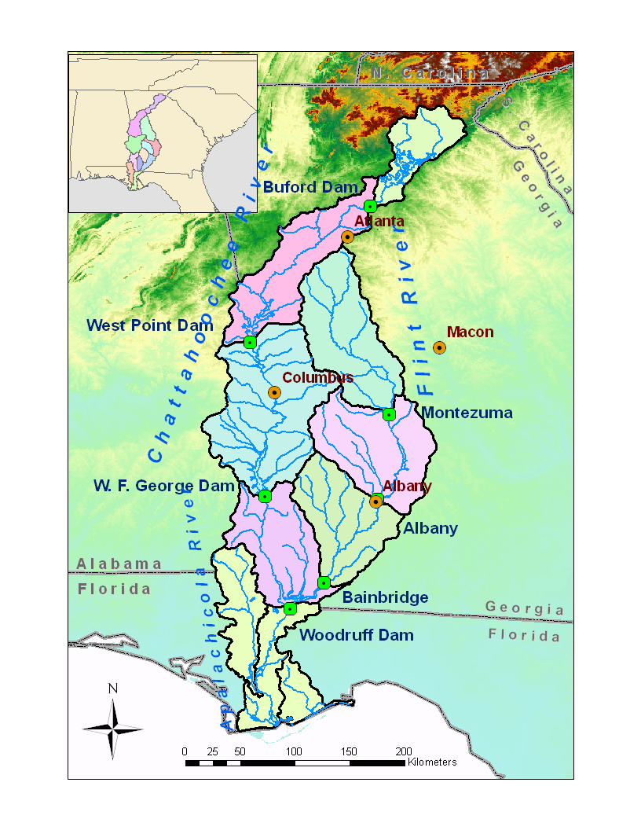
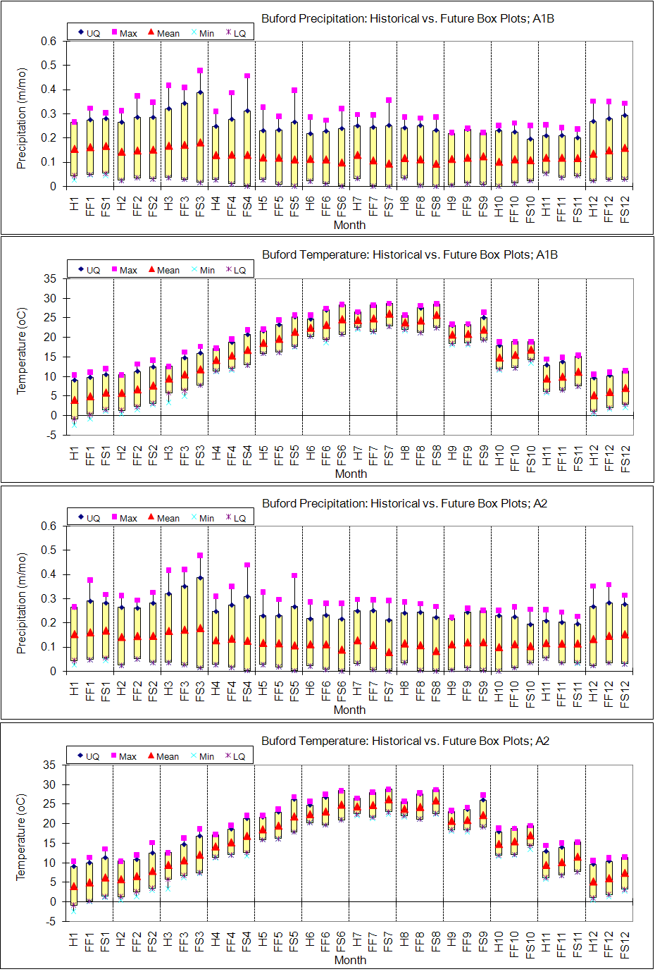
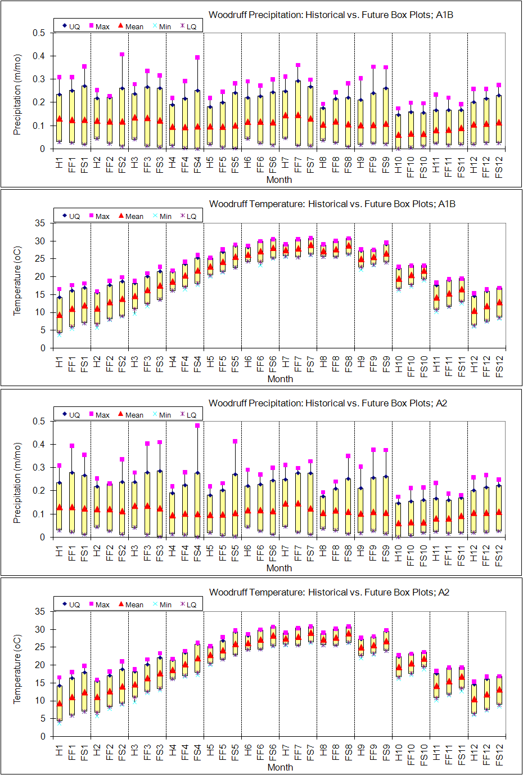
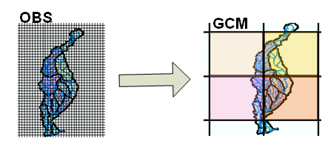
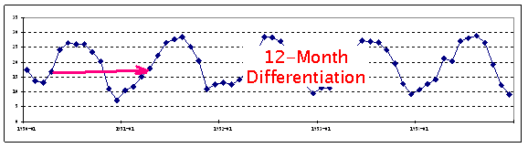
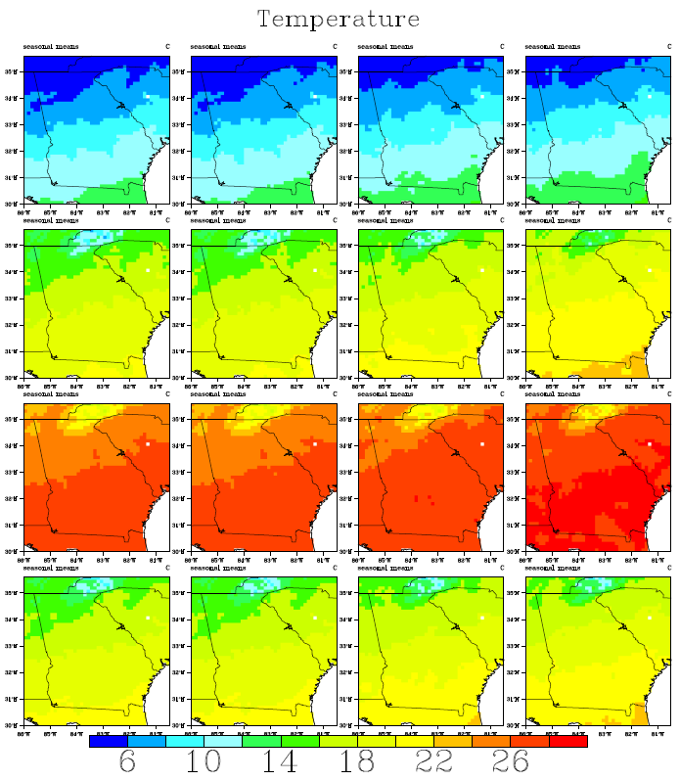
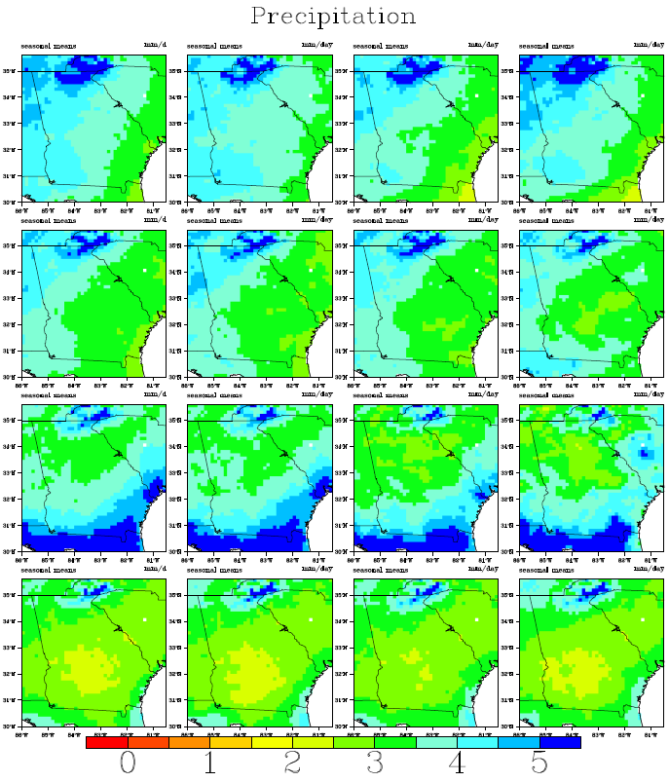
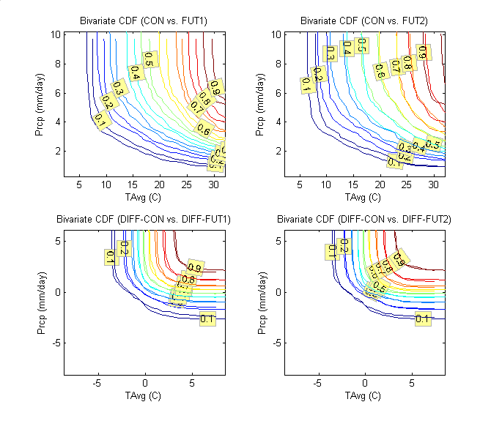




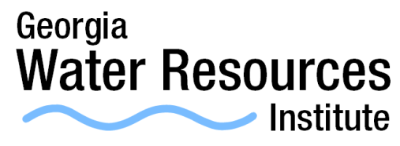

Comparing Joint Variable Spatial Downscaling Results with NARCCAP Datasets
Feng Zhang and Aris Georgakakos
School of Civil and Environmental Engineering, Georgia Institute of Technology
Introduction
Bias Correction
Comparison With Dynamic Downscaling Results
General Circulation Models (GCMs) are broadly used as an important tool for qualitative impact assessment. The GCMs represent (through a large system of partial differential equations) the coupled atmospheric and oceanic processes currently understood to govern the Earth’s climate.
Fut → Con → Obs
Creating a differenced series of future temperature and precipitation;
Finding the joint frequency of the contemporaneous differenced data values;
Considering that this joint frequency is the same in the future differenced series as it is in the control differenced series; and
Mapping each joint frequency point of the GCM control distribution to a corresponding point on the joint frequency distribution of the observed differenced series.
Subheading Goes Here
Low Resolution
~200km x 200km
Monthly & Few Daily
At present, GCMs run on global scales at relatively low spatial resolutions (~100x100 km2 to ~250x250 km2). Because of their coarse spatial resolution, GCM outputs are usually inadequate to capture the spatial variability at regional or local scales with higher resolution (~4x4 km2 to ~12x12 km2) necessary for hydrological applications.
Figure 7 Comparison Process of JVSD with Dynamic Downscaling Methods from the NARCCAP Dataset (CRCM/CGCM3)
for the Future Period 2041-2070 ) Reference: NARCCAP: http://www.narccap.ucar.edu/index.html
High Resolution
~12km x 12km
Monthly & Daily
Figure 1 Low & High Resolution Grids
Joint Variable Spatial Downscaling (JVSD), a new statistical technique for downscaling gridded climatic variables, is developed to generate high resolution gridded datasets for regional watershed modeling and assessments.
The proposed approach differs from previous statistical downscaling methods in that multiple climatic variables are downscaled simultaneously and consistently to produce realistic climate projections. It has two major steps: bias correction and spatial downscaling.
Figure 4 Joint Frequency Distribution Mapping
Spatial Downscaling
Sample of Chart
Pattern matching is performed simultaneously for temperature and precipitation fields;
Pattern matching is performed simultaneously for all GCM cells that cover the region of interest; and
Future temperature and precipitation fields that fall outside the historical range are accommodated by expanding the range of historical analogues.
30-day T-P
Historical Analog Approach
Contemporaneous for
all GCM Basin Coverage
10-day T-P
Spatially Downscaled
T-P Fields
Figure 8 Comparisons of Downscaled Temperature/Precipitation Frequencies for ACF Watersheds based on
NARCCAP Methods, BCSD, JVSD with no bias correction, and JVSD with bias correction
Reference: Wood, A. W., L. R. Leung, V. Sridhar and D. P. Lettenmaier, (2004). "Hydrologic
Implications of Dynamical and Statistical Approaches to Downscaling Climate Model Outputs."
Climatic Change 62.1-3: 189-216.
5-day T-P
Subheading Goes Here
Figure 2 Joint Variable Spatial Downscaling Flowchart
1-day T-P
Climate Change Assessment for ACF Basins
Introduction
r
Upscaling and Differentiation
Subheading Goes Here
Figure 3 shows that,
The joint frequency distributions of temperature and precipitation are different in the control and future runs; and
The relationship of the joint frequency distributions (of control versus future data) is appreciably different in the first versus the second 50-year period, indicating that the joint frequency distribution is non-stationary; and
The differenced sequences exhibit very good correspondence between control and future runs, for both future periods. This result and conclusion has been tested and shown to hold for all 13 GCMs available through IPCC.
Figure 5 Spatial Downscaling using Historical Analog Approach
Sample of Chart
Downscaling Results for CGCM3.1-run1 (A1B Scenario)
DJF
MAM
JJA
SON
Figure 9 Box Plots of Monthly Historical vs. Future (A1B and A2) Watershed Precipitation and Temperature:
H denotes the historical period (1950-1999); FF the first future period (2000-2049); and FS the second future
period (2050-2099). Left – Buford Watershed; Right – Woodruff Watershed.
Reference: F. Zhang and A. Georgakakos, (2010). "Joint Variable Spatial Downscaling“,Climatic Change, submitted
Figure 3 Bivariate Empirical Cumulative Frequency Curves
for Original (Top) and Differenced (Bottom) Time
Series of Temperature and Precipitation
Figure 6 Temperature/precipitation distributions over the ACF basin and the southeast US. Monthly precipitation fields
are aggregated by season (DJF, MAM, JJA, and SON in rows 1, 2, 3, and 4 respectively). The columns depict
observations for the period 01/1950 - 12/1999 (Column 1); JVSD downscaled data using input from the 20CM3
experiment for the period 01/1950 - 12/1999 (Column 2); JVSD downscaled data using input from the
CGCM3.1-run1A1B Scenario for the period 01/2000-12/2049 (Column 3); and JVSD downscaled data using input
from the CGCM3.1-run1 A1B Scenario for the period 01/2050-12/2099 (Column 4).
SPONSORS

