Slide 1
Additional NARCCAP Results
Melissa Bukovsky

Slide 2
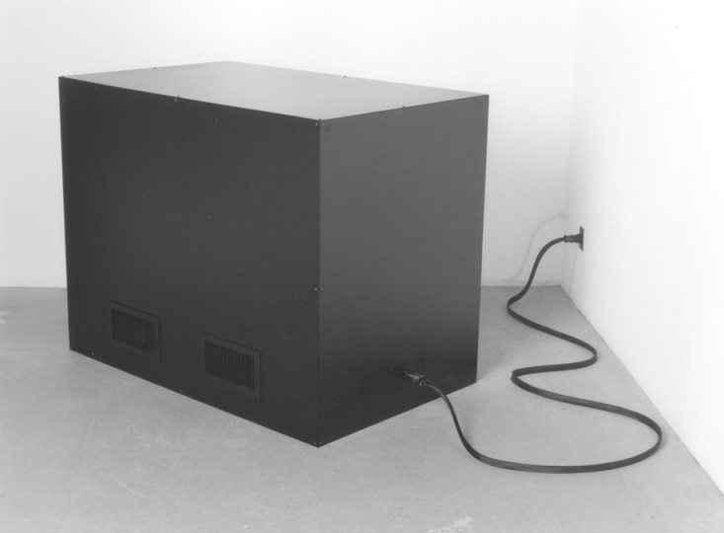
No Model Is Perfect Some Models Are Useful
Notes:
They all have problems - global or regional

Slide 3
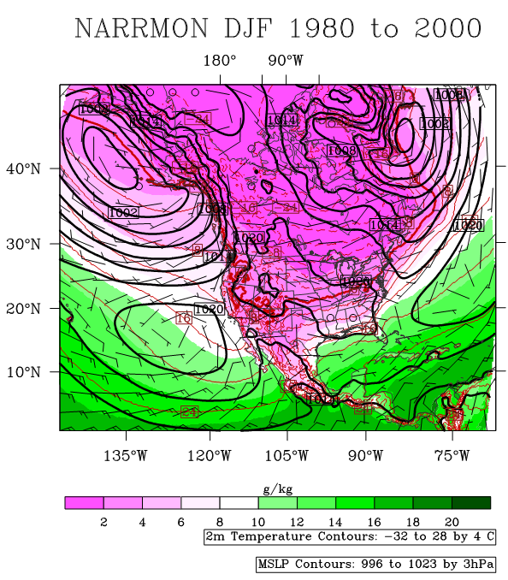
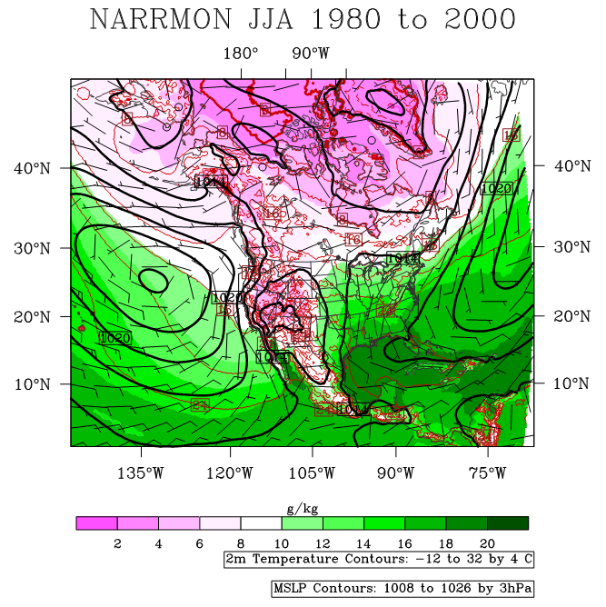
Surface Overview

Slide 4
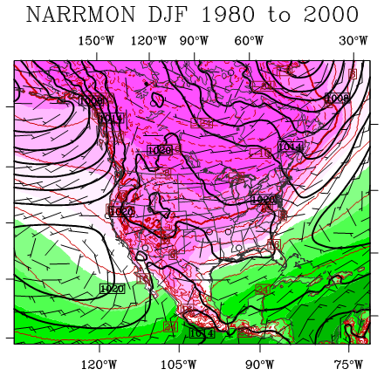
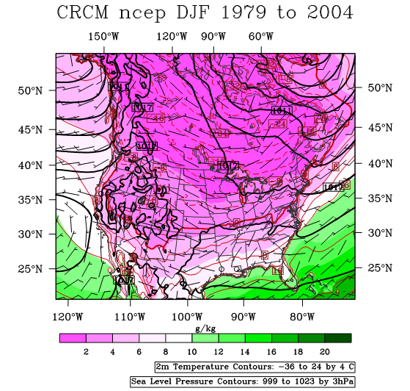
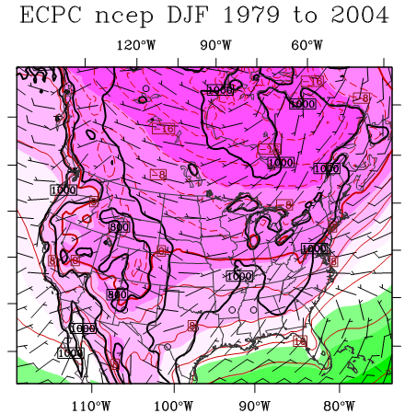
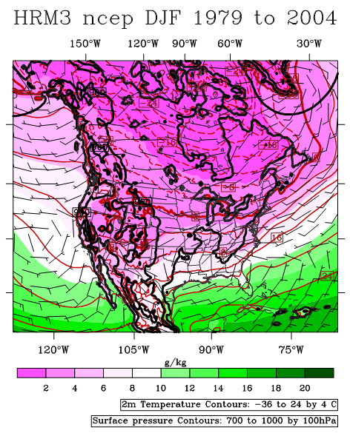
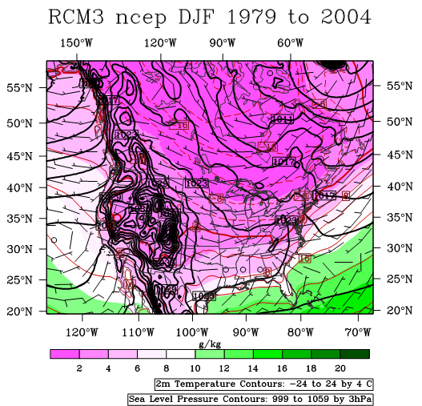
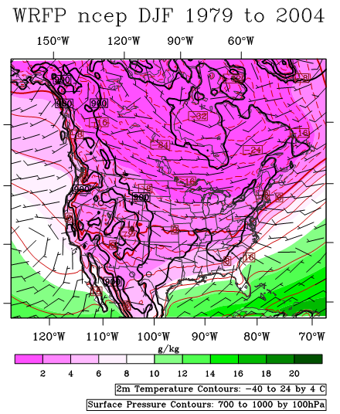

Slide 5
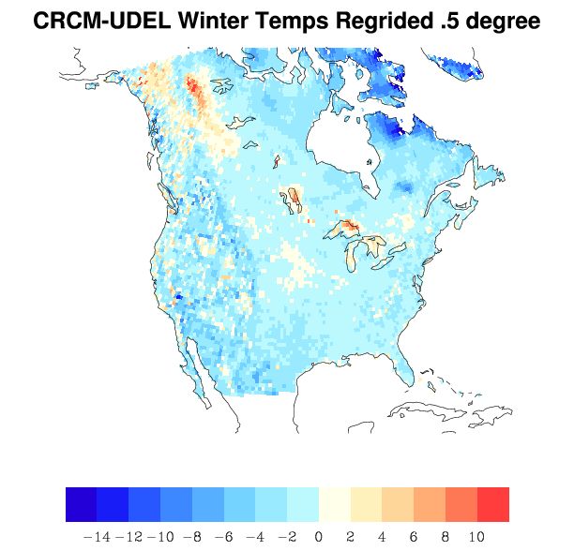
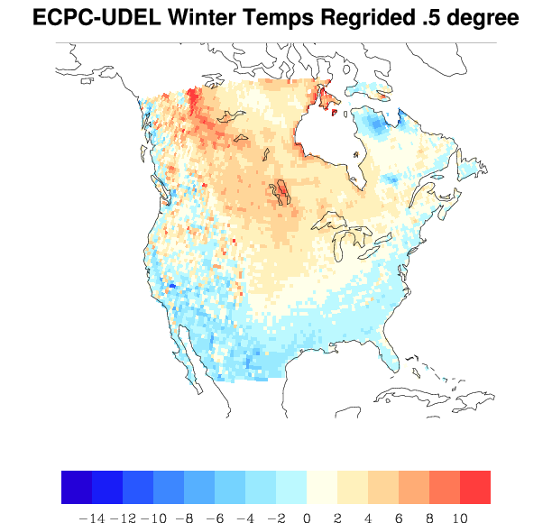
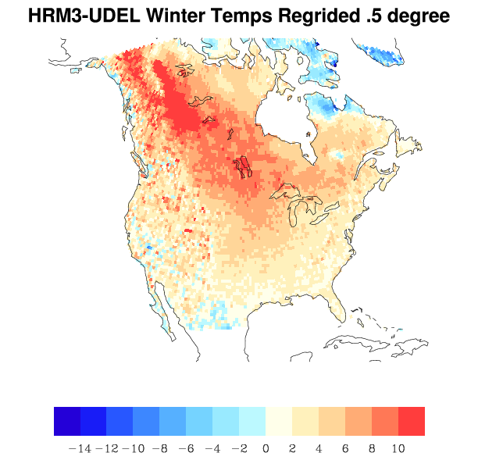
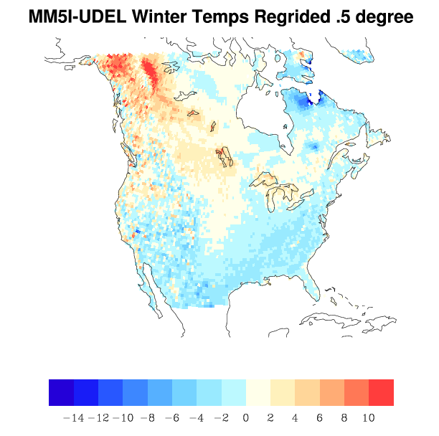
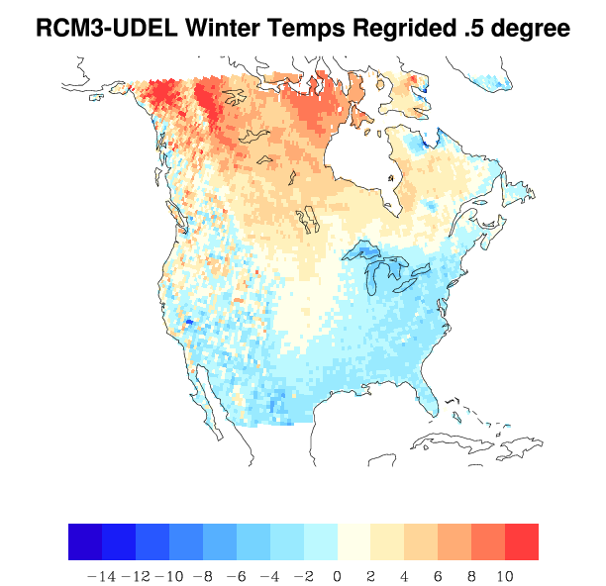
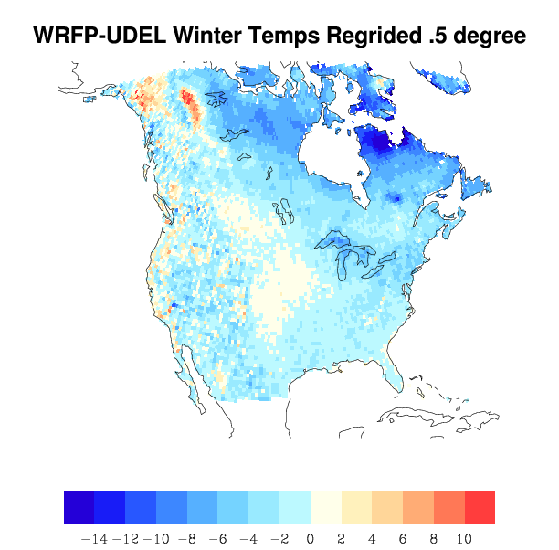
Winter Temperature Bias

Slide 6
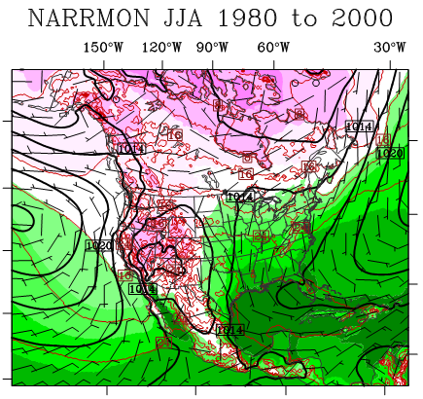
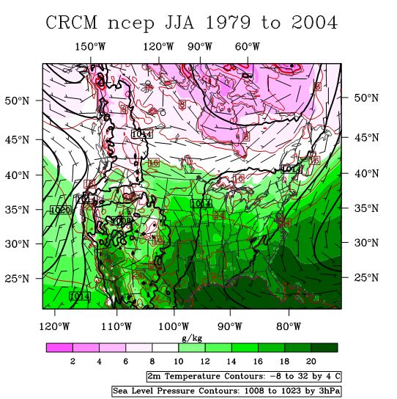
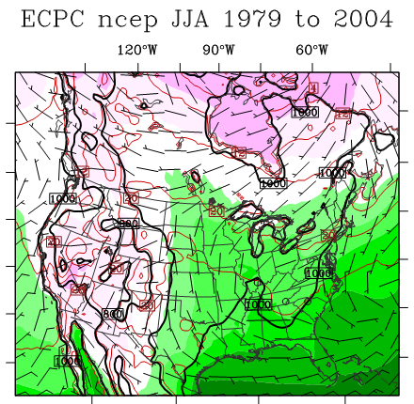
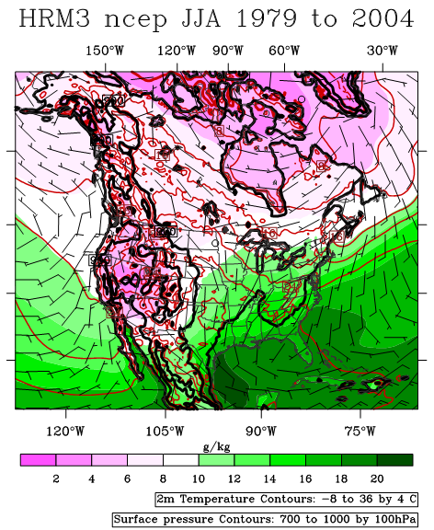
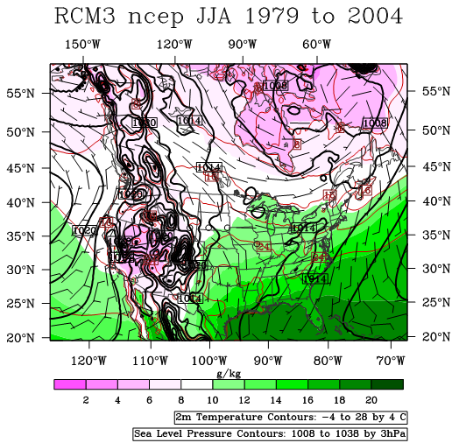
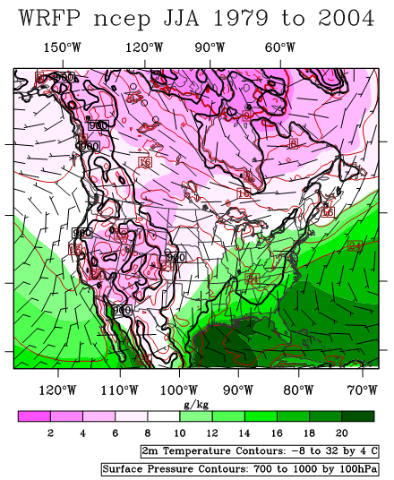

Slide 7
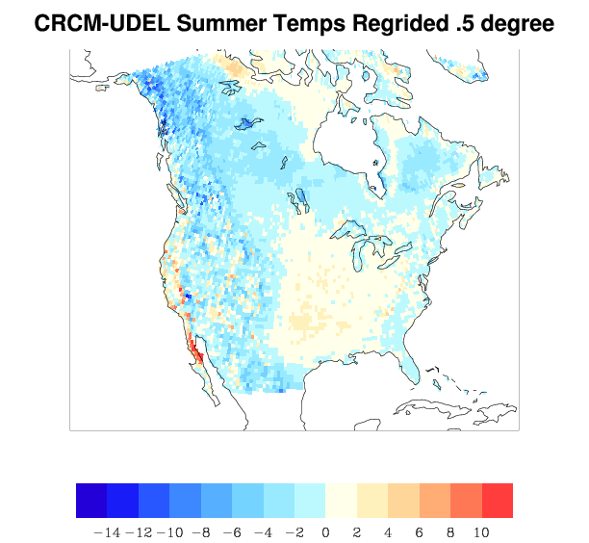
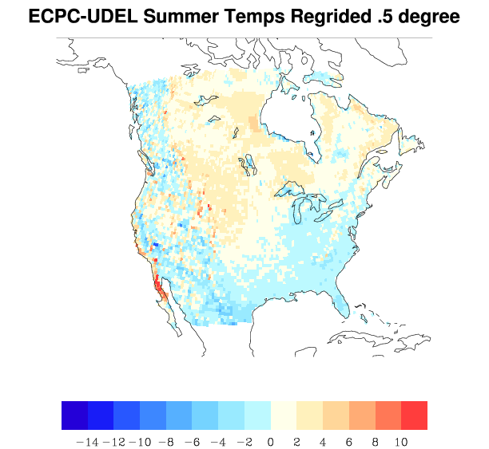
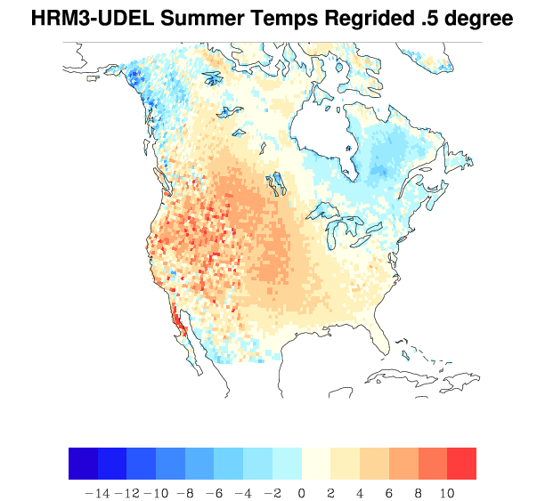
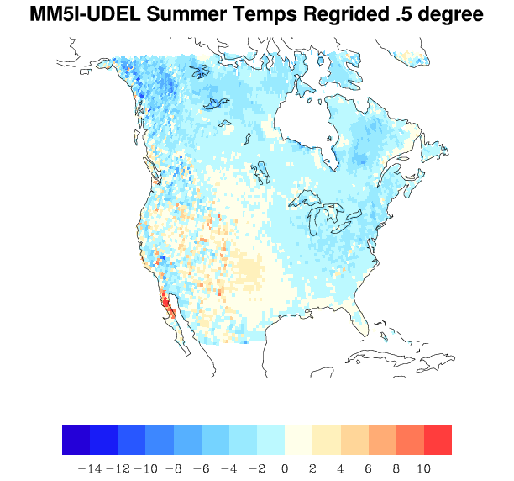
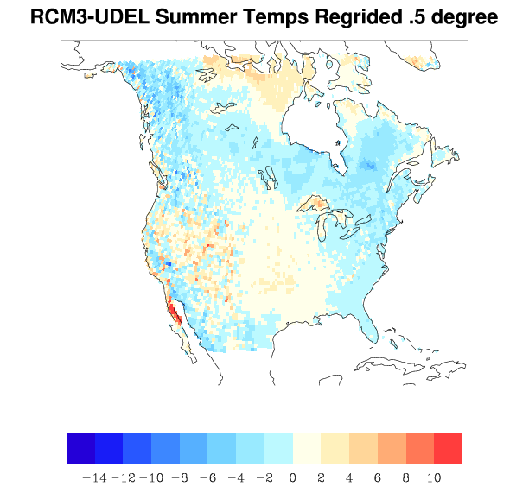
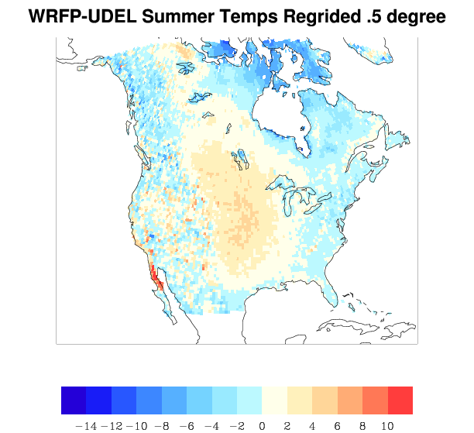
Summer Temperature Bias

Slide 8
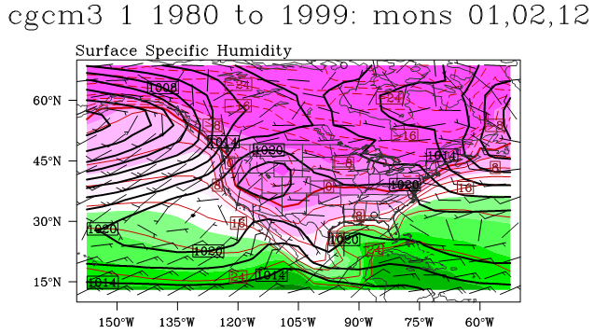
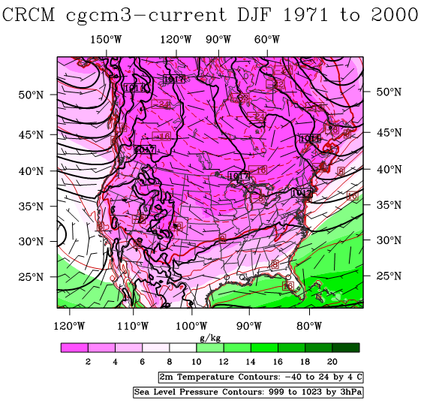
CGCM, CRCM-ncep, CRCM-cgcm Winter

Slide 9
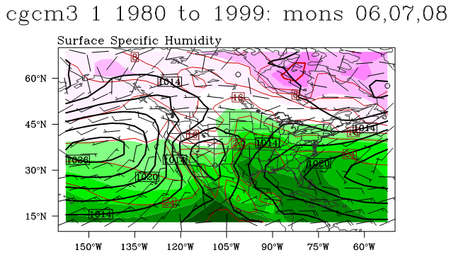
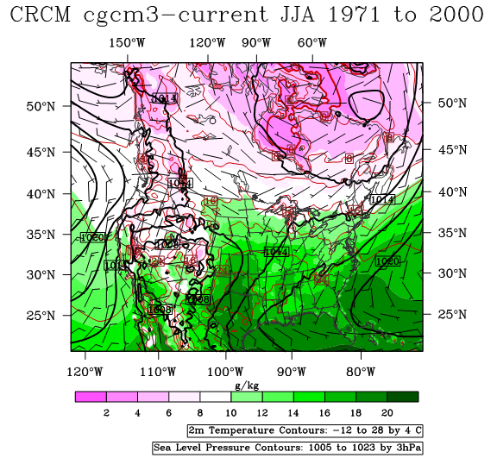
CGCM, CRCM-ncep, CRCM-cgcm Summer

Slide 10
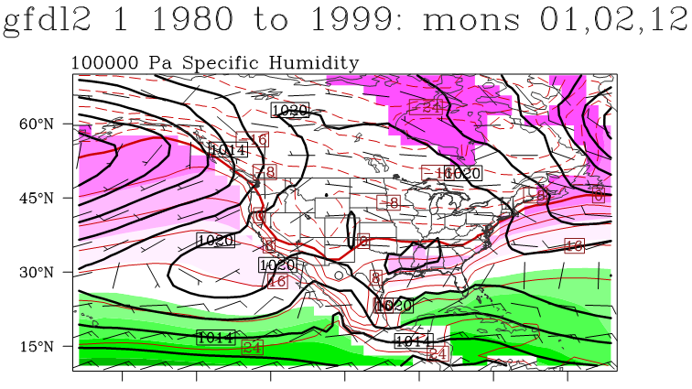
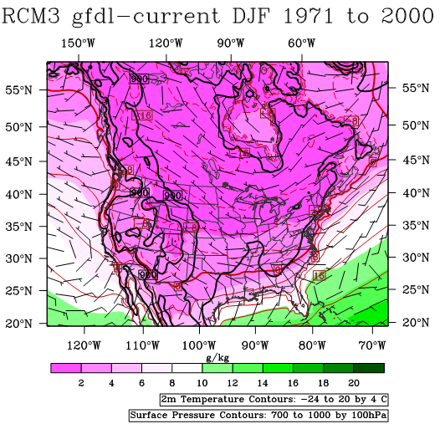
GFDL, RCM3-ncep, RCM3-gfdl Winter

Slide 11
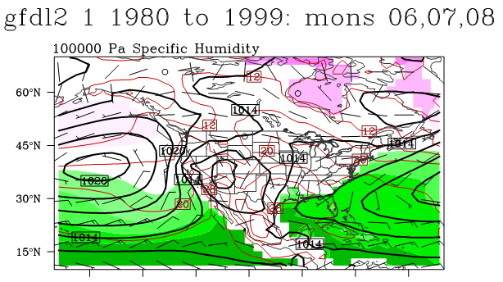
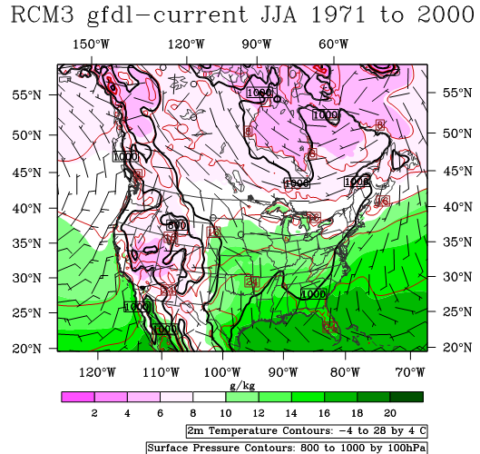
GFDL, RCM3-ncep, RCM3-gfdl Summer

Slide 12
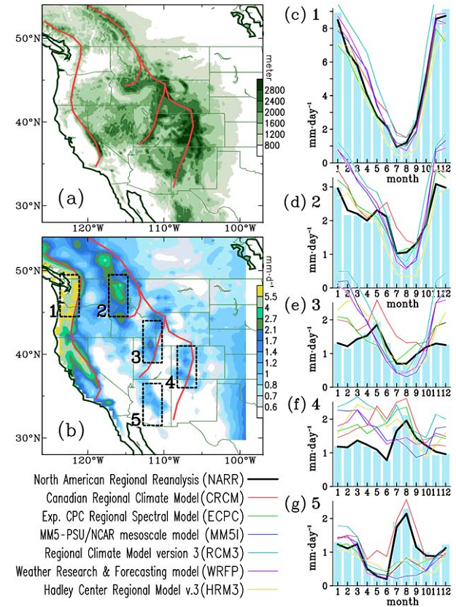
Monthly Precipitation
From Wang et al. 2009 (JRL)
Fig. 1. (a) Orography and (b) cold-season rainfall (Nov-May, Udel) of the Intermountain Region. The major mountain ranges are outlined by red lines. (c)-(g) Monthly rainfall histograms of Udel, averaged from the five regions indicated in Fig. 1b, superimposed with the corresponding precipitation of the NARR (thick black line) and all RCMs (color lines).

Slide 13
Diurnal Cycle: Temperature
Notes:
Good example of how not to do a comparison with the NARR…

Slide 14
Diurnal Cycle: Precipitation

Slide 15
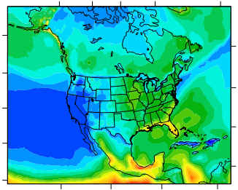
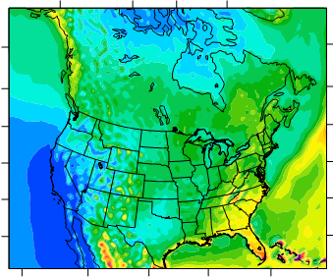
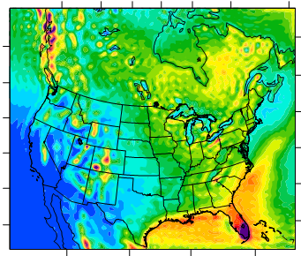
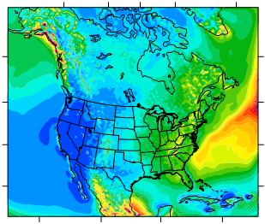

Summer Precipitation NCEP Driven Runs
NARR
CRCM
ECPC
HRM3
Notes:
NARR precip… caveats!

Slide 16
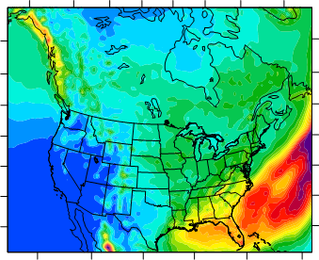
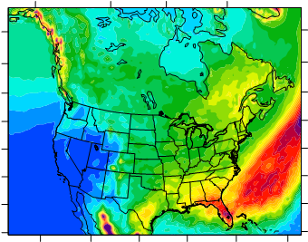
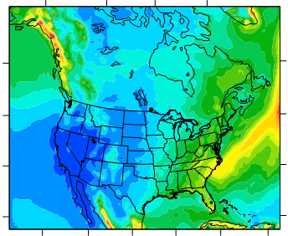
Summer Precipitation NCEP Driven Runs
NARR
MM5I
RCM3
WRFP

Slide 17
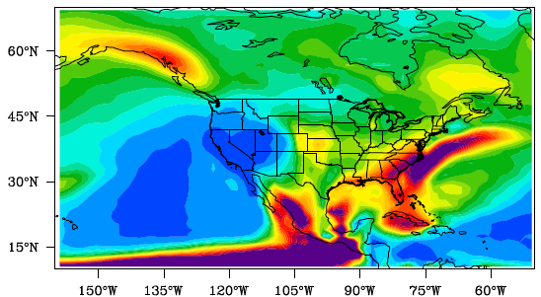
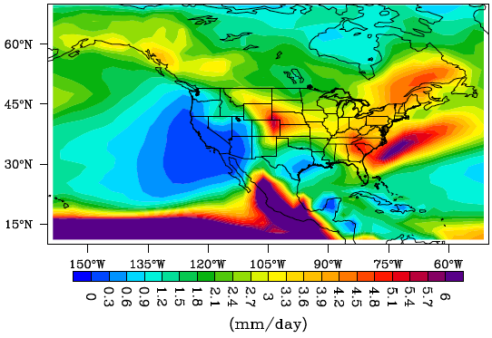
1980-1999 JJA GCM Precipitation
CCSM
GFDL
NARR

Slide 18
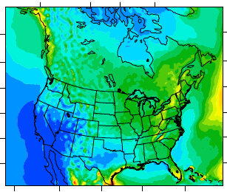
1980-2000 JJA Precipitation w/ GCM Driven Run: CRCM and CGCM
NARR
CRCM-ncep
CRCM-cgcm

Slide 19
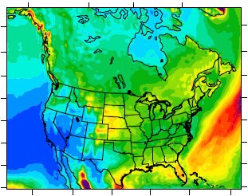
1980-2000 JJA Precipitation w/ GCM Driven Run: RCM3 and GFDL
NARR
RCM3-ncep
RCM3-gfdl

Slide 20
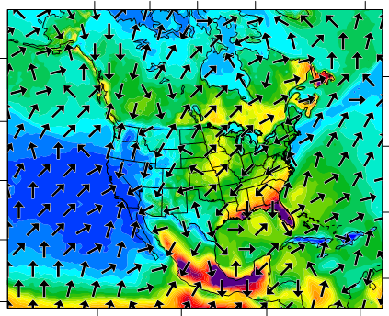
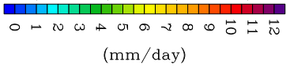
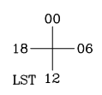



JJA 1980-2000 Precipitation Maximum Amplitude and Time of Maximum
NARR
CRCM
HRM3
MM5I
Notes:
HRM3 does precipitate around midnight – no signs of propagation, light pr
MM5I, does also, no signs of propagtion, light pr

Slide 21











JJA 1980-2000 3-hr Average Pr
NARR
CRCM
00 UTC
03 UTC
06 UTC
09 UTC
12 UTC

Slide 22




6h Pr Frequency Distribution 1980-1999/2000 JJA GCMs
NARR
%
CCSM
GFDL

Slide 23







RCM frqdist
NARR
CRCM
ECPC
%
HRM3
MM5I
RCM3
WRFP
3h Pr Frequency Distribution 1980-1999/2000 JJA RCMs
(mm/h)

