Slide 1
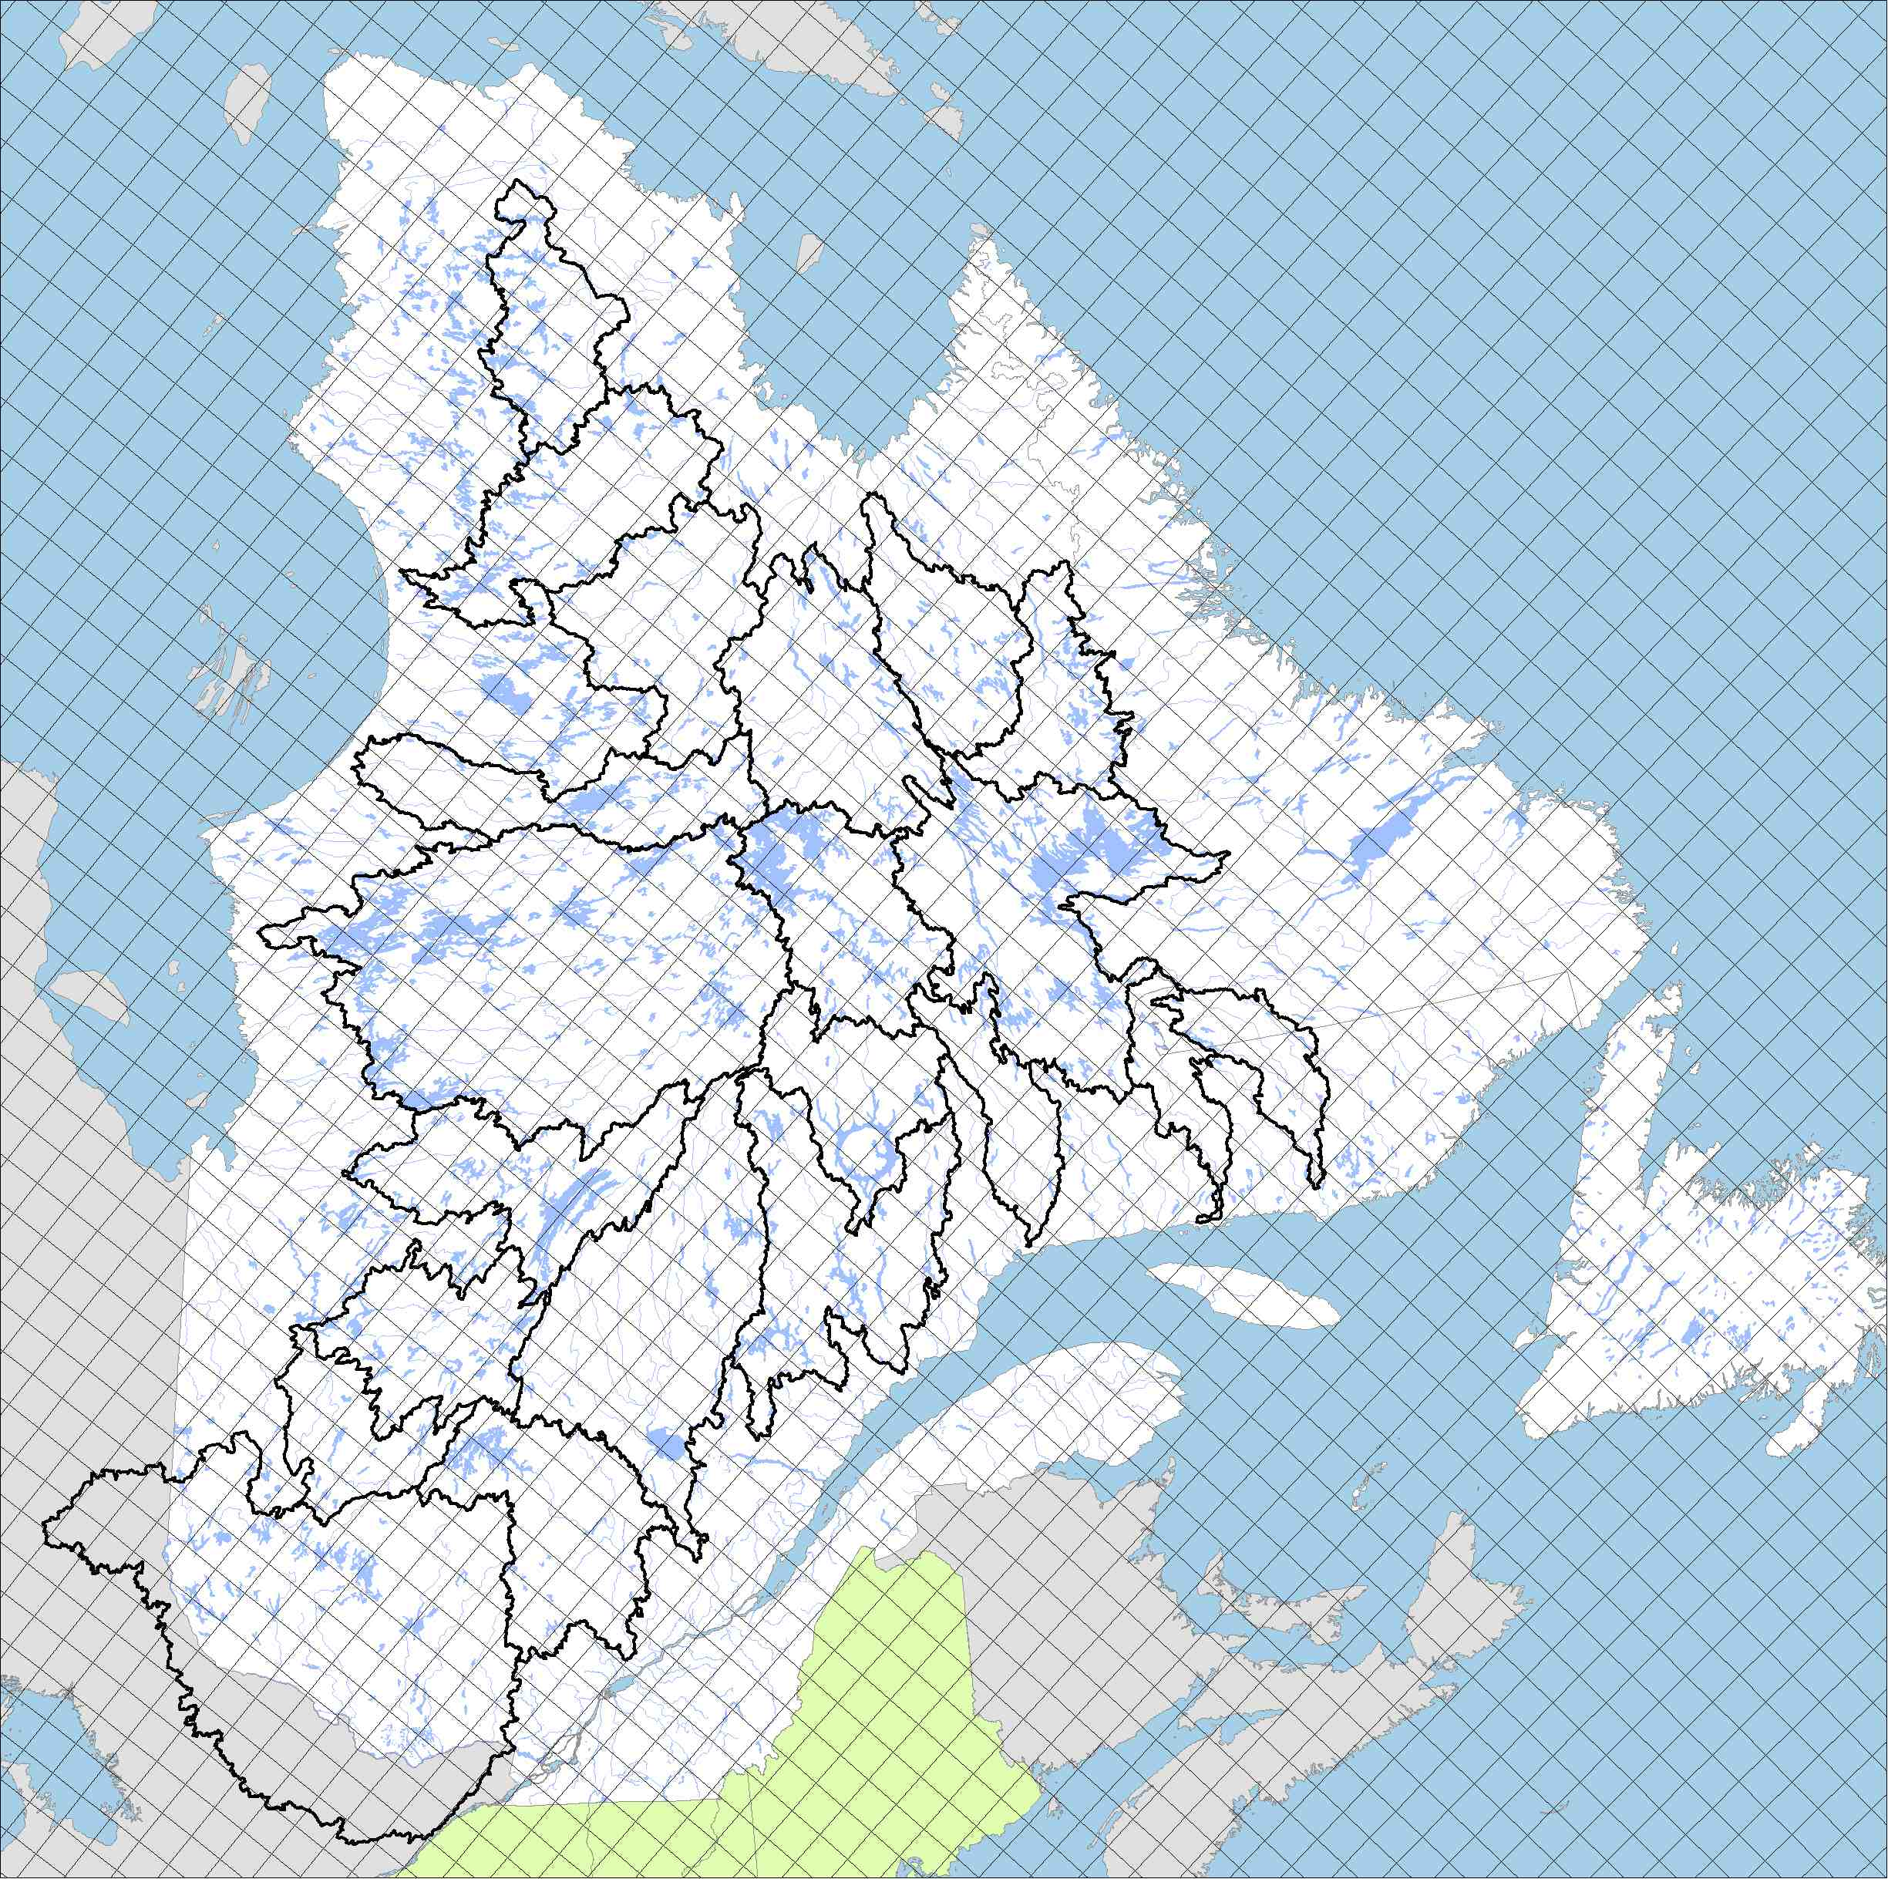

Slide 2
20 January Days over a Grid Cell North of Montreal

Slide 3
22 Years over a Grid Cell North of Montreal
Notes:
2° over a year
To get this through climate change it should take ~30 years

Slide 4
Notes:
4

Slide 5
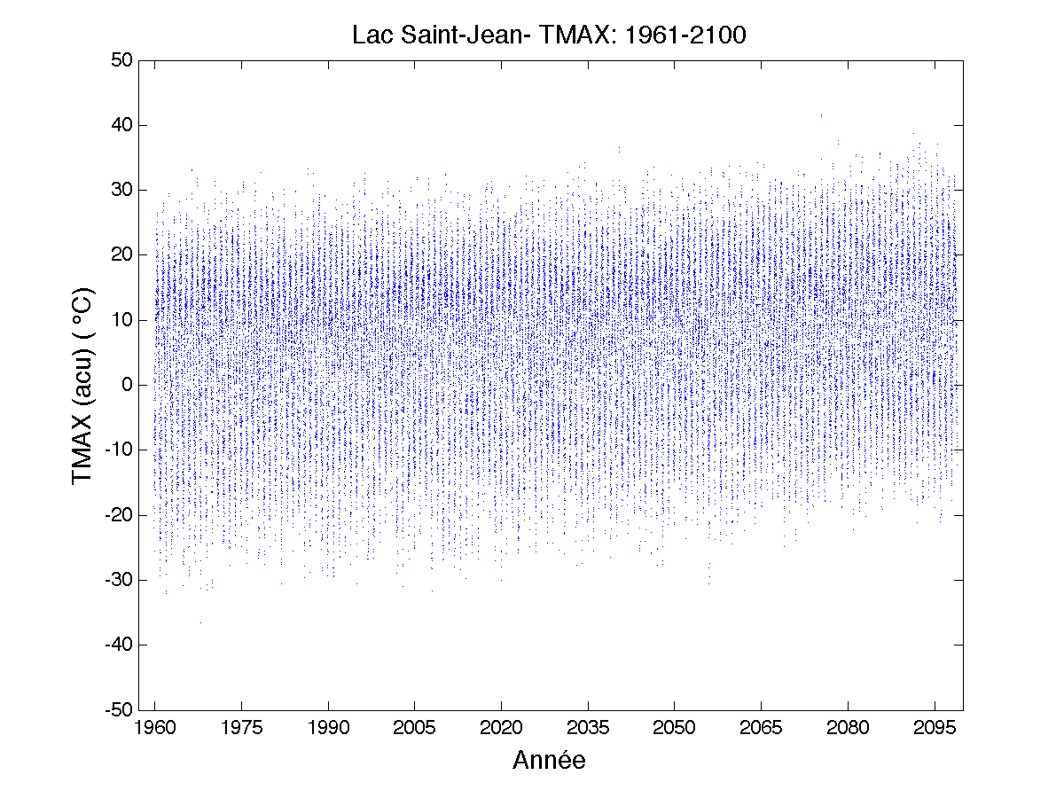
140 Years of Daily Maximum Temperature Lac St-Jean

Slide 6
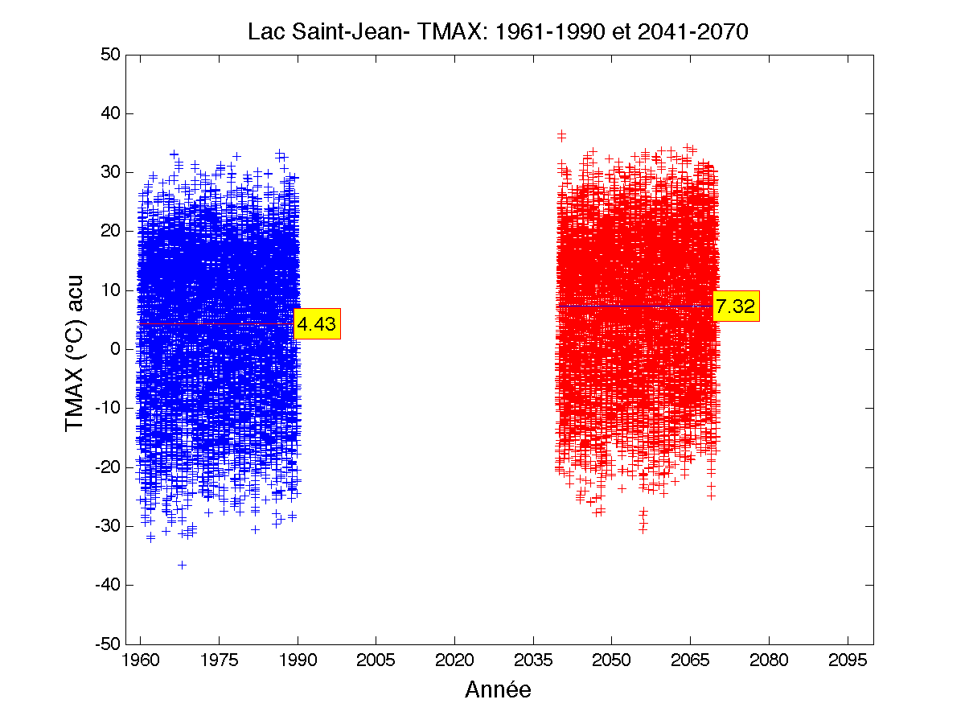
Climate Change for Max. Temperature Lac St-Jean
ΔT_{CC} = 7.32 – 4.43 = 2.89

Slide 7
CC Tx = +2.89°C
Notes:
7

Slide 8
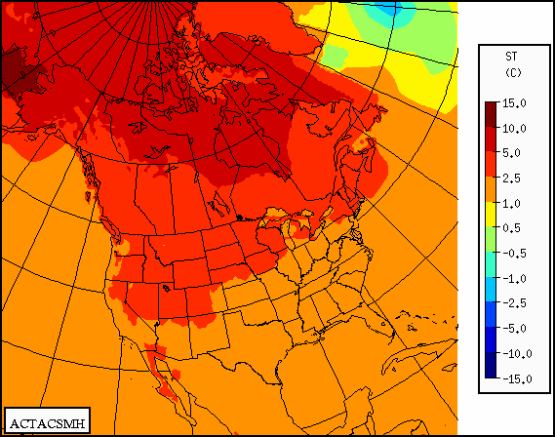
Winter (DJF) Change T_{2m} (Future - Present) °C Summer (JJA)
CRCM4
Source : Équipe Simulations climatiques Ouranos
Notes:
Simulation produite avec MRCC 4.1.1
Piloté par CGCM3 membre #4
Suivant scénario d’émission SRES A2
2041-2070 vs 1961-1990
Panneau 1: Réchauffement plus important au nord qu’au sud
Panneau 1 ete 2: Réchauffement plus important en hiver qu’en été
Panneau 3: Augmentation des précipitations au nord en hiver
Panneau 3: Diminution des précipitations au sud en hiver
Panneau 4: Diminution du couvert de neige au sol en hiver sauf dans l’extrême nord du Québec, le NO de l’Ontario et les Rocheuses...

Slide 9
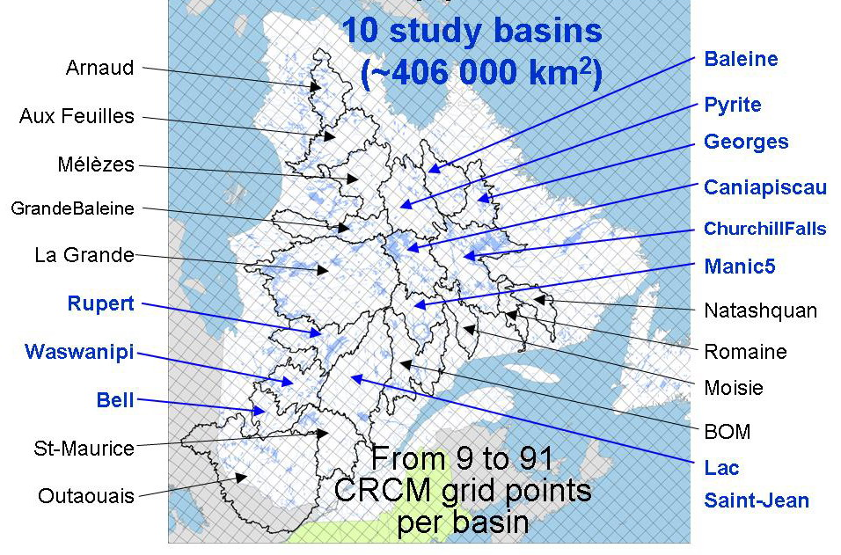
The 21 basins under study
73 000 km**2 for 43 Grid Cells
Notes:
Since we are looking at hydrology, we will concentrate on 10 basins, located in the Quebec/Labrador peninsula, surrounded by Hudson’s Bay and the Sea of Labrador
These basins were chosen because reliable 30-year streamflow OBS are available
Cover region west to east and south to north
Each basin of interest covers from 9 to 43 model grid-points, shown in red,
and the 10 basins cover a total of 406 000km2.
Streamflow is a very usefull RCM validation tool as it integrates all processes over a basin area, contrary to precipitation and temperature which are point values
especially in areas where SFC OBS are scarce!!!

Slide 10
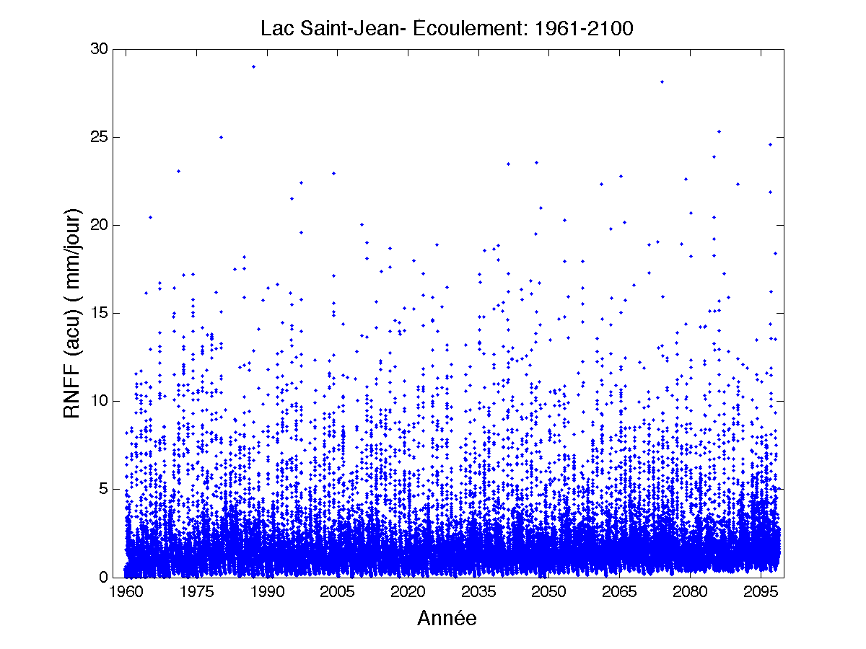
140 Years of Runoff over Saguenay Watershed

Slide 11
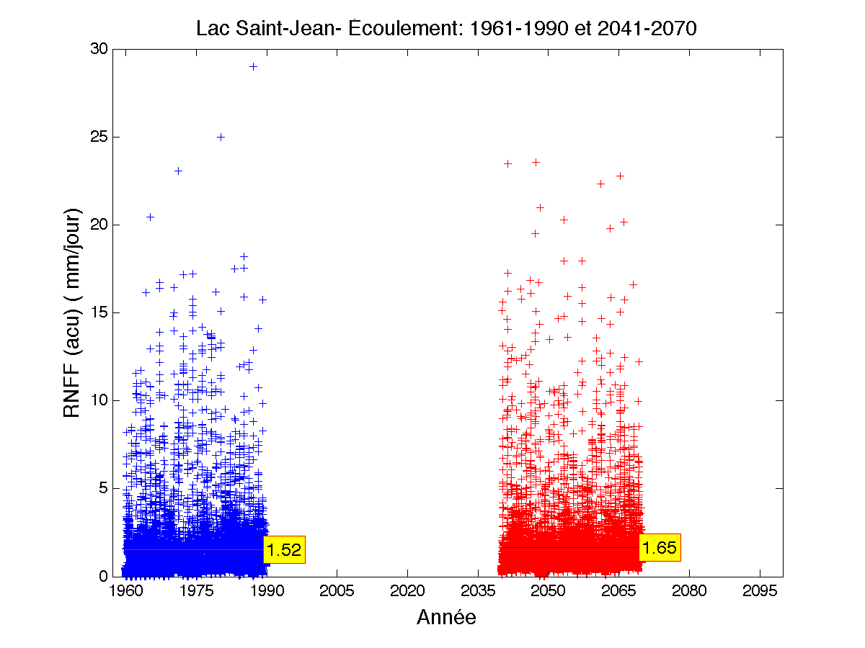
Climate Change for Runoff over Saguenay Watershed

Slide 12
140 Years of Runoff over Saguenay Watershed

Slide 13
140 Years of Runoff over Saguenay Watershed

