Slide 1
The Canadian RCM : general overview of the model and specific features of the Narccap simulations
Sébastien Biner and Daniel Caya with the contribution of the climate simulation team at Ouranos
Notes:
1

Slide 2
The Canadian RCM (CRCM) history
Developped at the University of Québec in Montréal during the 1991-2001 period
Started as the Ph.D. of Daniel Caya
Research assistants and students were added
Different versions were released
Developped, maintained and used by the Ouranos Consortium since 2001

Slide 3
CRCM v4.2.0 (version used for the Narccap simulations)
Dynamics
semi-implicit semi-Lagrangian algorithm
Arakawa-C grid on polar stereographic projection
Gal-Chen scaled-height vertical coordinates
Davies nesting on horizontal wind
large-scale nudging (aka spectral nudging)
Physics
Surface scheme | CLASS 2.7 (3 lyrs) soil: Wilson & Henderson-Sellers 1° veg: GLC2000 1km > 1°
Convection and large scale condensation | Bechtold-Kain-Fritsch sursaturation removal
Radiation | SW Fouquart & Bonnel LW Morcrette
Clouds | diagnostically based on relative humidity excess & conditional stability

Slide 4
Key features
CLASS surface scheme
Large-scale nudging

Slide 6
2nd generation surface scheme with 3 soil layers

Slide 7
Each cell is divided in 4 sub-regions

Slide 8
Sowpack treated as explicit 4th layer

Slide 9
Large-scale Nudging.
Modification of a prognostic variables X with the following equation :
Where X_{RCM} is the value of X from the RCM, X_{LBC} is the value of X from the LBC and α is a function of the length scale λ and the altitude z.
Only the fields higher than altitude z₀ and with scale larger than λ_{c} are affected by the large-scale nudging.
Tyically, λ_{c}=1400km, z₀=500 hPa and X=horizontal wind
α₀=0.05 (I.e. e folding time of 48h)
α
z
α₀
z₀
λ_{c}
λ
α₀
α

Slide 10
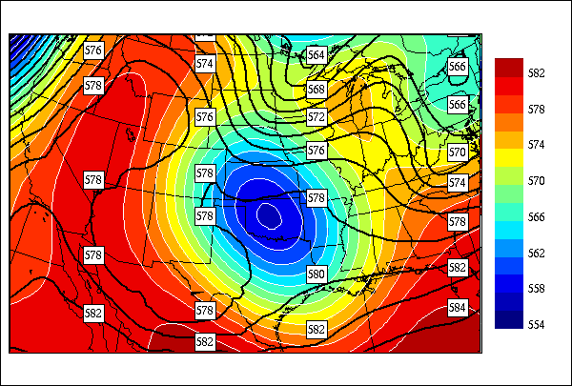
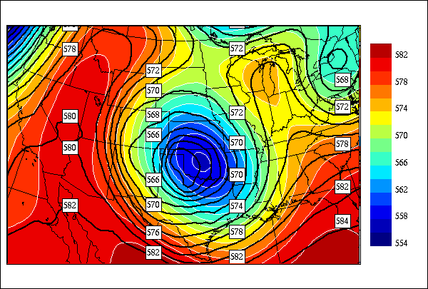
Large-scale Nudging.
Motivations to use LSN
Prevents the development of large discrepencies between the LBC and the RCM
Without LSN
With LSN
CRCM(blacklines) and NCEP(color) analysis GZ 500 hPa [dam] on 22 May 1988 at 12Z (i.e. 180 h of simulation)

Slide 11
Large-scale Nudging.
Motivations to use LSN
Prevents the development of large discrepencies between the LBC and the RCM
Reduction of the mismatch between the RCM and the LBC at the outflow boundary
Reduction of the sensitivity of a simulation to the domaine size and configuration
Side effects seem minimal up to now(c.f. Alexandru et al 2009, MWR)

Slide 12
Set-up for the Narccap simulations
CRCM version 4.2.0
160x135 computation grid
10 points Davies nudging on the perimeter
140x115 diagnostic grid (grid of the NetCDF files)
Polar stereographic grid with 50 km resolution @ 60deg. N
900s time-step

Slide 13
Other specific questions
Soil initialisation?
Spin-up length?

Slide 14
Soil initialization
Some soil variables are prognostic and only need to be initialized (e.g. soil moisture, temperature, snow cover, …)
Some soil variables are prescribed with different update frequencies (e.g. SST, Sea ice, Root depth, ozone, …)
Details :
Deep soil variables obtained from a 3 year simulation of the Canadian GCMiii
Topography and Ground Cover are taken from 1/6x1/6 deg US Navy datset
Vegetation fields : GLC2000 dataset interpolated on 1x1 deg grid
SST and Sea ice :
Using reanalysis LBC : lake and ocean use the AMIP2 values
Using a given GCM for LBC : ocean uses the GCM values and Lake uses a lake model with flux correction.
Other variables : initialized by a climatology of the Canadian GCMiii

Slide 15
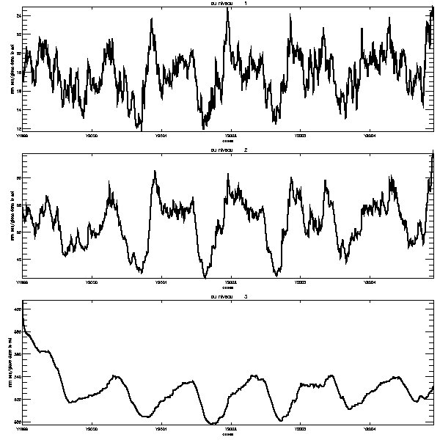
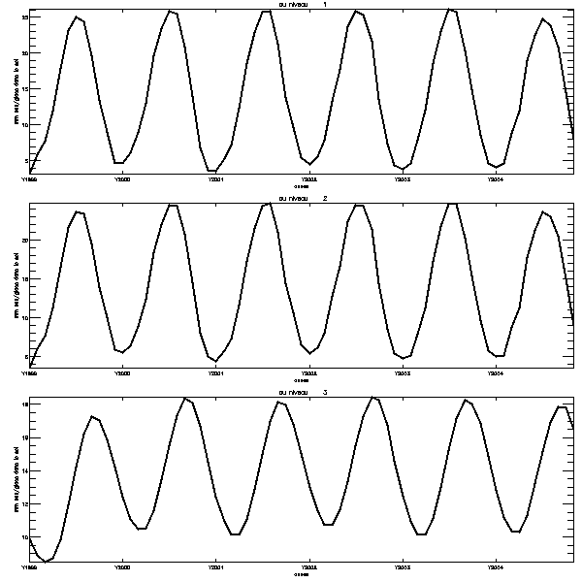
Spin-up period
We use 3 years of spin-up
Order of time taken for the deepest soil layer to reach steady state.
Soil moisture
Soil temperature
Layer 1
Layer 2
Layer 3
1999
2000
2001
2002
2003
2005
1999
2000
2001
2002
2003
2005
Time evolution of soil moisture (left) and temperature (right) for the three soil layer over a region covering apporximatively the contiguous USA (courtesy of Dominique Paquin)

Slide 16
Thank you

Slide 17
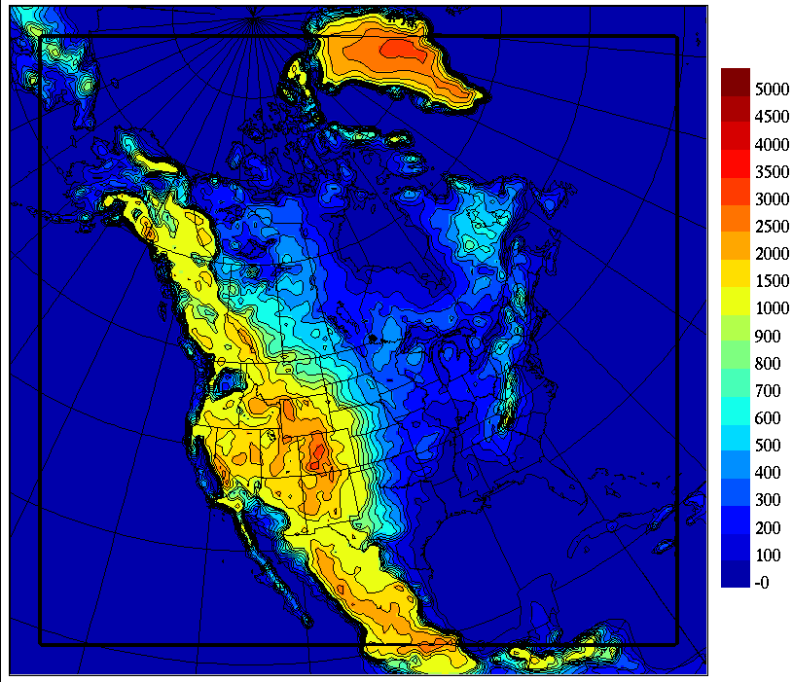
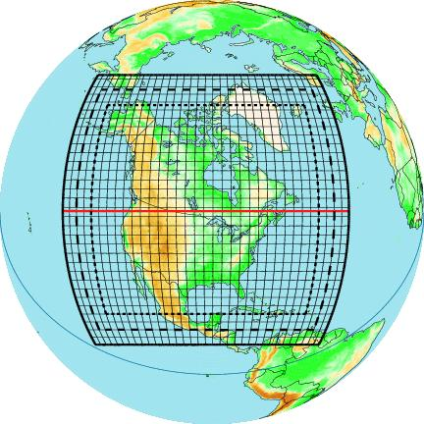
 | CRCM4 (v4.2.3) 201x193, 29L, @45km | CRCM5 (v3.3.0) 178x158, 53L, @0.5° | CRCM5C (v3.3.0) 178x158, 53L, @0.5° | CRCM5V (v3.3.0) 180x158, 35L, @0.5°
Surface scheme | CLASS 2.7 (3 lyrs) soil: Wilson & Henderson-Sellers 1° veg: GLC2000 1km > 1° | ISBA (2lyrs) soil: USDA 1km AGRC 10km FAO 1° veg: USGS 1km | CLASS 3.4 (3 lyrs, no mosaïc) organic soil snow (Brown) soil: Wilson & Henderson-Sellers 1° veg: USGS 1km | CLASS 2.7 (3 lyrs) soil: Webb (1993) Veg : Wilson & Henderson-Sellers
Convection and large scale condensation | Bechtold-Kain-Fritsch sursaturation removal | Kain-Fritsch Sundqvist | Kain-Fritsch Sundqvist | Zhang-McFarlane sursaturation removal
Radiation | SW Fouquart & Bonnel LW Morcrette | RRTM correlated-K | RRTM correlated-K | RRTM correlated-K
Clouds | diagnostically based on relative humidity excess & conditional stability | based on relative humidity with vertically varying threshold | based on relative humidity with vertically varying threshold | statistical cloud scheme
Spectral nudging | yes | no | no | no

Slide 18
CRCM_4.2.3
semi-implicit semi-Lagrangian algorithm
Arakawa-C grid on polar stereographic projection
Gal-Chen scaled-height vertical coordinates.
nesting follows Davies over the sponge zone (9-grid points)
large-scale nudging (Biner et al. 2000) is applied over the entire domain for horizontal wind over 500 hPa
physical parameterization follows AGCM3, including CLASS_V2.7 surface scheme (3 layers), but moist convection follows Bechtold-Kain-Fritsch
201x193 grid points (182 x 174)
45 km true at 60 N.
29 vertical levels
Dt 900 sec.
Pilot ERA40 at 2.5 deg and AMIPII 1 deg
Notes:
Documented features of this version over North America include good mean precipitation but underestimation of strong events, noisy signal over Rockies topography and lack of precipitation over the Mississippi basin in winter. Too cold minimum screen temperature in winter, especially in the northern part of the domain has been noticed, although lack of reliable long-term observations in this region does not guarantee a fair evaluation. Cloud-free radiation is fairly good, but all-sky radiation suffers from a large negative bias in cloud cover and an underestimation of downward longwave radiation throughout the year.

Slide 19
Histoire : 1991 - 2001

Slide 20
Regional Climate Modelling circa 1991
NCAR RegCM: F.Giorgi
Road-tested MM4
Δt = 5 min, Δx = 60 km
Adapted μ-scale Physics
Ensemble of 5-day sim.
CRCM-β: D. Caya, PhD
Novel NH-SI-SL Dyn.
Δt = 20 min, Δx = 45 km
Integral GCMii Physics
2-month continual sim.

Slide 21
A single January mean precipitation (mm da⁻¹)
1994
T32 GCMii
45-km CRCM-β

Slide 22
CRCM-β (Caya and Laprise, 1999 MWR)
Outcome:
No penalty for NH with use of SI-SL
SL acceptable for climate simulations
GCMii Physics (almost) acceptable at 45 km
No climate drift in long simulation with nested RCM
Plausible fine-scale details in RCM simulation

Slide 23
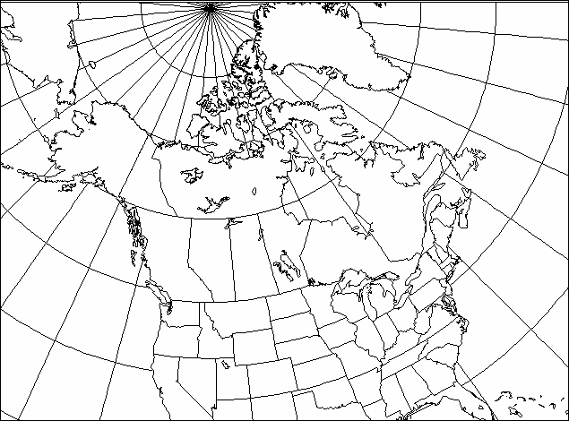
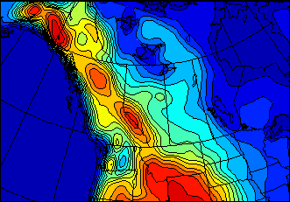
en 1996
CRCM-I (1/3)
First “Policy” Run
101 x 71 @ 45 km
19 levels to 29 km
2 X 5 years
1x and 2x CO₂
Atm: GCMii driven
Ocean: Results from GCMii mixed layer and thermodynamic sea-ice
No Lakes
Notes:
An even with such a small domain we have to remove the nesting zone before the analysis of the simulations

Slide 24
GCMii @ T32 5-year mean 1xCO₂ Winter precipitation (mm da⁻¹) CRCM-I @ 45 km

Slide 25
CRCM-I (3/3) (Laprise et al., 1998, Atmos.-Ocean)
Take home message:
Stable integration over 5 years of 1x and 2x CO₂
Increased spatial definition of climate features and climate-change signal
NO increased of temporal variability (variance)
Different distributions for some variables (pcp)
Systematic biases of GCM are passed on to RCM
Need to improve GCMii physics at CRCM resol.
Moist convection (in summer)
Cloud cover diagnostics

Slide 26
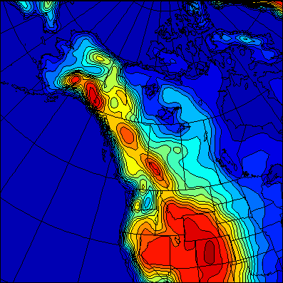
en 1999
CRCM-II (1/3)
Second “Policy” Run
120 by 120 @ 45 km
3 time-slices of 10 yrs
Transient CO₂ and aerosols scenario
Atm: CGCM2 driven
Ocean: Results from CGCM2 dynamical ocean and sea-ice
No Lakes

Slide 27
CGCM2 @ T32 10-year mean (1xCO₂) Winter precipitation (mm da⁻¹) CRCM-II @ 45 km

Slide 28
CRCM-II (3/3) (Laprise et al., Clim. Dyn., 2003)
Improvements upon CRCM-I
Moist convection of Kain and Fritsch (1990)
Modified diagnostic clouds
Implicit T_{g} prognostic equation
SSTs and sea ice interpolated from CGCM2-simulated dynamical ocean and sea ice
Transient CO₂ and aerosols as in CGCM2
Physics still requires attention
Bechtold’s version of Kain-Fritsch better
Clouds and Stratiform precipitation
Surface processes

Slide 29
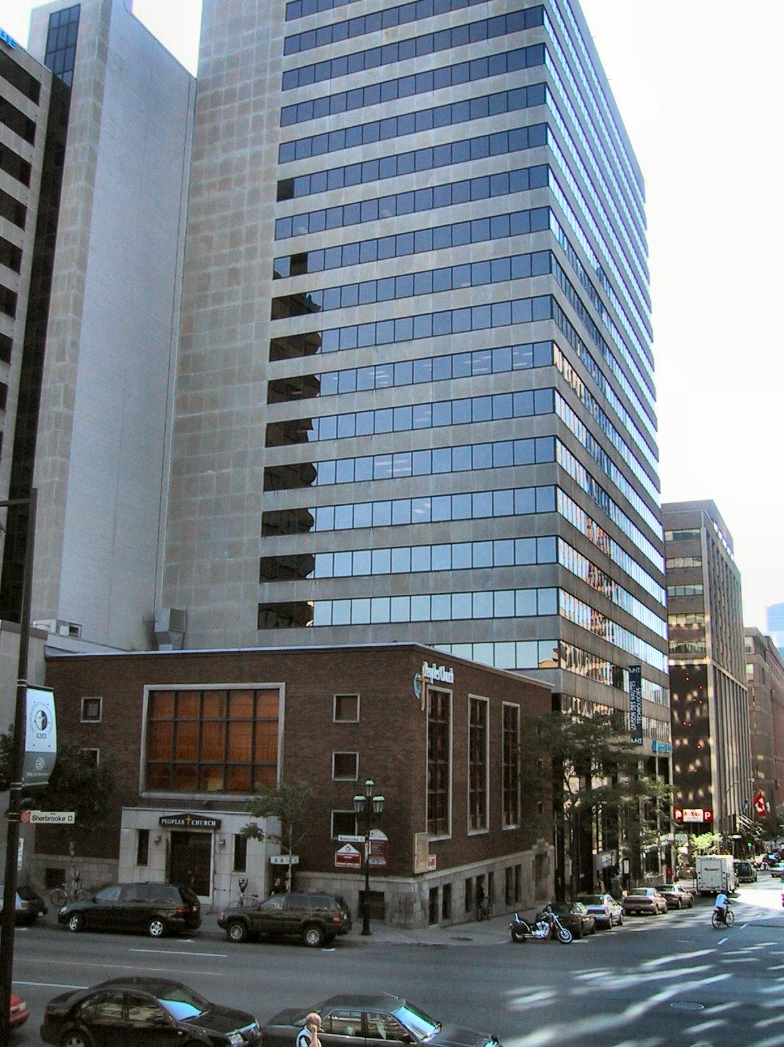
Le consortium Ouranos est créé en 2001
550 Sherbrooke ouest,
Montréal, au centre-ville,
18e-19e étage, 1600 m²
Partenaires fondateurs:
• 8 ministères provinciaux
• Hydro-Québec
• Service Météorologique du Canada
• Autres partenaires probables
+ 4 Universités
Financement:
• Environ 9M/an en support financier, technique et scientifique, sans inclure les fonds de recherche universitaires
Vision:
• Un lieu d'échange et de formation pour des climatologues, hydrologues, géographes, économistes, sociologues…
• Une masse critique de spécialistes des changements climatiques...
• Un nœud multi-universitaire, multi-partenaire, multi-disciplinaire…

Slide 30
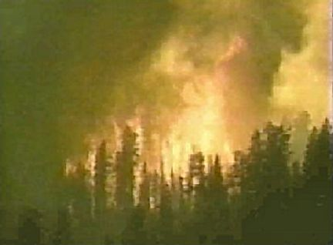
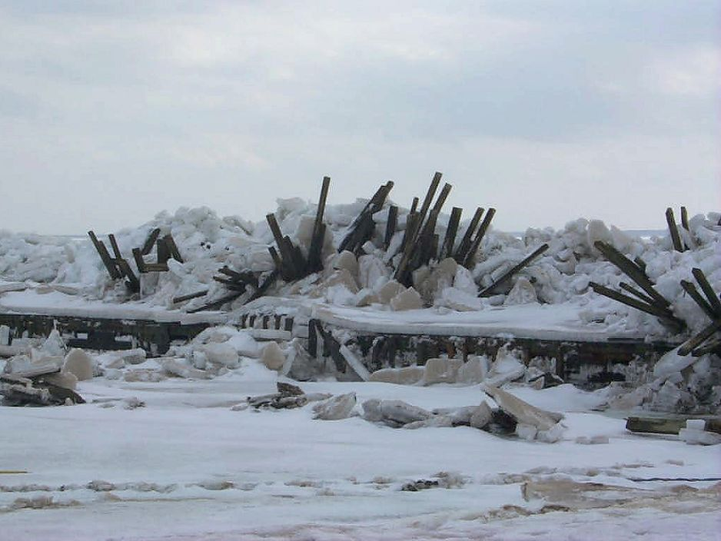
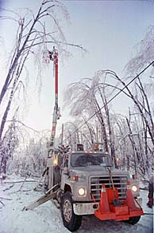
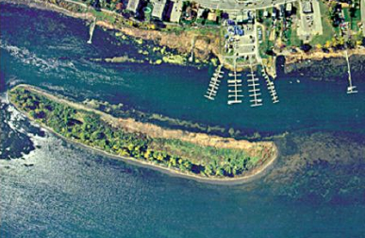
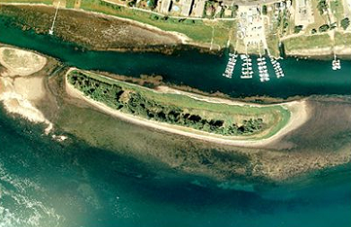
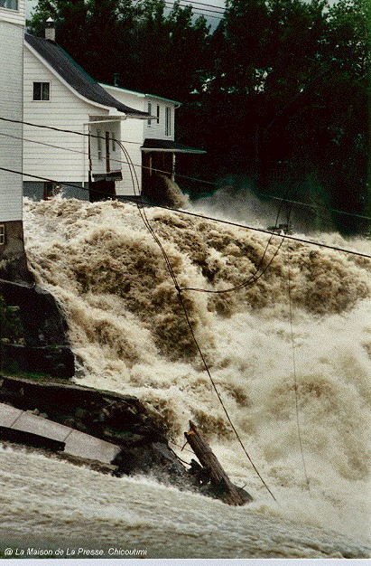
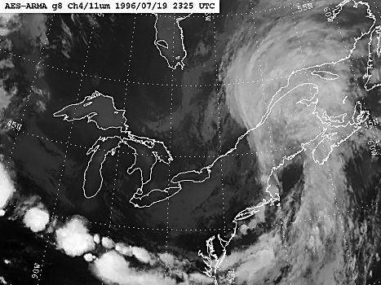
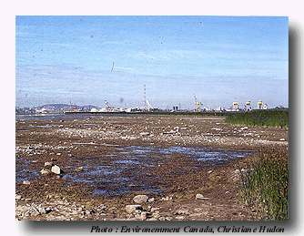
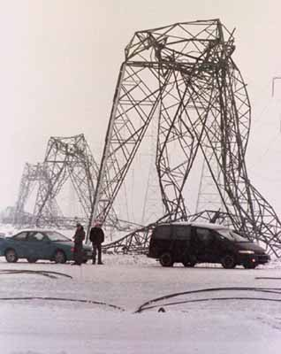
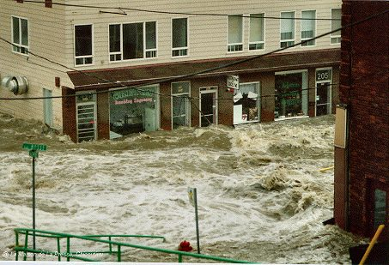
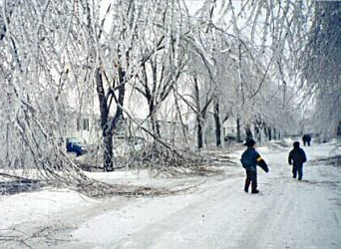
feux
fortes marées et tempêtes
1994
1999
sécheresses, canicules
Saguenay (1996), 26 millions de m³ d'eau et 9 millions de tonnes de débris
Le Grand Verglas (1998),1,5 millions d'abonnés affectés, jusqu'à 30 jours sans électricité
Notes:
Météo anormale + défaillance des infrastructures = catastrophes!

Slide 31
Les principaux projets à Ouranos

Slide 32
Simulations climatiques à Ouranos
MRCC-2 piloté par réanalyses
NCEP RA1 @ ~500km (1975-1999)
MRCC-2 piloté par GCM couplé
Modèle canadien CGCM2 @ ~500km (is92a 1968-1995)
Modèle canadien CGCM2 @ ~500km (is92a 2039-2064)
Validation
Observation de surface sur grille (Observations: T_{abri}, pcp)
Intégrations spatiale sur bassins versants (avec Hydro-Québec) Ruissellement (avec Hydro-Québec)
…
Évaluation de l’incertitude

Slide 33
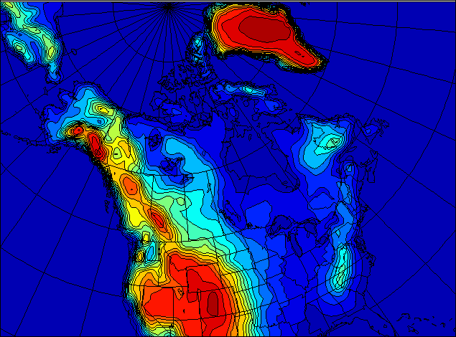
CRCM-III
“Pan-Canadian”
193 x 145 @ 45km
9,000 km x 6,500 km
Driven by CGCM2
Driven by NCEP
Mixed-layer lakes

Slide 34
Les domaines MRCC

Slide 35
3 x 25 ans
4 x 10 ans
2 x 5 ans

Slide 36
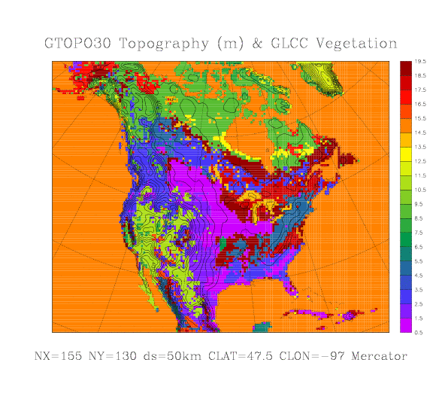
Domaine NARCCAP

Slide 37
