Slide 1
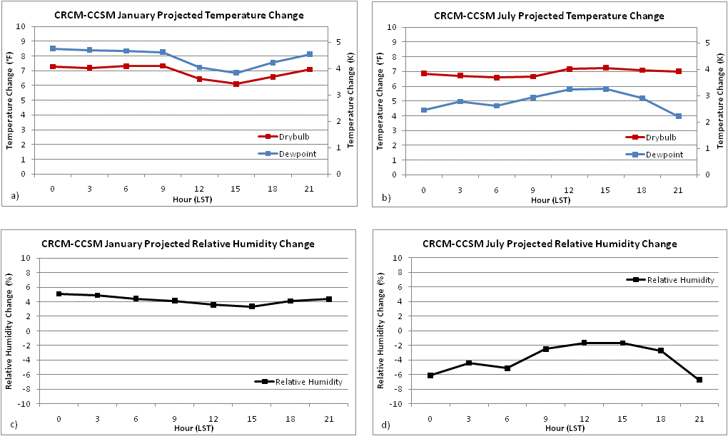
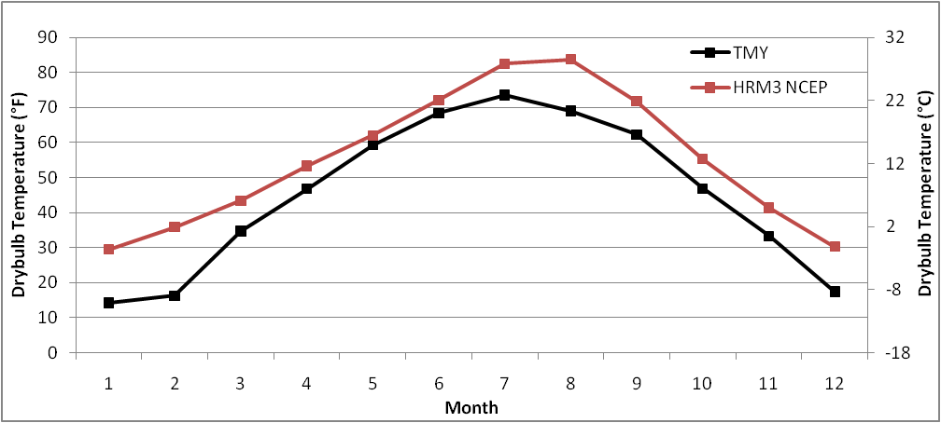


Use of NARCCAP Data to Develop a “Typical Meteorological Year” to Incorporate Climate Change into Building Design (GC21A-0868)
Eugene S. Takle¹, Shannon L Rabideau², Ulrike Passe³
¹ Agronomy Department, 3013 Agronomy Hall, Iowa State University, Ames, IA, 50011, gstakle@iastate.edu
² Department of Geological and Atmospheric Sciences, 3132 Agronomy Hall, Iowa State University, Ames, IA, 50011, srab@iastate.edu
³ Center for Building Energy Research, 491 College of Design, Iowa State University, Ames, IA, 50011, cber@iastate.edu
Introduction
Typical climate conditions for the 20th Century may not provide adequate design parameters for the built environment of the 21st Century due to a rapidly changing climate. The conventional practice in the engineering community for incorporating climate data into building design is to use the “Typical Meteorological Year” (TMY), a site-specific database of typical hourly values of climate developed by Wilcox and Marion based on observed conditions from the National Solar Radiation Data Base and meteorological data for 1976-2005 from NCDC. This TMY database enjoys wide use in building design and alternative energy applications. We propose an alternative method that uses regional climate models under the North American Regional Climate Change Assessment Program (NARCCAP) to produce scenarios of future typical meteorological years for the middle of the 21st Century.
Model Projected Change
Projected Impact on Building Energy
Consumption
Building energy consumption is influenced by many design and operational factors, but weather data plays a major role. As Huang (2006) points out, multiple researchers have taken a variety of approaches in the past twenty years to estimate potential impacts of changing climate. Using advances in climate science, climate modeling as well as energy modeling and simulations Crawley (2003) was among the first to create modified hourly weather files from gridded global climate results as input files for energy simulation software for 25 global locations. Huang (2006) followed using the same method for 18 US climate zones and prototypical residential and commercial buildings, while Xu et al (2009) focused on the impact on the state of California finding increases in cooling loads for 2100 of about 50% for the worst case IPCC carbon emission scenario (A1F1) and still 25% with the most likely carbon scenario (A2). Heating loads would decrease significantly under all scenarios leaving the overall annual aggregated energy consumption only slightly higher than today. But the implications for building systems and electrical power supply would be significant and therefore further research and verification are necessary.
Model | Totcld (tenths) | Drybulb (°F/ K) | Dewpoint (°F / K) | Rhum (%) | Ahum (g cm⁻³) | Pressure (in Hg / mbar) | Wspd (mph / m s⁻¹ ) | Wdir (degrees) | Precip (in / mm)
CRCM-CCSM | -0.03 | 5.18 / 2.88 | 5.67 / 3.15 | 2.05 | 1.49 | 0.014 / 0.48 | -0.09 / -0.04 | -6.51 | 0.08 / 1.96
CRCM-CGCM3 | -0.11 | 5.85 / 3.25 | 4.54 / 2.52 | -2.15 | 1.20 | 0.003 / 0.09 | -0.04 / -0.02 | -4.33 | 0.05 / 1.30
HRM3-HadCM3 | -0.25 | 4.80 / 2.67 | 3.37 / 1.87 | -2.84 | 0.92 | -0.022 / -0.73 | -0.02 / -0.01 | 15.72 | 0.29 / 7.34
MM5I-CCSM | N/A | 3.67 / 2.04 | 4.15 / 2.30 | 1.12 | 1.02 | 0.013 / 0.45 | -0.10 / -0.04 | -4.20 | 0.38 / 9.76
RCM3-CGCM3 | N/A | 4.61 / 2.56 | 4.27 / 2.37 | -0.04 | 1.07 | 0.004 / 0.14 | -0.17 / -0.08 | -6.48 | 0.20 / 5.04
RCM3-GFDL | N/A | 4.01 / 2.23 | 3.70 / 2.05 | -0.05 | 0.88 | 0.015 / 0.51 | -0.08 / -0.04 | 1.84 | 0.20 / 5.03
WRFG-CCSM | 0.16 | 4.87 / 2.71 | 5.19 / 2.88 | 1.19 | 1.03 | 0.020 / 0.68 | -0.18 / -0.08 | -3.58 | 0.25 / 6.27
WRFG-CGCM3 | N/A | 3.22 / 1.79 | 3.98 / 1.84 | 1.84 | 0.96 | 0.010 / 0.34 | 0.14 / 0.06 | -0.57 | 0.12 / 3.06
Mean projected change | -0.06* | 4.52 / 2.51 | 4.36 / 2.42 | -0.10 | 1.09 | 0.007 / 0.25 | -0.07 / -0.03 | -1.01 | 0.20 / 4.97
SD of models’ change | 0.17* | 0.85 / 0.47 | 0.76 / 0.42 | 1.80 | 0.19 | 0.013 / 0.44 | 0.10 / 0.05 | 7.33 | 0.11 / 2.84
SD of 20th C obs | 0.83 | 1.66 / 0.92 | 2.11 / 1.17 | 3.21 | 0.42 | 0.016/ 0.54 | 0.54 / 0.24 | 14.80 | 6.70/170.10
Data and Methodology
A total of nine variables are evaluated in this study – total sky cover, dry-bulb temperature, dew-point temperature, relative humidity, absolute humidity, pressure, wind speed, wind direction, and precipitation.
We first assess whether the TMY data for our selected site (Mason City, Iowa) are, indeed, “typical” compared to observations. We computed monthly and hourly averages of each variable using the current TMY3 data set and compared them to the 1976 to 2005 base period of observations using NCDC data. (Results not shown revealed that the differences were generally quite small – less than the monthly standard deviation in all months and all variables except relative humidity, pressure, and precipitation).
Next we use reanalysis-driven runs of five NARCCAP regional climate models to evaluate their skill in reproducing TMY3 data. Data were compared with the TMY3 months through both monthly and 3-hourly averages. Comparing data in this way clearly shows the bias structure for each model.
We then use NARCCAP data to evaluate monthly climate change in seven meteorological variables used in building design. The significance of these changes is assessed by comparison to interannual variability of the current climate at the selected site. Four NARCCAP global climate models (GCMs) and five regional climate models (RCMs) were used, represented by each model's closest grid point to Mason City.
Table 1: NARCCAP average projected climate change for Mason City, Iowa. Comparison of the bottom three rows for each variable shows that the models produce climate change values exceeding both natural variability of the 20th Century and inter-modal variability in projected climate change for dry-bulb temperature, dew-point temperature, and absolute humidity (highlighted).
Global climate models used include the Community Climate System Model (CCSM), the Third Generation Coupled Global Climate Model (CGCM3), the Hadley Centre Coupled Model version 3 (HadCM3), and the Geophysical Fluid Dynamics Laboratory GCM (GFDL). Regional climate models used include the Canadian Regional Climate Model (CRCM), the Hadley Regional Model 3 (HRM3), the PSU/NCAR Mesoscale Model (MM5I), the Regional Climate Model version 3 (RCM3), and the Weather Research & Forecasting Model (WRFG).
Seasonal and Diurnal Changes
Conclusions
TMY3 data is representative of (except for relative humidity, pressure, and precipitation) the 30-year observed conditions.
While each model and variable has its own unique bias structure, the NARCCAP models are generally able to reproduce the TMY3 data.
The NARCCAP models produce significant changes in dry-bulb temperature, dew-point temperature, and absolute humidity.
Additional significant changes in climate variables occur when examining model projections on seasonal and diurnal levels.
Further research and verification of the impact of climate change on building design is necessary.
Results
Model Evaluation
Further Work
This study is currently being expanded to include more locations. With a grant from the Center for Global and Regional Environmental Research (CGRER) we will examine the 16 different climate zones used in the creation of the U.S. Department of Energy (DOE) reference buildings. Also, energy performance simulations will be conducted to evaluate the impact of projected changes in climate on a selection of these 16 buildings that represent about 60% of the U.S. commercial building stock. For those regions having significant changes in energy consumption and patterns, future typical meteorological year data can be prepared for risk analysis of a changing climate.
Figure 4: Seasonal changes in the diurnal patterns of temperature and humidity for the CRCM-CCSM model for Mason City, Iowa. (a,c) January temperature changes project an increase in relative humidity. (b,d) July temperature changes project a decrease in relative humidity. Projected July temperature changes are more than twice the standard deviation (natural variability) of the last 30 years.
References
Crawley, D. B. 2003. "Impact of Climate Change on Buildings," in Proceedings of the CIBSE/ASHRAE International Conference 2003, September 2003, Edinburgh,
Scotland. London: CIBSE.
Huang, Y. J. 2006. The Impact of Climate Change on the Energy Use of the US Residential and Commercial Building Sectors. LBNL Report 60754, Lawrence
Berkeley National Laboratory, Berkeley CA.
NARCCAP. 2010. The NARCCP output dataset. National Center for Atmospheric Research. [Available online at http://www.narccap.ucar.edu/data/data-tables.html]
Wilcox, S. and W. Marion. 2008. Users Manual for TMY3 Data Sets. National Renewable Energy Laboratory. Technical Report NREL/TP-581-43156. 51 pp.
Xu, P., Y. J. Huang, N. L. Miller, and N. J. Schlegel. 2009. Effects of global climate change on building energy consumption and its implications on building energy
codes and policy in California. Lawrence Berkeley National Laboratory Report to the California Energy Commission. CEC 500-2009-006. 106 pp. [Available
online at http://www.energy.ca.gov/2009publications/CEC-500-2009-006/CEC-500-2009-006.PDF]
Figure 1: Comparison of TMY3 and HRM3-NCEP average monthly
dry-bulb temperature for Mason City, IA. The Comparison shows a consistent warm bias in the dry-bulb temperature for the HRM3 regional climate model.

